Slide 1
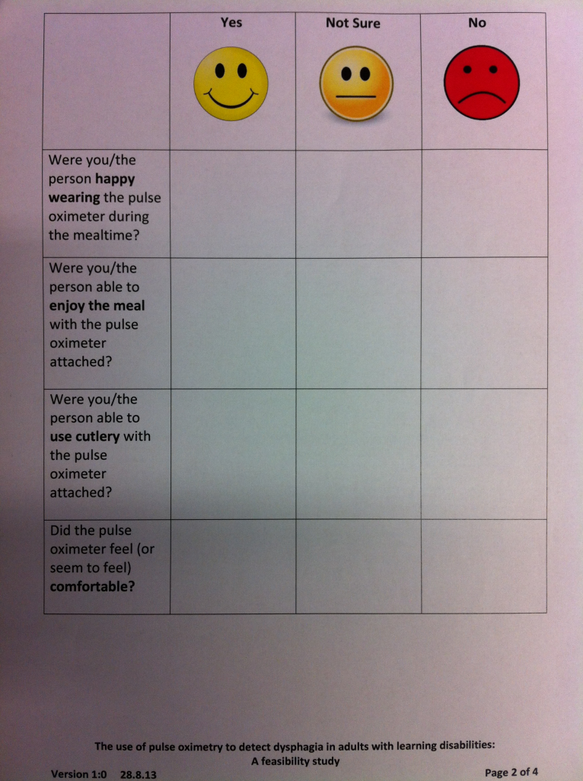
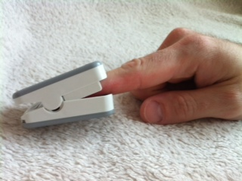
Alison Mullen
Newcastle University
Lay summary
Pulse oximetry may augment clinical dysphagia assessment, but minimal research has been conducted which included adults with learning disabilities. This study was designed to determine if a larger scale study was feasible. A number of barriers were met in the process of setting up and conducting this low risk study
Question/Rationale
Exploring the use of pulse oximetry in dysphagia assessment for adults with learning disability (LD): A feasibility study
What did you do?
Conducted mealtime assessment with pulse oximeter attached
Asked people to rate acceptability of pulse oximeter
Screened people for dysphagia using questionnaire
Picture 2
Picture 3
What did you find out? A larger scale study is not feasible. There are major barriers to research participation for adults with learning disabilities. This included difficulties designing accessible research documents, gaining ethical approval, recruitment and gaining consent.
Next steps:
Development of guidelines for accessible research documentation
Raising profile of LD research locally
Implications: Findings from research with other client groups may not be generalisable to adults with LD.
It is unethical to exclude adults with LD from clinical research that could benefit them.

