Slide 1


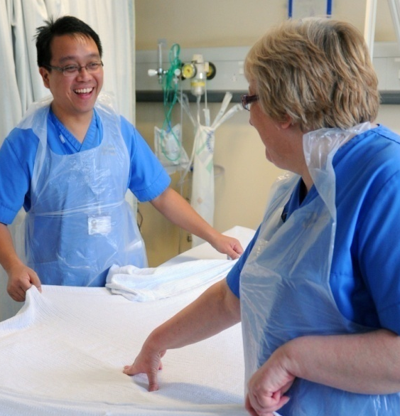
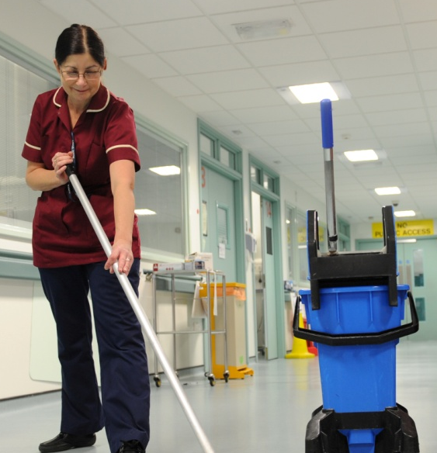
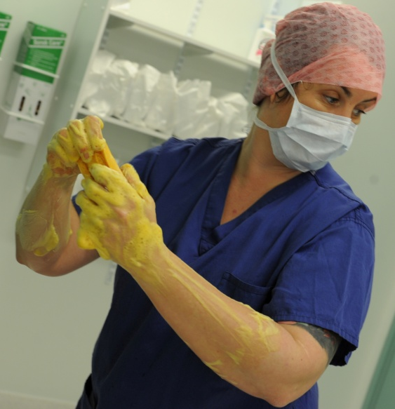
Improving Quality Together: Making Improvement a Habit
Presenter
Notes:
1

Slide 2
Most people would like to ‘do something about quality’ but don't have the time.
They are too busy dealing with complaints, correcting mistakes, doing the wrong things right and doing what they do twice.
paraphrased from Øvretveit (1992)
Notes:
2

Slide 3
Improvement and change:
What NHS staff are saying...
Proportion of staff agreeing with statements
I am able make improvements in my area of work the work of my team/department | 54%
I am able to contribute towards improvements at work | 46%
I am involved in deciding on the changes that affect my work/area/team/department | 37%

Slide 4
Decisions about change
Knowledge about what change is needed

Slide 5
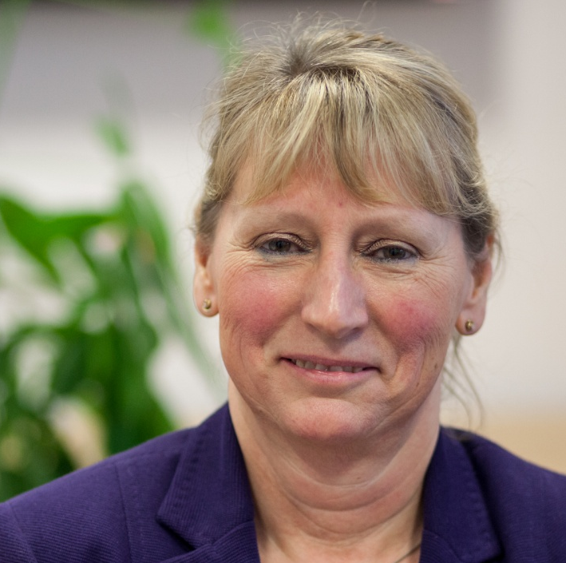
“Improving Quality
Together is patient-driven.
It’s also staff-driven. By
improving quality, we can
take away some of the stress and strains
on staff.”
Chris Rowland

Slide 6
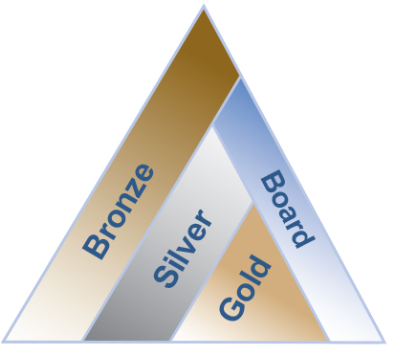
IQT Learning Programme
3 levels of development:
  Bronze – what
  Silver – how
  Gold – teach
Complemented by Board level development.

Slide 7
Bronze
E-learning
Facilitated sessions
Induction programmes
Pre-requisite for any
development programmes
Universities including in programmes

Slide 8
Silver
Set of core materials used
nationally
Cohorts starting in all
organisations
Mixture of team and individual approaches
Integrated into change leadership programmes

Slide 9
Gold
Developing quality
improvement capability
throughout each
organisation in NHS
Wales.
Expertise to coach and support Silver and Board levels in integrating quality improvement through all we do

Slide 10
Board
Support leading system-wide
quality improvement and
assurance
Create a culture where everyone feels engaged and accountable:
  Where we all demonstrate we believe we have one job with two roles – to do and to improve

Slide 11
So what is success?
Success is ...
improving how we safely and humanely meet the needs of our patients
focusing on processes, not blaming others
gathering and using data and information to identify changes and to learn from testing them out
using rapid small changes which engages staff and creates continuous improvement

Slide 12
Improving Quality Together
  Success requires collaboration and innovation from team members working together
  Combining professional knowledge with improvement knowledge is very powerful for providing safer and better care

Slide 13
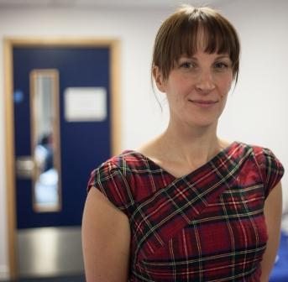
“Improving Quality Together will release some of the untapped potential that we’ve got in the workforce, enabling everyone to have the understanding and permission to make small changes that will make things better for patients,”
Rachel Robins, Nurse Metrics Lead

Slide 14
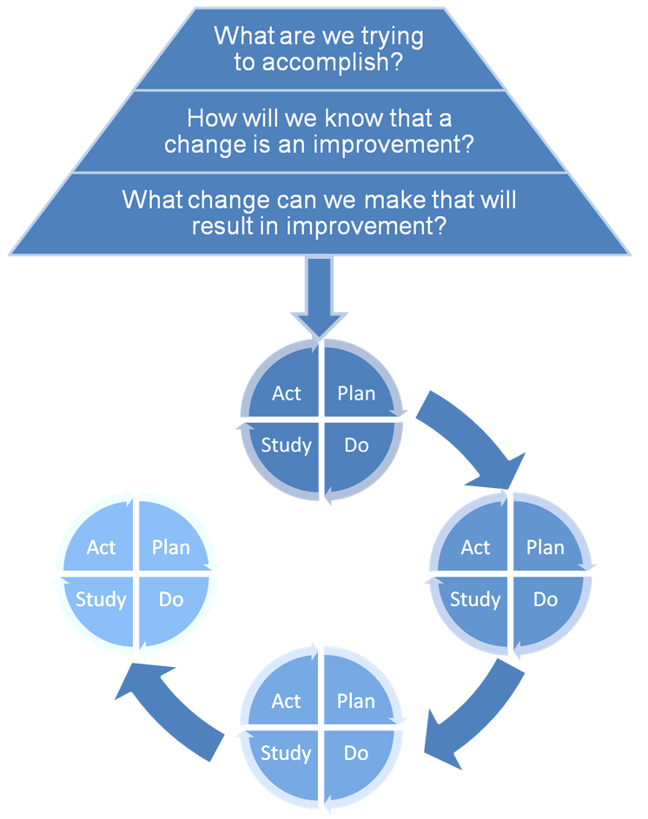
So what framework do we use?
Aims
Three fundamental questions for improvement
Measurement
Ideas, hunches,
other people etc.
How to make change happen
Langley et al (1996) – cited 1000 Lives plus (2012)

Slide 15
Your ideas for improvement
What would make your perfect day?
What gets in the way of you achieving this every day?
What improvements do you see that need to be made?
Bronze IQT can help you start to make those improvements

Slide 16
Accessing Improving Quality Together - Bronze
Access Learning@NHSWales by visiting: www.mle.wales.nhs.uk
If you do not have an account, click Create new account. Otherwise, select the Courses tab and under ‘Course categories’ you will see an option for ‘Quality Improvement’. Click here.
Then, select the Improving Quality Together – Bronze level module.
Enter the enrolment key for your organisation and click ‘Enrol me in this course’:
You’re now ready to take the Bronze level course!

