Slide 1
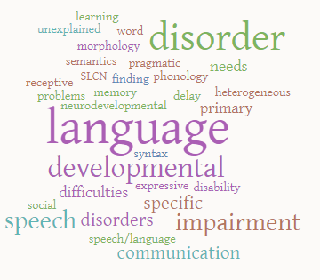
An Introduction to Developmental Language Disorder

Slide 2
This presentation will…
Explain the changes to terminology and diagnostic criteria for developmental language disorders
Give an overview of how these changes may impact on service delivery
Signpost to relevant information and resources

Slide 3
What has changed and why?
Specific Language Impairment (SLI) → Developmental Language Disorder (DLD)
In the past, terminology has been variable and confusing
There has been a lack of research funding for this area and terminology used in research is inconsistent (whilst specific language impairment was used, other terms were also in use e.g. developmental language impairment) (Bishop, 2010)
SLI was often used in a way that does not align with clinical reality (e.g. ‘pure’ cases with no co-occuring difficulties)
Strict discrepancy criteria has led to difficulties with equitable provision of services. A non-verbal IQ score is no longer required for a diagnosis, meaning DLD includes a broader range of children than those that would have met criteria for a diagnosis of SLI

Slide 4
CATALISE
Criteria and Terminology Applied to Language Impairments: Synthesising the Evidence
Group of 57 experts in children’s language disorders from English speaking countries including:
Speech and language therapists
Education
Medicine
Psychology
Audiology
Charities
Aim: to seek consensus on identifying children requiring support above and beyond what is available in the classroom

Slide 5
How?
A Delphi approach was used
Articles, debates, forums
Statements
Review & edit statements
Statements discussed and rated anonymously
Via email
Repeat process
Manuscript: summary of findings

Slide 6
Key points on terminology
SLI was rejected as a term due to implying difficulties are highly specific
‘Delay’ also rejected as a term due to a lack of research to back up traditional delay versus disorder distinction (e.g. spiky versus flat profile of strengths)
Acknowledgement that there is no perfect term
Sub-groups of DLD were not appropriate due to the heterogeneous nature
Bishop et al. (2016)

Slide 7
Why does terminology matter?
Without a term the difficulties can be seen as less important/ serious
Consistent terminology can lead to clarity in research studies and evaluation of services
Consistent terminology can help with raising awareness
Consistent terminology can help with building consensus across SLT and beyond, leading to more equitable support

Slide 8
In addition…
DSM 5 already uses ‘language disorder’ and ‘developmental language disorder’ as terms
The World Health Organisation ICD 11 is likely to include DLD in the revision of disease classification which will go into effect in January 2022
DLD exists as a term in SNOMED CT, a clinical health terminology soon to be mandated in the NHS in England
Other countries have begun to endorse and adopt DLD as a term, including Ireland and Australia (RCSLT, 2017)

Slide 9
This doesn’t mean there haven’t been arguments against labels…
Risk of being used as a gateway to resources and input
Risk of stigmatizing individuals
Suggests individuals with DLD are a homogenous group
However, the group felt a label was necessary despite these factors

Slide 10
Risk factors:
Family history
Poverty
Low level of parental education
Neglect/ abuse
Prenatal/perinatal problems
Gender (male)
Co-occurring disorders:
ADHD
Motor skills
Literacy
Speech
Exec. Function
Behaviour
Adaptive behaviour
Bishop et al. (2016)

Slide 11
Diagnostic criteria
Difficulties lead to functional problems with communication or learning in everyday settings
Indicators of poor prognosis – difficulties persist beyond 5 years
Language Disorder

Slide 12
Diagnostic criteria
Difficulties lead to functional problems with communication or learning in everyday settings
With indicators of poor prognosis
In association with a biomedical condition (ASD, intellectual disability, genetic syndrome, sensorineural hearing loss)
Language Disorder associated with X

Slide 15
Assessment and differential diagnosis
Accuracy of prognosis increases with age and it is often possible to identify children with persistent difficulties by the age of 5. Persistent difficulties are an indicator of Developmental Language Disorder
For children at high risk of persisting difficulties DLD can be diagnosed earlier than 5 years
For those at low risk, it is recommended that a diagnosis is not given before 5 years
A range of language domains should be assessed
Functional communication skills should be considered in more than one environment if possible
Diagnosis is not given purely based upon a ‘cut off’ score
(RCSLT, 2017)

Slide 16
Assessment and differential diagnosis
Continued…
Disorder is defined in terms of functional impairment and indicators of poor prognosis
Socio-economic status not used as an exclusionary factor
Assessment of non-verbal IQ by an educational psychologist is not required
Non-verbal IQ not used as criteria as no evidence to suggest those with low average non-verbal IQ won’t respond to intervention
DLD should not be characterised by a spiky profile and the term ‘delay’ is not recommended to describe a flatter profile
For children at risk of DLD, but where a diagnosis is not yet certain, the term ‘language difficulties’ is recommended
Ongoing assessment and monitoring should take place to reflect changing needs, demands and priorities over time

Slide 18
If a child has a ‘language disorder associated with X’ does this mean all their language difficulties are attributed to the biomedical condition?
‘Associated with’ does not equate to ‘caused by’
Support should be determined by the profile of needs of the individual

Slide 19
What does not meet criteria for developmental language disorder?
Late talkers with few indicators of poor prognosis
Poor phonological awareness as a stand alone difficulty
Children learning more than one language, unless there is evidence of meeting DLD criteria in their home language

Slide 20
So how does this all fit together?

Slide 21
What about children with an existing diagnosis of SLI?
A change in diagnostic terminology should not result in withdrawal of services or SLT input

Slide 22
Prevalence
Norbury et al. (2016) carried out the SCALES study to determine prevalence of language disorders.
Developmental Language Disorder (cause unknown): 7.58%
Language Disorder associated with another condition (e.g. ASD, cerebral palsy, intellectual disability): 2.34%
Total prevalence of children with Language Disorder (any kind): 9.92%

Slide 24
What does this mean?
In terms of language difficulty severity, social and emotional difficulties and behavioural difficulties no difference was found between children with an average or low-average non-verbal IQ
A spiky profile was not indicative of response to therapy
Research suggests language stability increases as children become older and therefore whilst prevalence rates for adults are not currently available they can be predicted
(Norbury, 2016)

Slide 25
Are services likely to be inundated with new referrals?
No differences found between those with average and low average NVIQ in terms of severity, social/emotional/behavioural difficulties or educational achievement
Needs-led services encouraged
Impact of difficulties will change over time
Conversations with commissioners are important

Slide 26
Intervention
All children with identified SLCN would benefit from speech and language support and early intervention
Research comparing language interventions for DLD is emerging
It is essential that SLTs use outcome measures and evaluate the impact of interventions provided
Evidence-based interventions can be found on the ‘What Works?’ database (The Communication Trust, 2019)

Slide 27
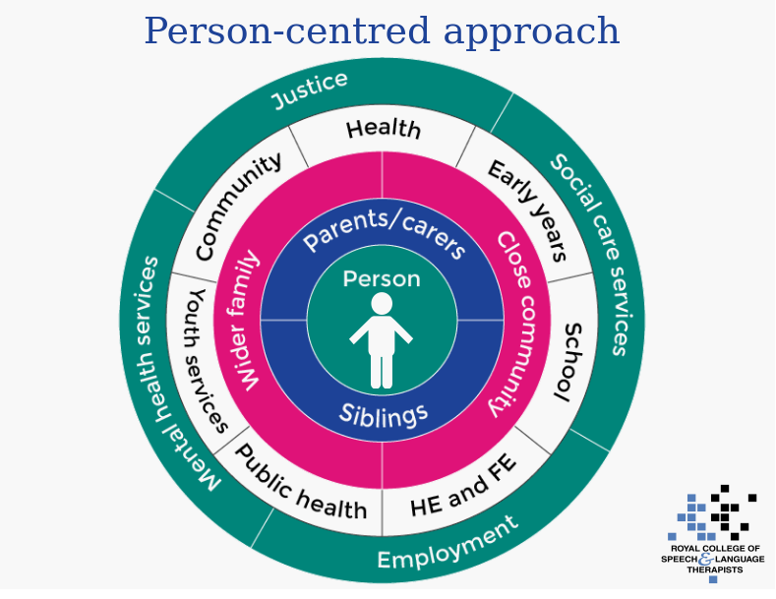

Slide 28
Impact and outcomes
Many features of DLD persist into adulthood (Nippold et al. 2009)
Individuals with DLD may have social communication difficulties, however, research suggests pro-social skills are an area of relevant strength (e.g. Toseeb et al. 2017)
Features of DLD can impact on academic success (e.g. information processing, reading, recalling information)
Individuals with DLD may have difficulties with functional tasks (e.g. learning to drive) (Durkin et al. 2016)
Individuals with DLD are at risk of economic disadvantage (e.g. Conti-Ramsden et al. 2016)

Slide 30
Implications for service delivery
Changes will take time to implement
The degree of change will depend on local circumstances
Access to services currently is variable
Terminology clarification can potentially help with planning services, data collection and outcome measurements
SLTs should continue to work in partnership with other professionals, ensuring that the children and families’ perspectives are central to decision-making and goal-setting
Services may need to adapt current resources/training materials to reflect terminology changes
(RCSLT, 2017)

Slide 31
What about local language provisions? The criteria states a diagnosis of SLI/ needs information about non-verbal IQ
Will depend on local services
Have open discussions with other professionals and commissioners
Entry criteria may need to be reviewed over time
These provisions should be needs-led

Slide 32
Top tips
Build confidence and understanding around the changes within your SLT teams first
Communication is key. Liaise with parents, service users and external stakeholders face to face. Make it a discussion rather than/ in addition to providing training
Highlight the positives of using a shared language and opportunities for a joined up approach
Pool your resources via RCSLT and make use of handy resources others have produced to save time
Create a network within your service of people with specialist skills or an interest in DLD
Watch the DLD webinar to hear more focused information about service delivery using a case study in Hackney
Have conversations with commissioners
Join your local CEN or hub and start discussions with peers, engage in study days
RCSLT webinar, 2018

Slide 33
Current RCSLT resources
Visit the RCSLT DLD web pages for links to resources such as:
Systematic reviews
Journal articles
Research impact case studies
Briefing paper
FAQ document
Fact sheet
External presentations and posters
Webinar
https://www.rcslt.org/members/clinical-guidance/developmental-language-disorder

Slide 34
Related and future RCSLT work
Research priorities project
Story telling project
Children's strategy work
Bercow: Ten years on
Outcome measures programme of work
Terminology work via. SNOMED CT
Liaising with government
DLD factsheet
System leader roundtable event
Collection of resources

Slide 35
External resources and organisations
#devlangdis

Slide 36
Useful references
Bishop, D. V. M. (2017). Why is it so hard to reach agreement on terminology? The case of developmental language disorder (DLD). International Journal of Language and Communication Disorders, 52 (6), 671- 680.
Bishop, D. V. M., Snowling, M. J., Thompson, P. A., Greenhalgh, T., & The CATALISE Consortium. (2017). Phase 2 of CATALISE: a multinational and multidisciplinary Delphi consensus study of problems with language development: Terminology. Journal of Child Psychology & Psychiatry, in press.
Bishop, D. V. M., Snowling, M. J., Thompson, P. A., Greenhalgh, T., & The CATALISE Consortium. (2016). CATALISE: a multinational and multidisciplinary Delphi consensus study. Identifying language impairments in children. . PLOS One, 11(7).
Conti-Ramsden,G., Botting, N., Simkin, Z. & Knox, E. (2001). Follow-up of children attending infant language units: outcomes at 11 years of age. International Journal of Language and Communication Disorders, 36, 207- 219.
Conti-Ramsden, G., Durkin, K., Mok, P. L., Toseeb, U., & Botting, N. (2016). Health, employment and relationships: correlates of personal wellbeing in young adults with and without a history of childhood language impairment. Social science & medicine, 160, 20- 28.
Ebbels, S. & Norbury, C. (2017). Changing terminology and diagnostic criteria: evidence based decisions and practice. Presentation on 05.07.17 at RCSLT DLD workshop. Available at: https://www.rcslt.org/clinical_resources/language_disorder/overview
Irish Association of Speech and Language Therapists. (2017). Supporting children with developmental language disorder in Ireland: IASLT Position paper and guidance document 2017. Available at: http://iaslt.ie/attachments/DLD%20Position%20Paper%20FINAL%2023MAY2017.pdf
Norbury, C. F., Gooch, D., Wray, C., Baird, G., Charman, T., Simonoff, E., Vamvakas, G. & Pickles, A. (2016). The impact of nonverbal ability on prevalence and clinical presentation of language disorder: evidence from a population study. Journal of Child Psychology and Psychiatry, 57(11), 1247–1257
Royal College of Speech and Language Therapists (2017). RCSLT briefing paper on language disorder with a specific focus on developmental language disorder. Available at: https://www.rcslt.org/clinical_resources/language_disorder/dld_briefing_paper
Royal College of Speech and Language Therapists (2017). Research priorities at the RCSLT. Available at: https://www.rcslt.org/members/research_centre/research_priorities/RCSLT

