Slide 1
Building research capacity in speech and language therapy: the SLT Research Practitioner Framework Resource Map
RCSLT conference 2021
05 October
Notes:
Thank you Judy – always so great to hear about this project.
And Thank you all for staying on for the next talk, where I’ll be presenting our work at RCSLT on building research capacity.

Slide 2

This session
Katie Chadd
RCSLT Research manager
@katie_chadd
katie.chadd@rcslt.org
Notes:
My name is Katie Chadd, I am a speech and language therapist and research manager at RCSLT

Slide 3
The team
Dr Hazel Roddam | Katherine Broomfield | Dr Jackie McRae | Dr Mari Viviers | Katie Monnelly | Dr Helen Stringer | Gemma Clunie
Milly Heelan | Katie Chadd | Amit Kulkarni | Dr Rebecca Palmer
Notes:
Whilst I am the one talking today, A lot of what I’ll mention was developed by a team of collaborators both RCSLT staff, and RCSLT members, so I am especially grateful for the contribution of those listed here.

Slide 4
Learning outcomes
Delegates will:
Develop their understanding of the importance of embedding research capacity within the speech and language therapy profession, and further afield
Have a greater understanding of where to look to find out more about the support networks available to them for developing research capacity
Learn about the resources available to them for planning their research career and practitioner skills
Notes:
I wanted to draw attention to the learning outcomes just very briefly – so I hope that after this session, you will all have@
Greater understanding of the importance of embedding research and research capacity within speech and language therapy
Understand more about where to find support, and from who
And know a bit more about the resources available to you for planning your research career and building capacity

Slide 5
What is research capacity and why is engaging in research important?
Notes:
So, I keep mentioned research capacity and research engagements… but what is this exactly?

Slide 6
Research capacity is a term that describes:
“a process of individual and institutional development which leads to higher levels of skills and greater ability to perform useful research”
Trostle (1992, p.1321)
Notes:
There are – as you may be surprised to hear as a speech and language therapist – many different definitions of research capacity.
I’ve taken this one from trostle, who neatly describes research capacity as:
As process of both individual and institutional development, which leads to higher level of skill and great ability to perform research

Slide 7
Why is research important?
For the therapist
Stipulated by HCPC (standard 12) – standards of proficiency for speech and language therapists, p.11.
(HCPC, 2014)
For the service
For the patients
Research engagement has a positive impact on patient health outcomes
(Boaz et al. 2015)
CQC performance monitoring indicators – questions about research now included in inspection frameworks, p. 24.
(CQC, n.d.)
Notes:
And why is it important? This holds value in many different ways – here’s just a few, but there are many!
On quite a surface level – for the therapist, engaging in research activity (including audit and service evaluation) is indeed stipulated in our standards of proficiency! That’s certainly not the sole reason.
For speech and language therapy services, again it is important for many different reasons, but research is now actually included in the inspection frameworks!
Finally, and most importantly, research is vitally important for the patients. Not only does research pave the way to better quality, evidence-based interventions or care, research has even shown that having clinicians just engaged in research in some way has a positive impact on patient outcomes.

Slide 8
Why is research important?
For the therapist
Stipulated by HCPC (standard 12) – standards of proficiency for speech and language therapists
(HCPC, 2014)
And…
You gain lots of new knowledge
It facilitates career development
It’s really interesting!
Notes:
Going back to the therapist in particular… we just wanted to do an extra plug of why research is important for the therapist!

Slide 9
Barriers and enablers
Growing body of research exploring this, e.g. Pager, Holden and Golenko (2011). They report barriers such as:
  Clinical responsibilities take priority
  Lack of time
  No funding for research time/activities
  Lack of skill
But also lots of enablers- including availability of mentors, and knowing colleagues doing research
SLTs also known to report:
  issues with managerial support
  regional variation in research infrastructure/support
  difficulties with funding especially for independent therapists
Notes:
However, despite this, we know there are some barriers to engaging in research as a busy clinician in busy services
There is an emerging evidence base around the reasons for this – I am just going to highlight one study, by Pager et al who spoke with AHPs in one Australian healthcare trust
The healthcare staff they spoke with, identified common barriers, which probably resonate with many here – this included the reflection that clinical responsibilities take priority, and that there’s often a lack of time, funding and development of skills for engaging in research
But they also identified a number of enablers of research capacity - which included having a degree of peer support ie through availability of mentors, and also having colleagues involved in research
We also know SLTs often report they face issues with getting managers on board (e.g to free up time for research activities) and that there is also variation across the UK, and especially additional issues for independent practitioners

Slide 10

Additional barriers for some?
Diversity of speech and language workforce :
  Student intake 2019 was 76% white (RCSLT, 2020)
Diversity in academia:
  People who are Black, Asian, have mixed or an ‘other’ non-white ethnicity make up just one quarter of academic contracts held in UK (Higher Education Statistics Agency, 2021). This is significantly reduced at senior levels e.g. Professors
Diversity of UKRI funding recipients:
  overwhelmingly likely to be: white, cis, non-disabled (UKRI, 2020)
What does this mean for the clinical researcher / clinical academic workforce in speech and language therapy?
Notes:
Also potentially additional barriers for some groups
We know that as a profession, even the newly graduating cohort, is not particularly diverse, for example, with regard to race or ethnicity
Importantly when we think about careers in research, there is also emerging evidence that Black and minority ethnic individuals are under-represented in research and academia,
And, whatsmore is that we see a decline in the diversity as academic careers progess- so, at the more senior levels, for examples, professors, there is are even fewer black or minority ethnic researchers
In addition to this, a report released by the UKRI (the UK’s biggest research funder), similarly found that their research funding recipients were overwhelmingly likely to be white, cis and non-disabled.
So, whilst we don’t have evidence to state exactly, there are indications that particular groups of individuals who are aspiring SLT researchers, are facing even greater, unfair and avoidable, challenges, and any strategy to bolster research capacity must also strive to mitigate this too.

Slide 11

Enabling networks
Notes:
Katie
Thanks Amit.
So we know there are some barriers – but also enablers, and what’s interesting is that perhaps in recognition of some of these, peer support and networking initiatives have become quite ubiquitous in speech and language therapy!

Slide 12









Research capacity building networks
Notes:
We’re in a very good position in terms of ‘what’s out there’ for our profession – there’s lots of support for research capacity building!
These are some of the key networks that are accessible and available to SLTs, and are indeed the networks that we’ve been working with – probably some of you have already come across them, or engaged with them in some way
Alongside the RCSLT’s own initiatives (our research champions and clinical academic mentors), SLTs can engage with CAHPR, CLinACSLT, CAHPR/NIHR research champions, ReSNetSLT, the NE SLT research network and the Health Professions in research facebook community

Slide 13

How do I know what to do, who to speak to, how to do it, and when?
Notes:
Katie
But - The RCSLT, cognizant of the fact that there were all these different networks, wanted to ensure we were all maximising impact and avoiding duplication of efforts
Also, wanted to ensure SLTs all knew about and understood the different networks and what they could support them with them
So, this is the key question that we hope the rest of this talk will show you one way to help navigate!
How do I Know what to do, who to speak to, how to do it, and when!?

Slide 14

Notes:
Katie
back in March 2020, representatives from the committees of these networks came together- and formed what we called the ‘research capacity builders group’
We identified that together we all shared one common goal – to help enable research activity and engagement in SLT
Thus, we decided to collaboratively undertake a project to bring everything together

Slide 15
Aims
Identify networks
Differentiate remit
Evaluate unmet need
Notes:
Katie
Our initial aims were to identify and bring together the different networks centred on building research capacity in SLT
Then, we wanted to carefully consider the differences and similarities in the remit of each network
We hoped to do this to evaluate the areas of overlapping and unmet need in developing research capacity in our profession

Slide 16
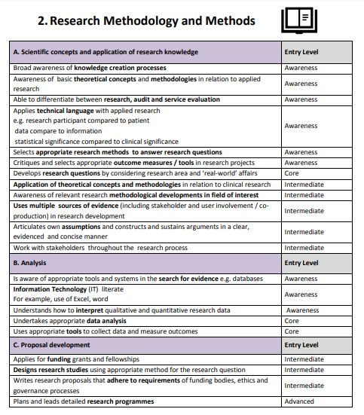

Method
Harris, J., Grafton, K. & Cooke, J. (2020). Developing a consolidated research framework for clinical allied health professionals practising in the UK. BMC Health Services Research, 20, 852 https://doi.org/10.1186/s12913-020-05650-3
Notes:
Katie
We wanted to do this remit-mapping activity systematically, so we decided to use the research practitioner framework, created by CAHPR, as a tool to map the roles of each network/group.
The CAHPR framework lists a series of knowledge and skills statements, across multiple domains (e.g. research delivery, or research leadership), mapped to different ‘levels’ based on your experience e.g. awareness, intermediate…

Slide 17
Method
..and mapped each knowledge and skill statement as being either:
an active focus or goal
an aspirational focus or goal
not a focus or goal
..of the represented networks
Notes:
Katie
each network went through the CAHPR framework and mapped which items on the framework where either:
An active focus of the network currently
An aspirational focus that they perhaps intended to support to a degree, or in future
Or, not a focus
This helped to identify the specific remit of each network, as well as highlighting to us where there may be a gap in support, and areas in which our networks overlapped

Slide 18
The result
What emerged was a comprehensive ‘guide to’ the networks that can support SLTs to embed research into their careers….
The SLT Research Practitioner Framework Resource Map
Notes:
Katie
What resulted was a really thorough audit, which we decided in itself was a really valuable resource
So, we turned this into the SLT research practitioner framework resource map – which we hope will be of use to you as individuals and services, to help plan and develop your research practitioner skills and build research capacity

Slide 19
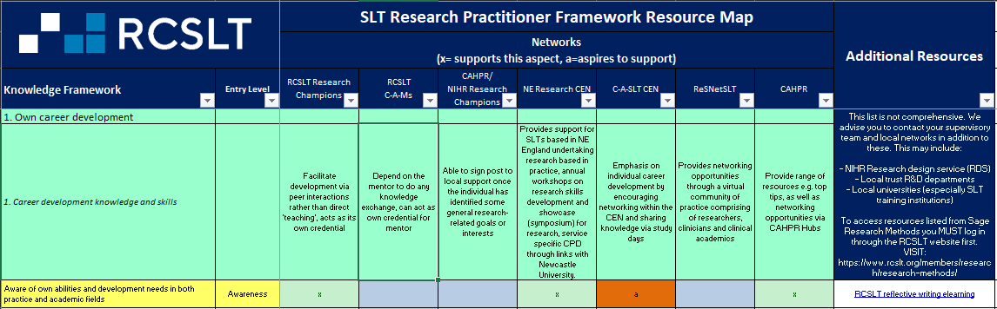
SLT Research Practitioner Framework Resource Map
Notes:
So I’ll just briefly introduce you all to the resource map – but I appreciate this is not the most exciting slide!!!!
It’s a just a really big table, which has all the knowledge and skills from the framework down one side, then a little checklist from each network about whether they ‘cover’ this in their initiative or not.
It’s also got some more specific information from each network about their remit, for each of the big categories of knowledge/skills.
It’s got lots of filters so you can narrow down the table to show you exactly the information you need – so, if you just want to look at everything for the ‘awareness’ level, for example, you can trim the table down.
To look at this in more detail, I recommend you head over to our RCSLT research exhibition booth to see a tutorial video on how to use it, plus the opportunity to ask us any questions about sigi t

Slide 20
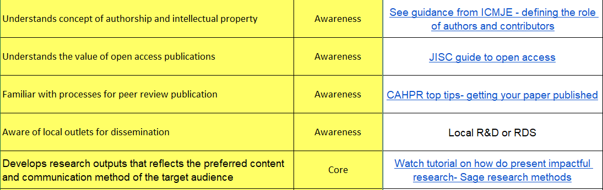
And more suggestions!
An additional column dedicated to key resources to also support each element of the framework.
Notes:
Katie
We’ve also added in to the tool a bonus column, which lists some suggested resources that you might also want to take a look at, which are relevant for each of the knowledge statements.
Some of these are RCSLT resources, or from the NIHR, or other external sources that have been recommended.

Slide 21
Next steps
Evaluate
Update resource
Gap analysis
Strategize on how to fill the gaps
Notes:
Katie
Just briefly, in future we hope to:
Evaluate the use of the resource through surveys and interviews – please do complete our feedback survey if you do use the tool!
As initially planned, we will be using this to conduct a gap analysis. Here, we will examine what areas are lacking support, and whether there are any other networks not yet represented on the map, that might fill some of these gaps
Where true gaps to exist, we plan to collaboratively strategize on how to fill the gaps. This could be, to discuss in which areas could the networks that already exist could develop, or it may well be the development of new initiatives/projects that might be needed to fill the gaps.

Slide 22
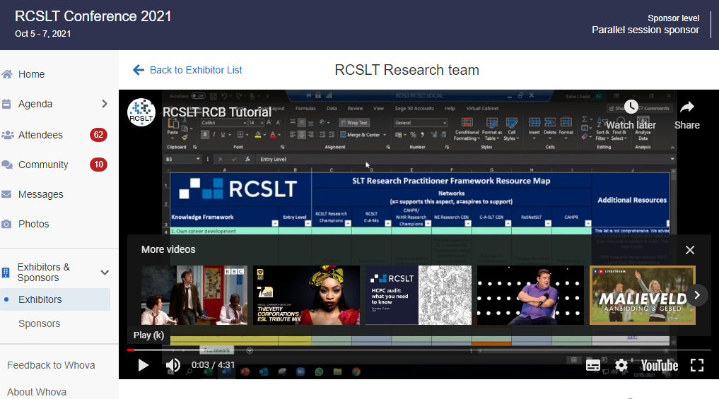

Find us at the RCSLT Research Exhibition Stand!
Further information
Useful webpages:
https://www.rcslt.org/members/research/
https://www.rcslt.org/members/research/careers/
https://www.rcslt.org/members/research/careers/#section-4
https://www.rcslt.org/members/research/careers/slt-research-practitioner-framework-resource-map/
Notes:
Katie
As mentioned – you can check out the tool, which is the focus of our Exhibition stand
You can also find out more on our open access rcslt webpages
Or get in touch with the team!

Slide 23


Thank you for listening.
Any questions?
Complete the RCSLT survey on the impact of COVID-19 and post-COVID syndrome on speech and language therapy
For *all* UK speech and language therapy services
https://www.surveymonkey.co.uk/r/rcsltpostcovid
Notes:
Katie
Just a reminder about the survey…

Slide 24
References
Boaz, A., Hanney, S., Jones, T., & Soper, B. (2015). Does the engagement of clinicians and organisations in research improve healthcare performance: a three-stage review. BMJ Open, 5(12).
Care Quality Commission (n.d.) Key lines of enquiry, prompts and ratings characteristics for healthcare services. Online. Available from: https://www.cqc.org.uk/sites/default/files/20180628%20Healthcare%20services%20KLOEs%20prompts%20and%20characteristics%20FINAL.pdf (accessed 16 September 2021)
Harris, J., Grafton, K., & Cooke, J. (2020). Developing a consolidated research framework for clinical allied health professionals practising in the UK. BMC Health Services Research, 20(1), 1–15. https://doi.org/10.1186/s12913-020-05650-3
Health and Care Professions Council (2014). Standards of Proficiency: Speech and language therapists. Online. Available from: https://www.hcpc-uk.org/globalassets/resources/standards/standards-of-proficiency---speech-and-language-therapists.pdf?v=637018072470000000 (accessed 16 September 2021)
Higher Education Statistics Agency (2021) Who’s working in HE?:Personal characteristics. Data obtained online. Available at: https://www.hesa.ac.uk/data-and-analysis/staff/working-in-he/characteristics. (accessed 16 September 2021)
Pager, S., Holden, L., & Golenko, X. (2012). Motivators, enablers, and barriers to building allied health research capacity. Journal of Multidisciplinary Healthcare, 5, 53. https://doi.org/10.2147/JMDH.S27638
Royal College of Speech and Language Therapists (n.d.) Diversity in the profession: statistics. Online. Available from: https://www.rcslt.org/members/speech-and-language-therapy/careers-promotion-and-diversity/careers-fast-facts/#section-3 (accessed 16 September 2021)
Trostle, J. (1992). Research capacity building in international health: definitions, evaluations and strategies for success. Soc Sci Med, 35, 1321-4.
UKRI. (n.d.). Diversity data collection – UKRI. Online. Available from: https://www.ukri.org/our-work/supporting-healthy-research-and-innovation-culture/equality-diversity-and-inclusion/diversity-data/ (accessed 16 September 2021)

