Slide 1

Effective and accessible communication in the criminal justice system
Claire Moser
Claire.moser@rcslt.org

Slide 2
Content
Link between neurodiversity and speech, language and communication needs
Why is this important
Impact on the person and staff
Guiding principles and communication tips
Q&A / Discussion

Slide 3

Links between neurodiversity and speech and language needs
Neurodivergence encompasses different conditions (Doyle, 2020).
High prevalence of speech, language, and communication difficulties needs among neurodivergent people.
In prisons, half of people may be neurodivergent (MOJ)
and over 60% have communication needs (Bryan, 2004).

Slide 4
Why is this important
Communication skills are fundamental and foundational – they enable us to understand and be understood. They underpin social communication.
Communication needs are invisible, with low levels of diagnosis. People can mask their needs.
People will struggle to navigate and engage with the criminal justice system, which has its own rules, regimes and demands.
Around 40% of offenders find it difficult or are unable to benefit from and access verbally mediated interventions, such as anger management and drug rehabilitation courses (Bryan, 2004)
Young offenders with speech and language needs rarely ask for help or said they did not understand compared to those without (Lanz et al, 2009)
If we get communication right, it will benefit a lot of people

Slide 5

Impact on the person and staff
Where individuals cannot understand others and cannot express themselves, this can manifest as:
Challenging behaviour – intensity, severity and frequency
Increased use of physical intervention
Aggressive and violent behaviour
Increasing self-harm
Wrong decisions/choices made

Slide 6
Guiding principles
1. Do your services have a communication champions?
2. Do they know to provide accessible information? – written and verbal
3. Are services delivered in communication friendly environments?
4. Do services make their environments work via clear signage?
5. Are staff trained and capable to respond to those with communication needs using your services?
6. Are there clear referral pathways to access speech and language therapy?

Slide 7

Principles 1 and 2
Your services will have people with communication needs.
Do they have communication champions to advocate and raise awareness of communication..?
2. Providing accessible information, for example:
Using simple clear language and avoiding jargon.
Ensuring vocabulary used is understood
Explaining abbreviations and acronyms
Using short simple sentences
Avoid using open questions
More communication tips: here
Notes:
Capture the person's attention and speak slightly slower than usual
Give extra time for the person to listen & process information
Make written materials simple and clear
Use pictorial materials, visuals or imagery
Use gestures and visual cues to supplement the spoken word
Check that the person has understood what has been said, by asking them to repeat back the information in their own words
Encourage them to say when they have not understood
www.rcslt.org/speech-and-language-therapy/where-slts-work/justice/#section-3

Slide 8
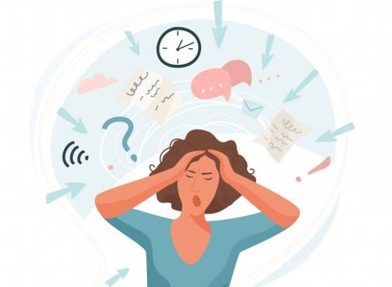
Principle 3
3. Communication friendly environments, are services thinking about:
Noise on the wing / cell / station
Noise and lighting in healthcare waiting and assessment rooms
Conflict with other people (disrupted routine, direct style of communication, disrupted routine)
Sharing a cell or space with others
Sensory overload
Awareness of staff
Lightening
Space

Slide 9
Principle 4
4. Making environments work via clear signage – are services thinking about:
Issues
People less likely to rely on text on signs and struggle to tell the time
Difficulty navigating unfamiliar settings can lead to missed appointments and being in the wrong place
Solutions
Clear and simple routes, using pictorial images for the end route
Use colour and images on the sign
Have directional signs
Provide clocks and calendars to help people track time and date
Provide visual timetables to illustrate prison routines or office hours etc

Slide 10

Principles 5 and 6
5. Develop staff capability to respond to communication needs
Staff training to increase understanding of what communication difficulties are, the impact of these and the skills to work successfully with individuals who have such issues
Resource: The Box
6. Are there clear referral pathways to access speech and language therapy?
Do partner agencies know how to refer? Do healthcare know?
Notes:
www.rcslt.org/learning/the-box-training
6. Clear referral pathway to access to speech and language therapy in all prisons

Slide 11
Useful resources
Royal College of Speech and Language Therapists - factsheets link
Royal College of Speech and Language Therapists - Justice evidence base: consolidation link
Communication tips link
The Box Training link
Notes:
RCSLT factsheets www.rcslt.org/speech-and-language-therapy/speech-and-language-therapy-factsheets/
RCSLT justice evidence base: consolidation www.rcslt.org/wp-content/uploads/media/Project/RCSLT/justice-evidence-base-2017.pdf
Communication tips www.rcslt.org/speech-and-language-therapy/where-slts-work/justice/#section-3
The Box Training www.rcslt.org/learning/the-box-training/

Slide 12

DC
Q & A
Discussion

Slide 13



Thank you
www.rcslt.org
Claire.moser@rcslt.org
@RCSLTpolicy

