Slide 1
An SLT’s perspective of communication
So you think he/she/they/we can communicate?
Susan Guthrie, Cardinal Clinical Academic Research Fellow & Advanced Practitioner SLT
Leeds and York PFT & School of Healthcare, University of Leeds
Twitter @SusanGuthrieSLT #SLTsinMH

Slide 2
Acknowledgements:
Supervisors:
Professor John Baker, Dr Jane Cahill University of Leeds; Professor Bronwyn Hemsley, University of technology, Sydney
SLTsinMH network
Amy Hird & Jo Brackley

Slide 3
So, we think ………. can communicate?
A discussion around communication: different styles and complexity

Slide 4
Maggie’s story:
Staff: It’s Friday, time for your gardens session
Maggie: I don’t go garden sessions
Staff: No, but you should have been going to gardens
Maggie: I don’t go to gardens
Staff: No, but you should have
Maggie: but I DON’T GO TO GARDENS!!
Maggie becomes increasingly
distressed leading to restraint
and seclusion
(unrecognised DLD)
Notes:
Maggie just heard “you have been to gardens”

Slide 5
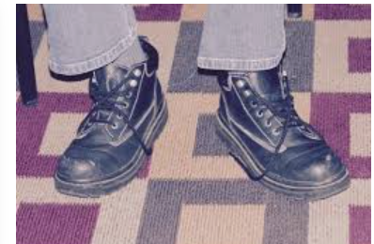
John’s story:
John is about to leave the ward for a walk after many days of ‘no leave’.
Staff: ‘take your shoes off John’
John: ‘but I’m going for my walk!’
Staff: ‘no we just need to take your shoes off now’
John becomes distressed
and is restrained
(staff haven’t explained that
his shoes are on the wrong feet,
walk isn’t cancelled as John thinks)

Slide 6
Today’s presentation:
what can go wrong?
Definitions and prevalence
Communication and mental illness
SaLT role in MH settings
Subtext: everyday language vs complex language ???
How does this impact on mental wellbeing?
what can we do to help?

Slide 7
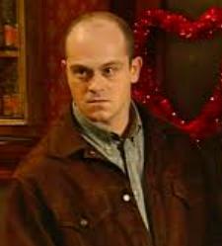
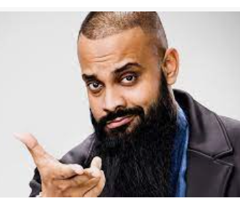
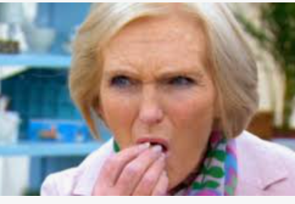
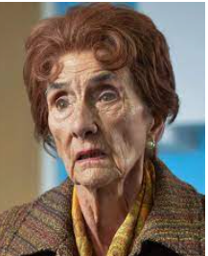
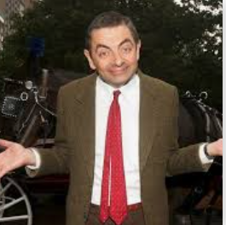
Only through communication can human life hold meaning,
Pablo Freire

Slide 8
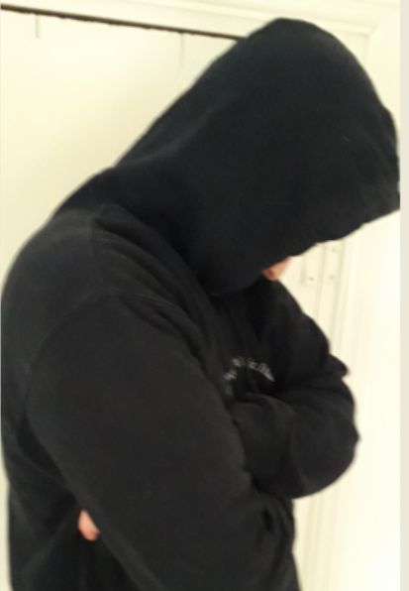
Communication - difficulties are typically hidden
Self report of difficulties can be unreliable (reluctance to admit weaknesses)
Individuals with communication difficulties may ‘go along with’ information or actions (difficulties understanding, difficulties asking questions, difficulties with perceived authority)
Individuals’ communication difficulties not diagnosed earlier (school attendance erratic/ family access to services)
Bravado, Streetwise attitude, ‘talk the talk’ as coping strategies (hiding significant difficulties with communication)
Person learns to ‘mask’– but only effective in certain (usually informal) situations
Cultural variation and diversity in communication (ref Bhui et al 2015)
Notes:
Anyone can have a communication difficulty – you don’t need to have a ‘learning disability’ to have one
You can have a ‘normal’ IQ and have a specific communication difficulty.
Developmental from childhood – you grow up – you still have it
Brain injury
Communication difficulty associated with another condition e.g. learning disability, autism, stroke, ADHD

Slide 10
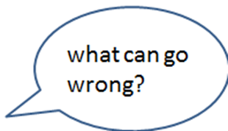
Assessing language ….
Developmental language disorder (known prevalence 7-8% in children)

Slide 11
Prevalence of Speech, Language, Communication needs (SLCN)
Inpatient & community psychiatric services: 80% found to have previously undetected impairment in one or more aspects of receptive or expressive language. Jagoe & Walsh (2007)
Longitudinal study found association between severe receptive developmental language disorder (DLD), and social adaptation difficulties and increased risk for psychiatric disorders in adulthood. Clegg et al (2005)
See also:
Rough sleepers – 17% SLCN (compared to general population 9%) (Andrews & Botting, 2020)
Long term unemployed – 88% SLCN (Bryan et al 2007)
Offender population - 80% SLCN (McNamara 2012; Bryan, 2004)

Slide 12
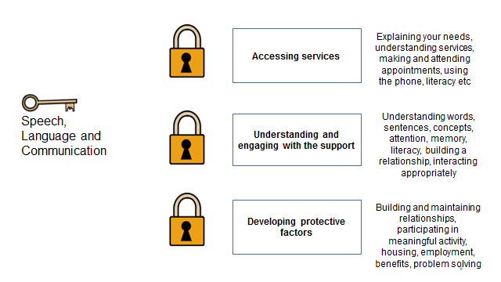

Slide 14
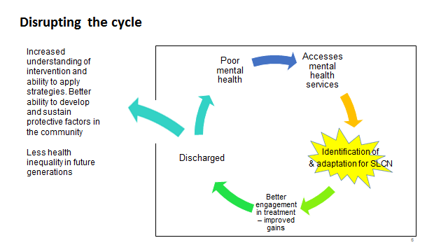

Slide 15
Communication Mental health
People with SLCN are more likely to experience mental ill health
Goh et al. (2021).
People with MH conditions are more likely to present with SLCN
(Jagoe & Walsh 2007)
Common co-existing conditions include IDs/LDs, ABI, autism, diagnostic overshadowing ….
Associations with safeguarding – neglect, abuse, rough sleeping, long term unemployment …..

Slide 16
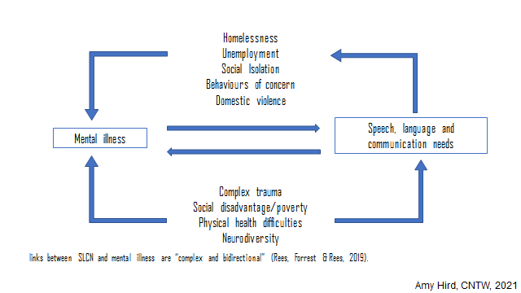

Slide 18
Thinking about the language we use?
The single biggest problem with communication is the illusion that it has taken place
George Bernard Shaw

Slide 19
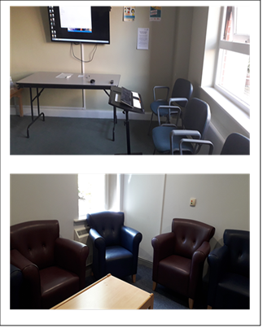
Thinking about the language we use?
The single biggest problem with communication is the illusion that it has taken place
George Bernard Shaw
(Images show ward round and meeting rooms, information given verbally or displayed as text on screens)

Slide 20
Maggie’s language difficulties: (?DLD)
Difficulty in understanding syntax & processing multisyllabic words
…considering potential resettlement options …
You have established a therapeutic relationship with …
Possible or impossible?
Acknowledging the inappropriate nature of your behaviours …
Nobody’s saying ‘No’
(Examples from MDT review meetings)

Slide 21
Thinking about the language we use?
Idioms & abstract language:
Dip your toe in the water …
You’ve turned things around…
Technical:
Developing a therapeutic relationship…
Jargon & acronyms:
The RC will be at your CPA and also your IMCA

Slide 22
Thinking about the language we use?
Accessibility - Plain English or jargon?
Understanding language and conventions of group setting, meetings, hearings, court?
Selecting appropriate register and style of communication?
Suggestibility and compliance
“Yes I’m fine”
Camouflage and masking
Defence strategies, use of scripts
Frustration, behaviour, withdrawal ….
Capacity assessment -
Understand information given to them
Retain that information long enough to be able to make the decision
Weigh up the information available to make the decision
Communicate their decision

Slide 23
Thinking about the language we use?
Chantelle, Can you tell me what these words mean?
Victim “when you get in trouble”
Recovery “when you’re poorly”
Optimistic “when you get told off”

Slide 24
Communication & Mental illness
Can we find common characteristics? Is this helpful?
Bipolar –pressure of speech, tangentiality, poverty of content
Manic – fast rate, flight of ideas, distractible, volume
Depression – withdrawal, slower rate of speech, volume, voice
Anxiety – barriers to engaging which provokes further anxiety
Schizophrenia – difficulties at different linguistic levels
- confused ideas, frustration, incoherence, pragmatic skills,
- negative symptoms include poverty of speech/content, tone, social withdrawal
BUT - Impact of additional difficulties, ASC, LDs, ABI, FAS etc
Cf Tan & Rossell 2020; Jagoe & Walsh 2020;

Slide 25
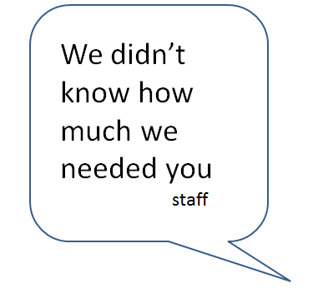
SLT role in MH settings
How to evaluate?
Some thoughts on
outcome measures…
Risk assessment for
Communication needs?

Slide 26
How has your understanding of SLT role changed since SLT came into post?
When the post began, I really questioned the need for SLT within our service but all I can say is I was very wrong. ….
…..has helped us develop a much deeper understanding of communication needs and Autism. This has altered the support we offer significantly for the better.
(B. Care coordinator & Nurse)

Slide 27
Measuring impact of SLT intervention
Example:
Coffee and chat group (every Friday for 6 weeks)
Open access for inpatients and staff
Joint social skills guidance working with OT and Nursing
Supported discussions with topics led by group members
Outcome Measures: quantitative
and qualitative

Slide 28
Outcome measures: incident reporting
(data not shared prior to publication)
Is there a difference in number of incidents pre and post group?
Yes, reduction in number and
duration of verbal abuse incidents
Qualitative measures: patient and
staff feedback very positive

Slide 29
Questions …..
What are we seeing? “Challenging behaviour” or Communication difficulties ?
Presentation of mental illness vs SLCN?
Where are the adults with developmental language disorder?

Slide 30
So, how do we communicate?
https://communication-access.co.uk/
Royal College of Speech and Language Therapists

Slide 31
SLCN Training and screening resources:
RCSLT https://communication-access.co.uk/
Also The box training in SLCN https://www.rcslt.org/learning/the-box-training/#section-1
YOSALT project https://www.ealing.gov.uk/downloads/download/1539/youth_offending_and_speech_and_language_therapy_yosalt_study

