Slide 1
RCSLT HEI Roadshow The RCSLT and your road to success #RCSLTUniTour
Notes:
Start with introducing yourself and your role at the RCSLT

Slide 2
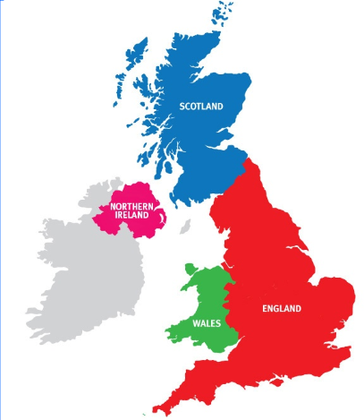
What is the RCSLT?
A professional body with over 20,000 members
Run by the members....for the members
Offices in all 4 nations in the UK
Notes:
The RCSLT is its members
We are the professional body for over 20,000 speech and language therapists in the UK; providing leadership and setting professional standards.
We facilitate and promote research into the field of speech and language therapy, promote better education and training of speech and language therapists and provide information for our members and the public about speech and language therapy.
There are offices in all four nations of the UK

Slide 3
What we are not...
We are not the regulator for the profession, this is the Health & Care Professions Council (HCPC)
We are also not the union for SLTs, this is Unite in the UK
Notes:
Not the HCPC (the regulator), not the union (Unite is the union)
It is a legal responsibility to be registered with the HCPC to work in the UK. To be registered with HCPC you MUST follow their standards on CPD, ethics, conduct and proficiency, and be able to prove that you have insurance to cover your work
It is important for all members to join their union as soon as they get their first speech therapy role as they will be able to help and support you should you encounter any work place disputes or issues, including during consultations around cuts etc.

Slide 4
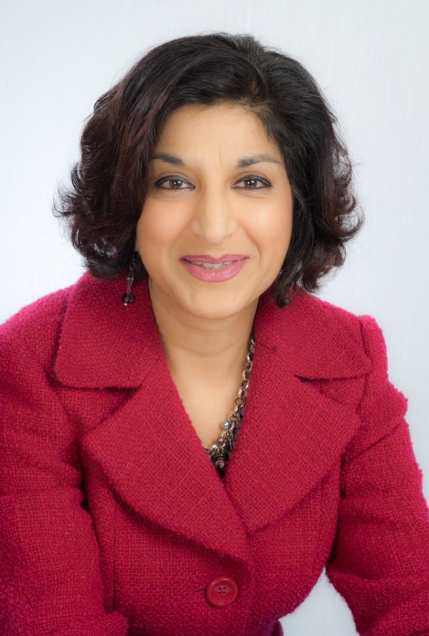
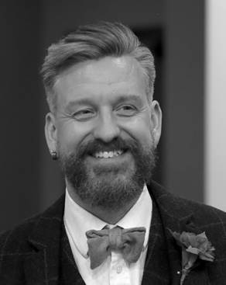
We are run by the members....for the members!
Governed by a Board of Trustees who are elected from the membership and who oversee and agree all work on behalf of the membership
CEO Kamini Gadhok MBE
Chair Dr Sean Pert
Notes:
There is a board of trustees which is formed from elected members and headed by a chair. The current chair is Dr Sean Pert. Officers of the RCSLT are employed to carry out the day-to-day work of the RCSLT, reporting back to the board of trustees as required.
The board is headed by CEO, Kamini Gadhok MBE – Kamini is a qualified SLT and also has a background in the civil service. She is a massive champion for students and is keen to ensure that all students feel that they are able to get involved in all aspect of work that the RCSLT does and play an important role in the local SLT communities.

Slide 5
RCSLT mission statement
To enable better lives for people with communication and swallowing needs
RCSLT values
Commitment, innovation and ambition; active accountability; strong and empathetic leadership; active engagement; Respectful, collegiate yet challenging.

Slide 6
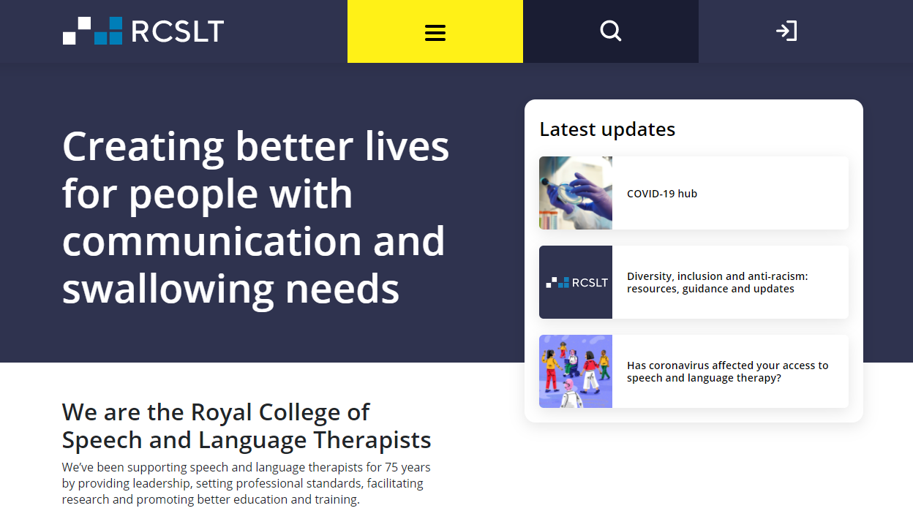
Resources - Keeping you informed
Bulletin magazine (quarterly)
E-newsletter (twice monthly)
Website
Twitter
YouTube
Instagram
LinkedIn
Notes:
The RCSLT provides resources that are useful from when you start thinking that you might want to study speech therapy, right through to retirement.
In the short term, these resources are available to help you with your coursework, placement and finding a job. After all, your Athens password expires after you graduate.
The Bulletin is a quarterly magazine for SLTs produced by the RCSLT, and is valuable resource to complement your studies – with articles, job adverts, courses and conferences.
We also send out an RCSLT enewsletter to all members. This is sent out twice a month showcasing our latest work and important updates
The website and social media are great ways to stay informed. With membership now being free for students, you can log on an explore most areas of the website.
You can follow @RCSLT for our main updates

Slide 7
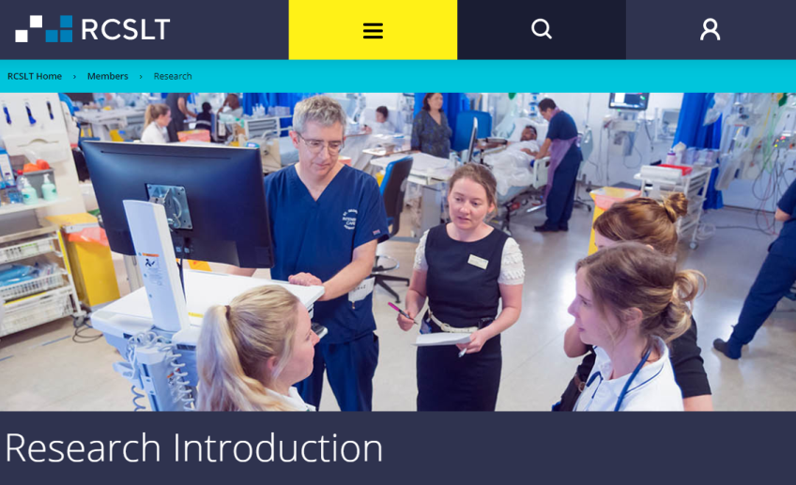
Resources - research and the evidence base...
The RCSLT has a growing research centre on its website full of useful information.
Members are also now able to access over 1,700 journal titles free through the research centre.
RCSLT membership means you are also an automatic member of the Council for Allied Health Professions Research (CAHPR).
Notes:
Imagine what life will be like without an Athens login – and then imagine the RCSLT is there to help!
The research section of the website includes resources on how to find the evidence, apply evidence to practice and collect your own evidence. You will also find e-learning resources, information about our research networks and top tips from other SLTs

Slide 8
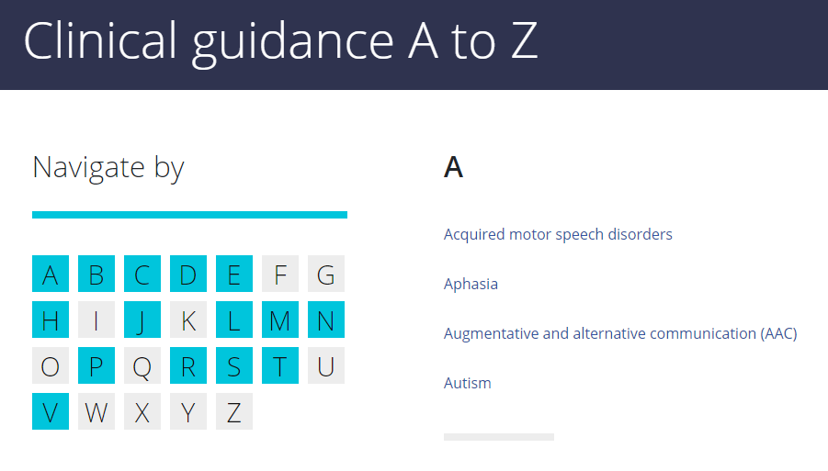
Resources - clinical resources
We have recently developed a series of webpages based on clinical conditions/areas ranging from AAC to Social, emotional and mental health (SEMH).
Notes:
Our clinical resources are updated very regularly, and feature information on guidance, learning, influencing and evidence. The guidance tile features relevant information

Slide 9
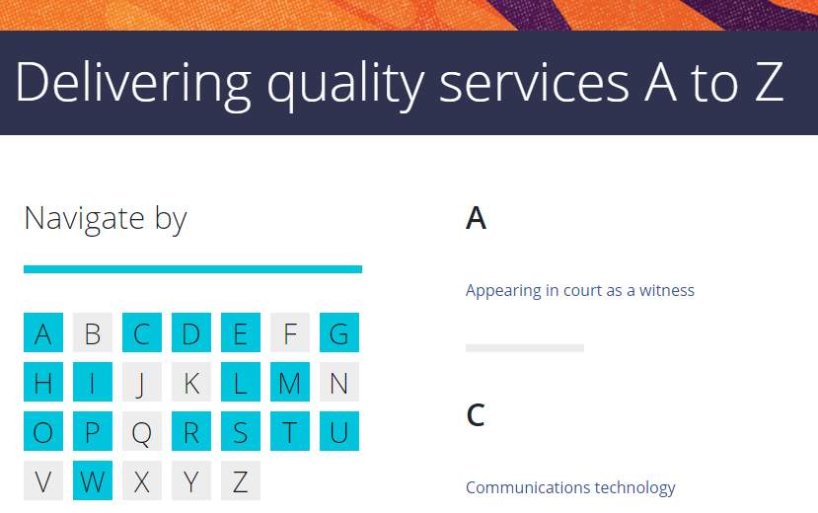
Delivering quality services
Accessible online guidance for a wide range of clinical topics, based on HCPC standards
Allows access to useful resources to help you meet professional and CPD standards
Notes:
This is a set of standards and resources to support SLTs to deliver a high-quality service that integrates the Health and Care Professions Council (HCPC) standards of conduct, performance and ethics.
This is an online resource which allow us to update the information and resources quickly and easily to ensure all members have the resources required to help them meet HCPC standards

Slide 10
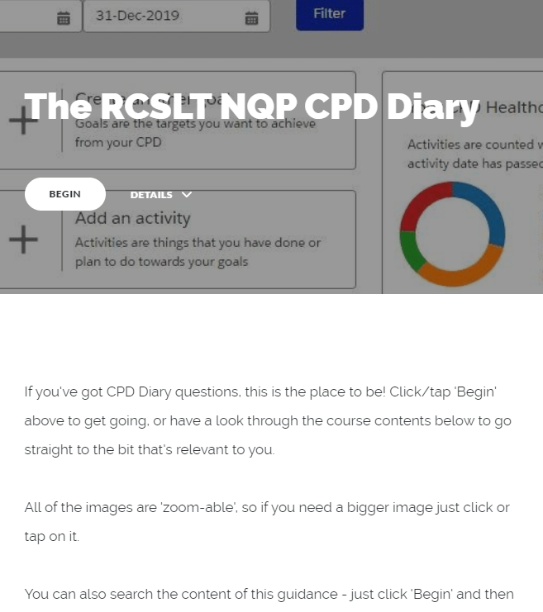
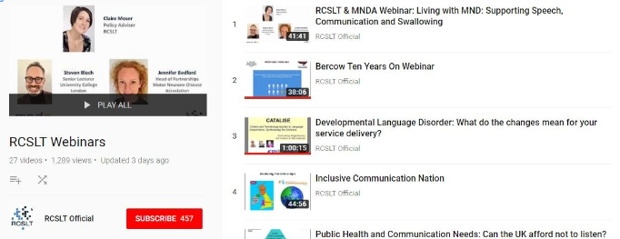
Resources - CPD resources, support and materials
eLearning tools
Videos on subjects such as leadership, supervision and telehealth
Webinars on a variety of topics
Virtual events
Networks & specialist communities
Notes:
Many of you will be aware that you will be required to do CPD from when you qualify
We offer advice about completing your required CPD and e-learning and resources to help you develop. You can find CPD resources on our website
You can find frameworks for CPD and competencies on the website.
Any questions, email cpd@rcslt.org

Slide 11
Resources - Get involved in RCSLT projects...
We are always keen for students to be involved in our work.
Have your say by being:
Part of a working group
A peer reviewer and reviewing draft guidance
Contact info@rcslt.org for more information!
Notes:
Getting involved in RCSLT work looks great on a CV.
The RCSLT is always looking for students (and NQPs) to be involved in working groups and drafting guidance.
Visit the website to find out about what’s going on now
Or email info@rcslt.org for more information

Slide 12
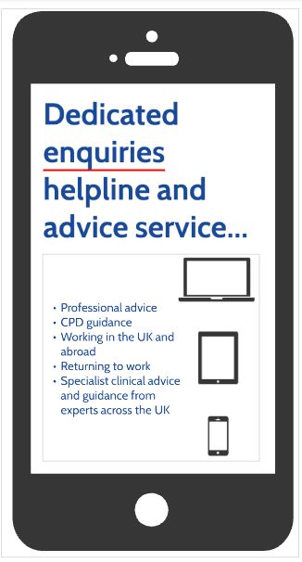
Professional support
Email: info@rcslt.org
Call: 020 7378 3012
Notes:
Once you leave university, remember that you are not alone! The RCSLT is available to support you throughout your career
We have a dedicated enquiries service to assist you with professional questions, such as supervision queries, or worries about your practice, which can be reached via phone or email.

Slide 13
Support - specialist advice and guidance...
We can link members to a wide network of specialist advisers.
This covers areas such as specific clinical areas, research and leadership.
Notes:
We have members who work closely with the RCSLT to provide information, help and guidance to other SLTs through their knowledge and experiences
You can contact info@rcslt.org at any point during your studies or career with questions or issues, and if there is an adviser who is better suited to supporting you rather than RCSLT staff, we will put you in touch

Slide 14
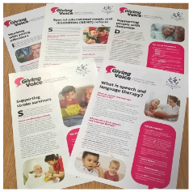
Local and National Influencing
What does the RCSLT Policy team do?
Put together resources to help SLTs make a case for service or to influence
React to new developments
Develop policy positions and responses
Influence and lobby Government
Notes:
The RCSLT has a dedicated policy team, including policy officers in each of the nations, who advocate on behalf of the profession and people with communication and swallowing needs. The policy team is able to advocate on behalf of the profession in part due to the excellent campaigning work that starts with Giving Voice.
We are here to promote the profession. RCSLT has always seen it as a key priority to influence parliamentarians and policy-makers. We:
Influence policy and legislation
Hold on-going meetings with peers and MPs
Have an all party parliamentary group (APPG) on speech and language difficulties

Slide 15
Local and national influencing
Why does it matter?
Speech and language therapy does not exist in a vacuum. There are lots of external influences on your role:
Government
NHS/STPs Commissioners
Public attitudes
Changing demographics
Influencing these groups is difficult - but not impossible!
Notes:
Speech and language therapy does not exist in a vacuum. The policy team highlights important information to decision makers outside of the profession.
The policy team helps to make it easy for decision makers to see the value and impact of speech and language therapy by collating research into easily digestible formats and ensuring that decision makers have the information they need.

Slide 16
Local and national influencing
Why get involved?
Make contact with the profession
Boost professional skills
Develop skills in networking, leadership and advocacy
Improves awareness of SLT amongst future generations of professionals
How do I get involved?
Awareness raising events
Encourage your SLT service to get involved
Use your time on placement to build an interest
Notes:
Show your own leadership skills, ability to coordinate and delegate and your passion for your profession by including your Giving Voice work on your CV!
Join your local Hub if you haven’t already and see how you can get involved in local work
You can also engage with wider RCSLT awareness raising events ie CAUK

Slide 17
Local and national influencing
How can you help?
Get involved in influencing
Take part in Giving Voice activities via your student body
Be a presence on Twitter, within your university and in your community
Notes:
Students have always been leaders within the Giving Voice campaigns and led the way for the profession. This continues now and most universities have Giving Voice societies or groups that organise events and campaigns to raise the awareness of SLT to the next generations of professionals such as GP’s, Lawyers, and Parliamentarians etc.
The RCSLT has been able to influence parliamentarians and decision makers due to the excellent work of local giving voice campaigns.

Slide 18
Networks and communities - Hubs
RCSLT Hubs bring together members from all stages of their career to:
Create a strong professional identity
Build the evidence base
Share intelligence and learning
Secure the voice of service users
Collect data and measure outcomes
Notes:
The RCSLT is run by the members for the members and so the communities that members develop are the most important part of the RCSLT and how we are run, and the profession as a whole. Students are an integral part of these communities and have a major role to play in the work they do.
Students have a key role to play within the development and running of these local communities and all Hubs actively seek student members to sit on their steering committee. Students are the future for the profession and so the work that Hubs do has a direct impact on how you will work, what jobs are available and standing of the profession in the future. So it is important you get involved to ensure that you are able to contribute to and influence this work and develop the future of the profession the way you want it!
Hubs are the geographic networks of SLTs. They bring local members together to:
Create a strong professional identity
Help to develop and build on the evidence base for the profession by building on research and resources
To help to share intelligence across members and teams and develop tools and resources that can be used regionally and nationally
To secure the voice of the service users by campaigning together to raise the profile of the work that SLT’s do in supporting patients with speech, swallowing and communication needs
Help to collect specific data and figures to inform national and local workforce planning and further emphasise the importance of SLT working with these client groups.

Slide 19
Networks and communities – Hubs continued
Most Hubs actively look for students to join their steering groups
You are the future of the profession - and so the work that Hubs do will directly influence how you work - so get involved!
Email hubs@rcslt.org for more information!
Notes:
There are 14 Hubs across the UK and they are often keen for students to join thei steering groups. If you want to get involved contact the RCSLT who can get you set up!

Slide 20
Networks and communities – CENs
Clinical Excellence Networks (CENs) provide opportunities for members to network at regional, national and local levels and share the latest in evidence-based practice, research and service development.
This may include a combination of:
Hearing from expert speakers
Discussing articles written in the RCSLT Bulletin and other publications
Providing a platform for members to share their work, including innovations in practice
Identifying the implications of changes to legislation or national policy on practice, drawing on resources and guidance available through the RCSLT website
Notes:
Clinical area or interest based networks of SLTs.
CENs provide members with the opportunity to network at a national, regional or local level and share/contribute to the development of the evidence base and research into the field.
CENs feed into the regional Hubs to help support the work they do and expand on/inform latest research etc.
CENs also have a key role in developing guidance and advice for the RCSLT to be used at a national level and to respond to consultations etc.
Being part of a CEN gives members the opportunity to hear from/network with experts in that field either through events or study days etc. It also provides the opportunity to not only have access to the latest articles etc but also to contribute to guidance and publications at all levels.
They provide members with a platform on which to showcase the work they are doping and develop themselves in to experts and advisers for the next generation of SLTs.

Slide 21
Networks and communities – CENs continued
A great way to...
Gain access to the latest evidence base and research
Get involved with the development of your profession
Develop and expand on your areas of interest
Network with other members of the speech and language therapy community
Develop valuable contacts that may be useful throughout your career!
Notes:
Access the latest evidence base, experts etc
Help to shape the profession by inputting into the evidence base and national guidance
Develop on your own areas of interest etc. and gain valuable experience.
Network with other members of the SLT community and make key links that can be vital throughout your career and could help you find that first crucial role in SLT

Slide 22
For more information
Please get in touch if you have any questions:
Email: info@rcslt.org
Call: 020 7378 3012
To join as a student member:
Website: www.rcslt.org/about-us/membership-overview
Cost: FREE!
Join us on social media:
Twitter: @RCSLT #RCSLTUniTour
Instagram: @RCSLT
Notes:
Generally, students who are passionate and involved and in-the-know will find job-hunting in the future to be a less painful experience than those that try to go it on their own. You’re part of a profession and you’ll need good people around you to allow you to flourish.
If you have any questions feel free to get in touch, and if you’re interested in taking part in our current work or joining a Hub or CEN, just let us know

