Slide 1
Building research capacity for UK SLTs: the SLT Research Practitioner Framework Resource Map Katie Chadd, Amit Kulkarni, Mari Viviers, Jackie McRae, Hazel Roddam, Gemma Clunie, Milly Heelan, Katherine Broomfield, Helen Stringer & Rebecca Palmer
ESLA Congress 2022

Slide 2
The team
Katie Chadd | Amit Kulkarni | Mari Viviers | Jackie McRae | Hazel Roddam
Gemma Clunie | Milly Heelan | Katherine Broomfield | Helen Stringer | Rebecca Palmer
Notes:
Whilst I am the one talking today, A lot of what I’ll mention was developed by a team of collaborators both RCSLT staff, and RCSLT members, so I am especially grateful for the contribution of those listed here.

Slide 3
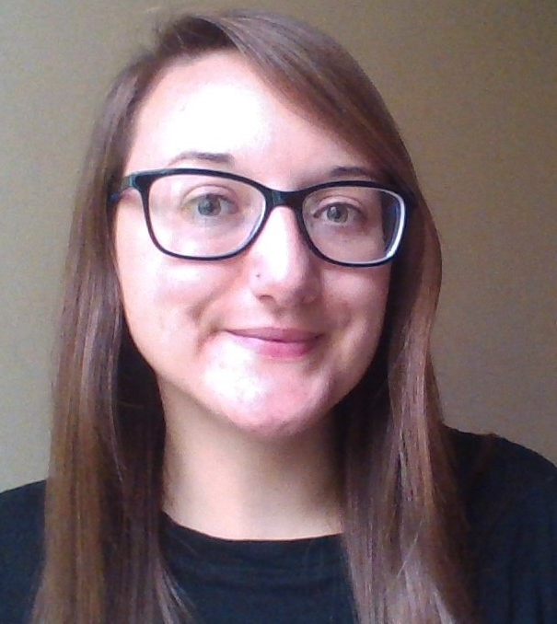
This session
Katie Chadd
SLT and research manager
Royal College of Speech and Language Therapists
(RCSLT)
@katie_chadd / @RCSLTResearch
katie.chadd@rcslt.org
Notes:
My name is Katie Chadd, I am a speech and language therapist and research manager at RCSLT

Slide 4
Research in speech and language therapy
Current UK context:
During training
Modules in:
After training
Regulator (HCPC¹) mandates that SLTs should:
Evidence-based practice
Research and research methods
Research project and dissertation
take an evidence-based approach to practice
engage in audit or service evaluation activity
Research
not
embedded
Notes:
In the UK, research and research activity does receive attention at the level of training SLTs, but when SLTs go into practice, there otherwise, there is not much incentive in the broadest sense for SLTs to engage in research activity.
There are many other factors of course contributing to the fact that research is rarely embedded in clinical roles these days …. ()

Slide 5
Research drivers
Clinical curiosity
Interest in EBP/ research
Notes:
Even though research is not embedded in the role of an SLT, there has always been drivers for research culture… (these , among many others!)
This meant that SLT, even though a small profession, has established itself as research-active.
Historically, in some areas, research duties featured on SLT job descriptions – research was part of an SLT career

Slide 6
Impact on research capacity and capability
Research
Interest in EBP/research
Clinical practice
Planning
Direct clinical hours
Service targets
Admin
Clinical curiosity
Notes:
These drivers still exist, however, when combined with the ever-increasing other pressures put on SLTs to carry out their clinical duties, it is perhaps unsurprising that in the current climate, research capability and capacity in clinical roles is very limited.
Whilst the desire and ‘culture’ may still exist in individuals.. It has become quite hard to straddle these two worlds.

Slide 7
Developments facilitating research capacity
Notes:
Nonetheless In recent years – some doors have been presented for SLTs – and it is starting to become possible for SLTs to embark on clinical academic/ research careers and become research active.

Slide 8
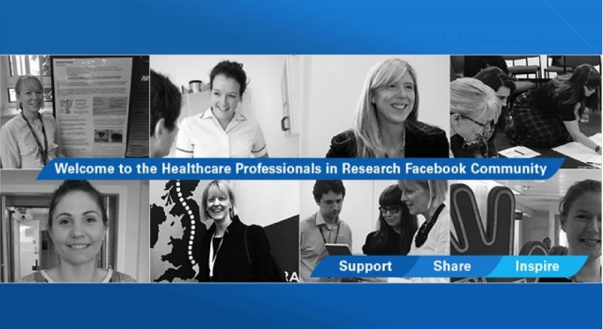
UK research capacity building networks
This Photo by Unknown Author is licensed under CC BY-SA-NC
Notes:
Even though those doors now exist.... SLTs were finding that they still needed some help to unlock and open those doors– lots of initiatives have come to light in this area
These are some of the key networks that are accessible and available to SLTs in the UK and beyond, and are indeed the networks that we’ve been working with – probably some of you have already come across them, or engaged with them in some way
Alongside the RCSLT’s own initiatives (our research champions and clinical academic mentors), SLTs can engage with CAHPR, CLinACSLT, CAHPR/NIHR research champions, ReSNetSLT, the NE SLT research network and the Health Professions in research facebook community

Slide 9
I want to embed research in my practice.
How do I know what to do, who to speak to, how to do it, and when?
Notes:
Now there seems to be lots of support (lots of keys!!!) for research in SLT, but how do you know which group does what , where to start?
The question still get getting asked- I want to do research, how?
(which keys for which lock for which door?!)
So…
back in March 2020, representatives from the committees of these networks came together- and formed what we called the ‘research capacity builders group’
We identified that together we all shared one common goal – to help answer this question, ie. enable research activity and engagement in SLT
Thus, we decided to collaboratively undertake a project to bring everything together

Slide 10
Aims
Identify networks
Differentiate remit
Create a resource to guide SLTs
Notes:
SLTs needed to know how to access, who to access and for what reasons
Our initial aims were to identify and bring together the different networks centred on building research capacity in SLT
Then, we wanted to carefully consider the differences and similarities in the remit of each network
We hoped to do this to evaluate the areas of overlapping and unmet need in developing research capacity in our profession
Ultimately, we wanted to guide SLTs in how to take pro-active steps in embedding research in practice – which was inclusive of those at the very start of the journey, but also those already established and on these paths

Slide 11
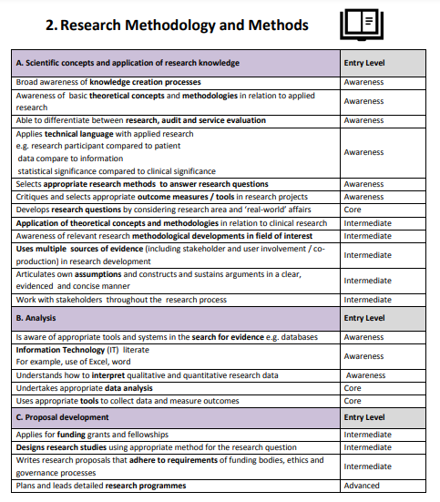
Method
6. Harris, J., Grafton, K. & Cooke, J. (2020). Developing a consolidated research framework for clinical allied health professionals practising in the UK. BMC Health Services Research, 20, 852 https://doi.org/10.1186/s12913-020-05650-3
Notes:
We wanted to do this remit-mapping activity systematically, so we decided to use the research practitioner framework, created by CAHPR, as a tool to map the roles of each network/group.
The CAHPR framework lists a series of knowledge and skills statements, across multiple domains (e.g. research delivery, or research leadership), mapped to different ‘levels’ based on your experience e.g. awareness, intermediate…

Slide 12
Method
..and mapped each knowledge and skill statement as being either:
an active focus or goal
an aspirational focus or goal
not a focus or goal
..of the represented networks
Notes:
Katie
each network went through the CAHPR framework and mapped which items on the framework where either:
An active focus of the network currently
An aspirational focus that they perhaps intended to support to a degree, or in future
Or, not a focus
This helped to identify the specific remit of each network, as well as highlighting to us where there may be a gap in support, and areas in which our networks overlapped

Slide 13
The result
A comprehensive ‘guide to’ the networks that can support SLTs to embed research into their careers….
The SLT Research Practitioner Framework Resource Map
Notes:
Katie
What resulted was a really thorough audit, which we decided in itself was a really valuable resource
So, we turned this into the SLT research practitioner framework resource map – which we hope will be of use to you as individuals and services, to help plan and develop your research practitioner skills and build research capacity

Slide 14
SLT Research Practitioner Framework Resource Map
Open-access
Some networks and resources are UK-based (and/or via the RCSLT)
Others may be more open
Practitioner framework is universal!

Slide 15
SLT Research Practitioner Framework Resource Map
Notes:
So I’ll just briefly introduce you all to the resource map –
It’s a just a really big table, which has all the knowledge and skills from the framework down one side, then a little checklist from each network about whether they ‘cover’ this in their initiative or not.
It’s also got some more specific information from each network about their remit, for each of the big categories of knowledge/skills.
It’s got lots of filters so you can narrow down the table to show you exactly the information you need – so, if you just want to look at everything for the ‘awareness’ level, for example, you can trim the table down.
To look at this in more detail, I recommend you head over to our RCSLT research exhibition booth to see a tutorial video on how to use it, plus the opportunity to ask us any questions about sigi t

Slide 16
And more suggestions!
An additional column dedicated to key resources to also support each element of the framework.
Notes:
Katie
We’ve also added in to the tool a bonus column, which lists some suggested resources that you might also want to take a look at, which are relevant for each of the knowledge statements.
Some of these are RCSLT resources, or from the NIHR, or other external sources that have been recommended.

Slide 17
This Photo by Unknown Author is licensed under CC BY
Notes:
Just to quickly loop back to the door metaphor --- We hope that by bringing together these networks and resources, SLTs can more easily find the keys they want for the right locks.. And open the doors to SLT clinical academic and research careers.

Slide 18
Next steps
Evaluate
Update
Add more!
Fill the gaps
Gap analysis
Clinical
Doctoral
Research
Fellow
Peer Support Group
International
Groups?
Upcoming update!
New Initiatives?
Notes:
Katie
Just briefly, in future we hope to:
Add more networks
Evaluate the use of the resource through surveys and interviews – please do complete our feedback survey if you do use the tool!
As initially planned, we will be using this to conduct a gap analysis. Here, we will examine what areas are lacking support, and whether there are any other networks not yet represented on the map, that might fill some of these gaps
Where true gaps to exist, we plan to collaboratively strategize on how to fill the gaps. This could be, to discuss in which areas could the networks that already exist could develop, or it may well be the development of new initiatives/projects that might be needed to fill the gaps.

Slide 19
Evaluation
Now
Next
1. Check out the SLT Research Practitioner Framework Resource Map
2. Complete the Evaluation survey

Slide 20
Thank you for listening. Any questions?
Notes:
Katie
Just a reminder about the survey…

Slide 21
References
Health and Care Professions Council (2014). Standards of Proficiency: Speech and language therapists. Online. Available from: https://www.hcpc-uk.org/globalassets/resources/standards/standards-of-proficiency---speech-and-language-therapists.pdf?v=637018072470000000 (accessed 25 March 2022)
Whitworth, A., Haining, S., & Stringer, H. (2012). Enhancing research capacity across healthcare and higher education sectors: development and evaluation of an integrated model. BMC Health Services Research. https://doi.org/10.1186/1472-6963-12-287
Deane, J. A. & Clunie, G. (2021) Healthcare professionals in research (HPiR) Facebook community: a survey of U.K. doctoral and postdoctoral healthcare professionals outside of medicine. BMC Medical Education, 21 (236). https://doi.org/10.1186/s12909-021-02672-1
Royal College of Speech and Language Therapists (2022). Research champions. Online. Available from: https://www.rcslt.org/members/research/research-networks/#section-2 (accessed 25 March 2022).
Council for Allied Health Professions Research (2022). About CAHPR. Online. Available from: https://cahpr.csp.org.uk/about-cahpr (accessed 25 March 2022).
Harris, J., Grafton, K., & Cooke, J. (2020). Developing a consolidated research framework for clinical allied health professionals practising in the UK. BMC Health Services Research, 20(1), 1–15. https://doi.org/10.1186/s12913-020-05650-3

