Slide 1

Celebrating 80 years of the RCSLT

Slide 2
80th anniversary exhibition
Founded on January 6, 1945, the Royal College of Speech and Language Therapy is celebrating 80 years of progress, passion, and impact. To mark this milestone, we commissioned photographers Cat Goryn and John Behets to capture the powerful moments—both big and small—that define the daily lives of speech and language Therapists (SLTs) across the UK.
Through their lens, we’ve highlighted the joy, the hard work, the challenges, the connections, and the unwavering dedication that SLTs bring to their work. These images reflect the compassion, resilience, and perseverance of those who tirelessly support people with communication and swallowing needs.
Our photographers were able to share their knowledge and lived experience through their work. John is a psychology graduate with an interest in language and speech after brain injury. He says: “I think it’s important to have an understanding of who I’m photographing in order to have an empathy with the subjects”.
Cat had speech and language therapy as a adult. “I grew up shy and quiet, but not having a voice was something else. Like the ability to speak was taken away. Spending time with my SLT in a little quiet room in the depths of Addenbrookes hospital really changed my life. Being able to showcase this profession and the wonderful people in it goes a little way to repaying the impact it has had.”
Acknowledgements
With thanks to the staff and service users at: Aneurin Bevan University Health Board, Betsi Cadwaladr University Health Board, Hertfordshire Community NHS Trust, HMP Brixton, The Include Project, Kingston Hospital NHS Foundation Trust, and Lewisham and Greenwich NHS Trust.

Slide 3
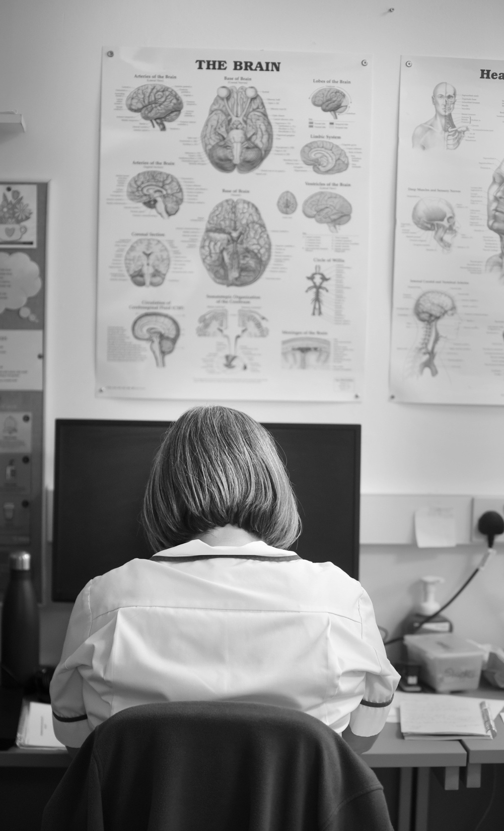
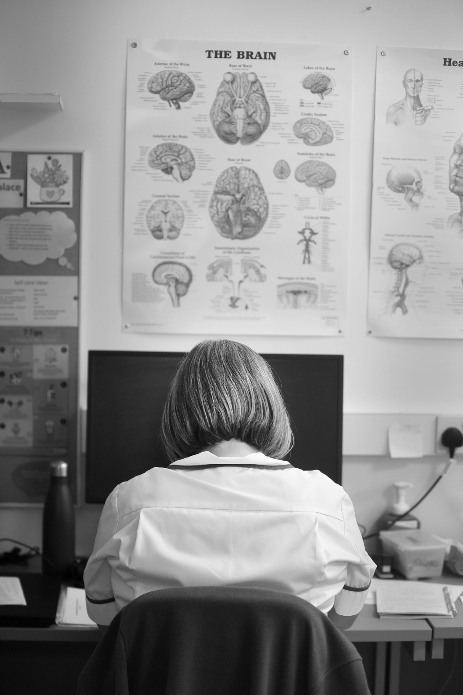
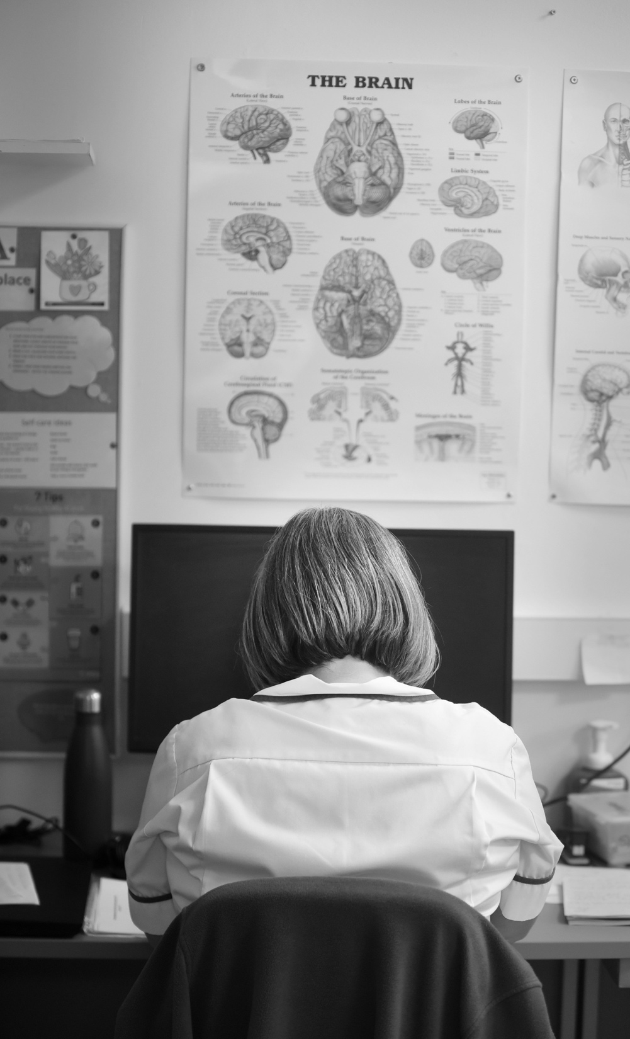

Slide 4
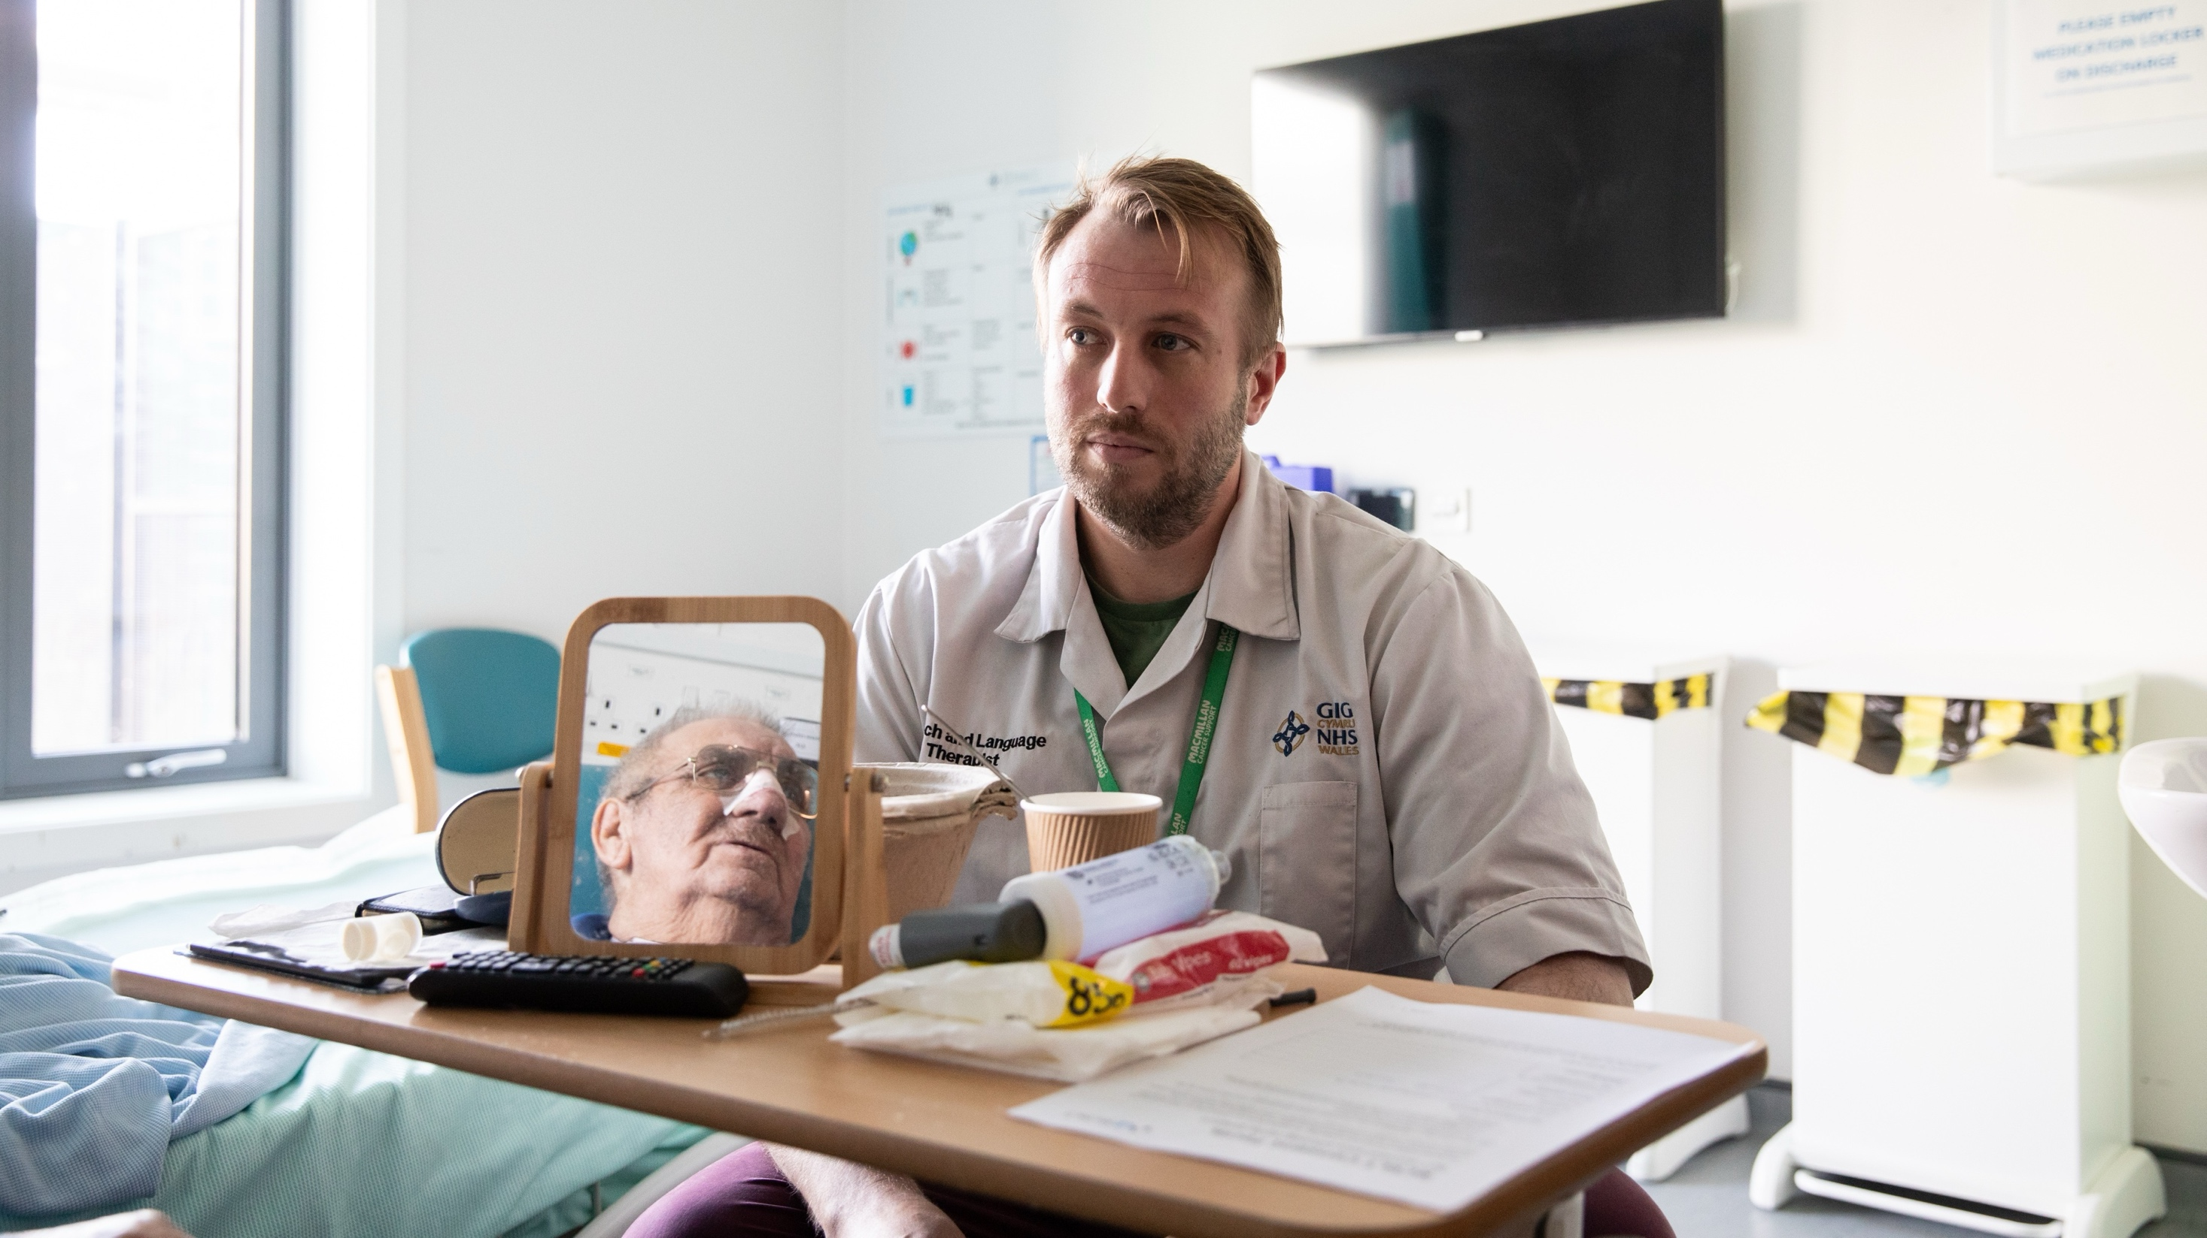

Slide 5
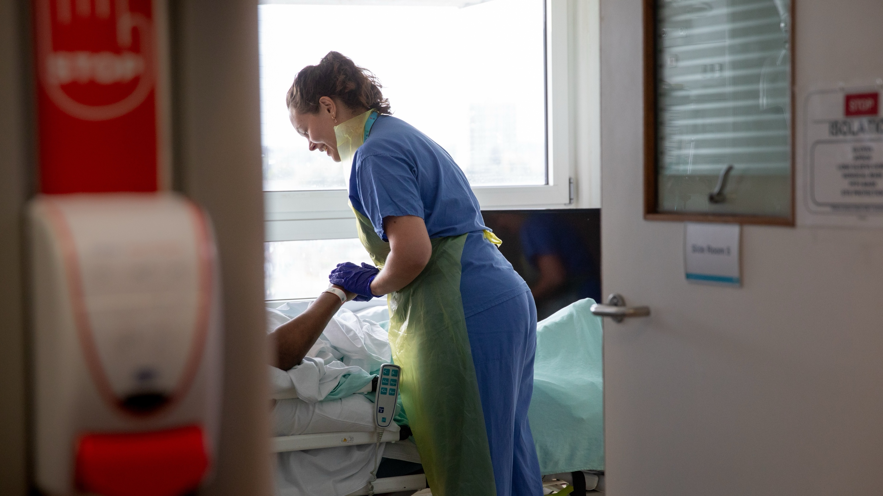

Slide 6
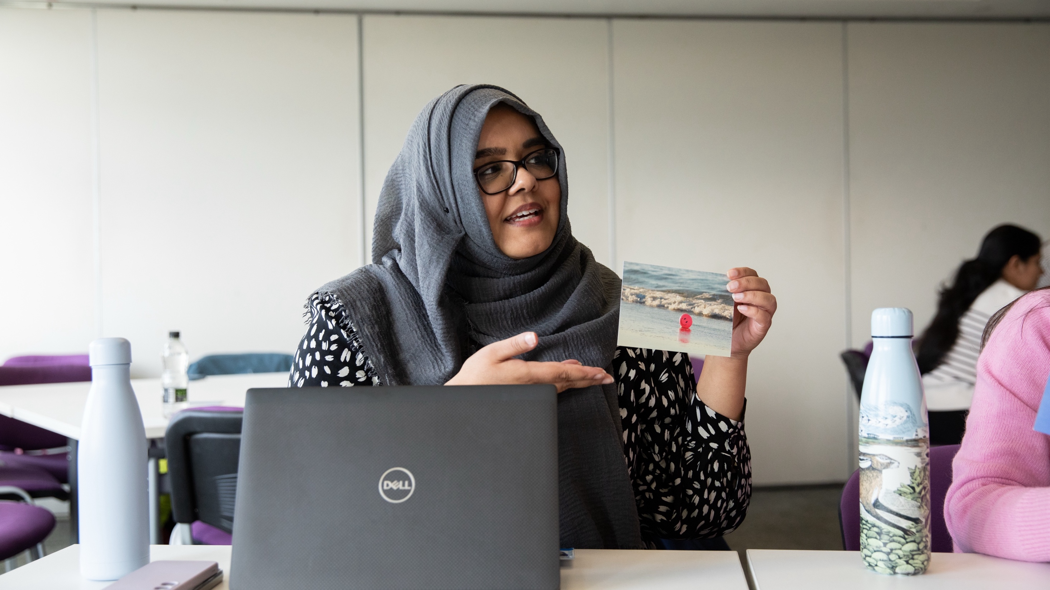

Slide 7
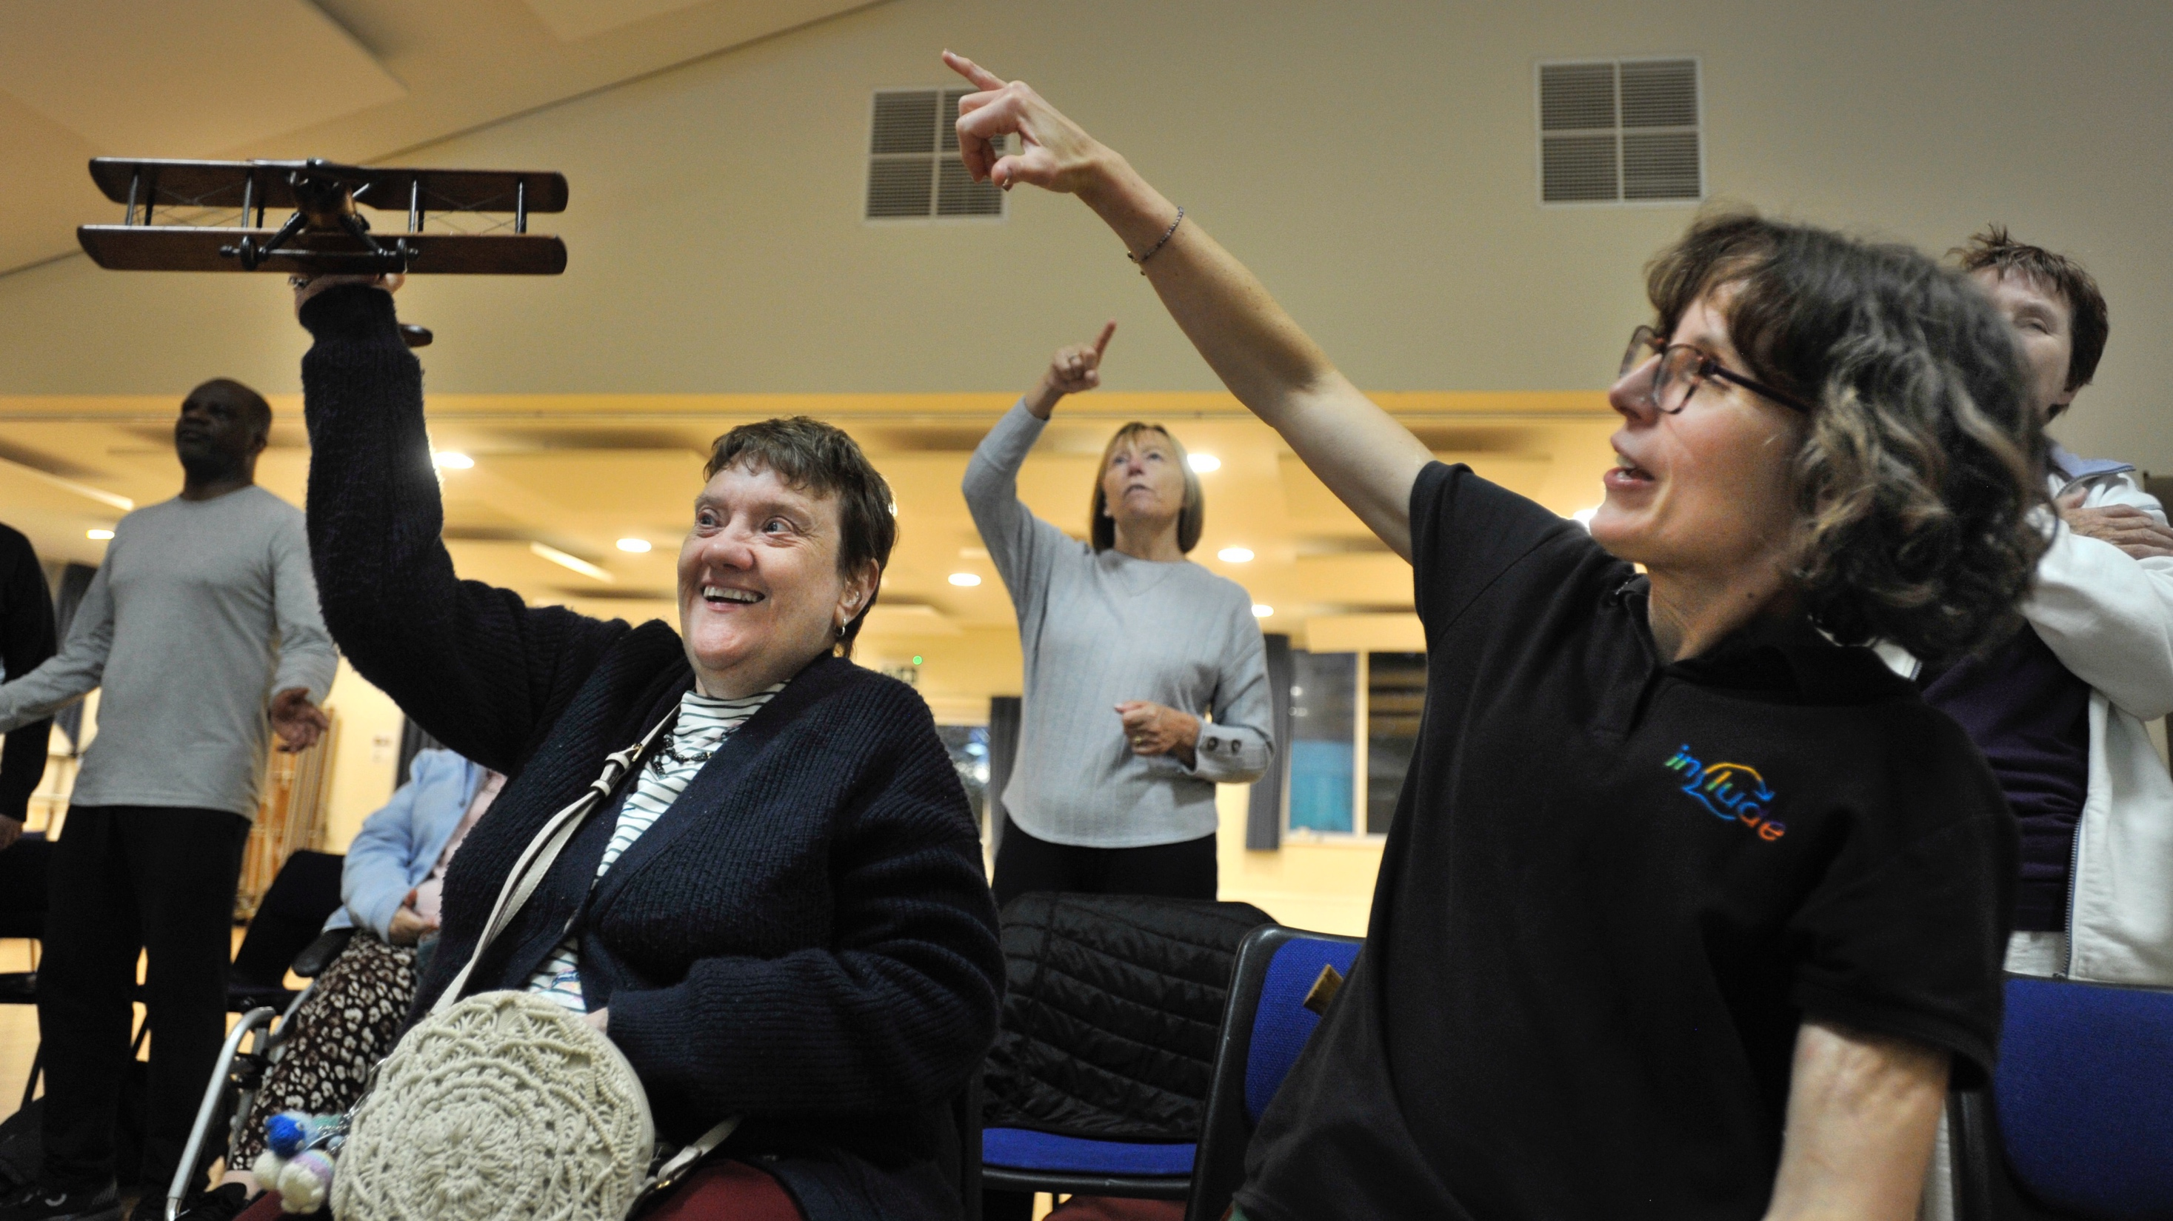

Slide 8
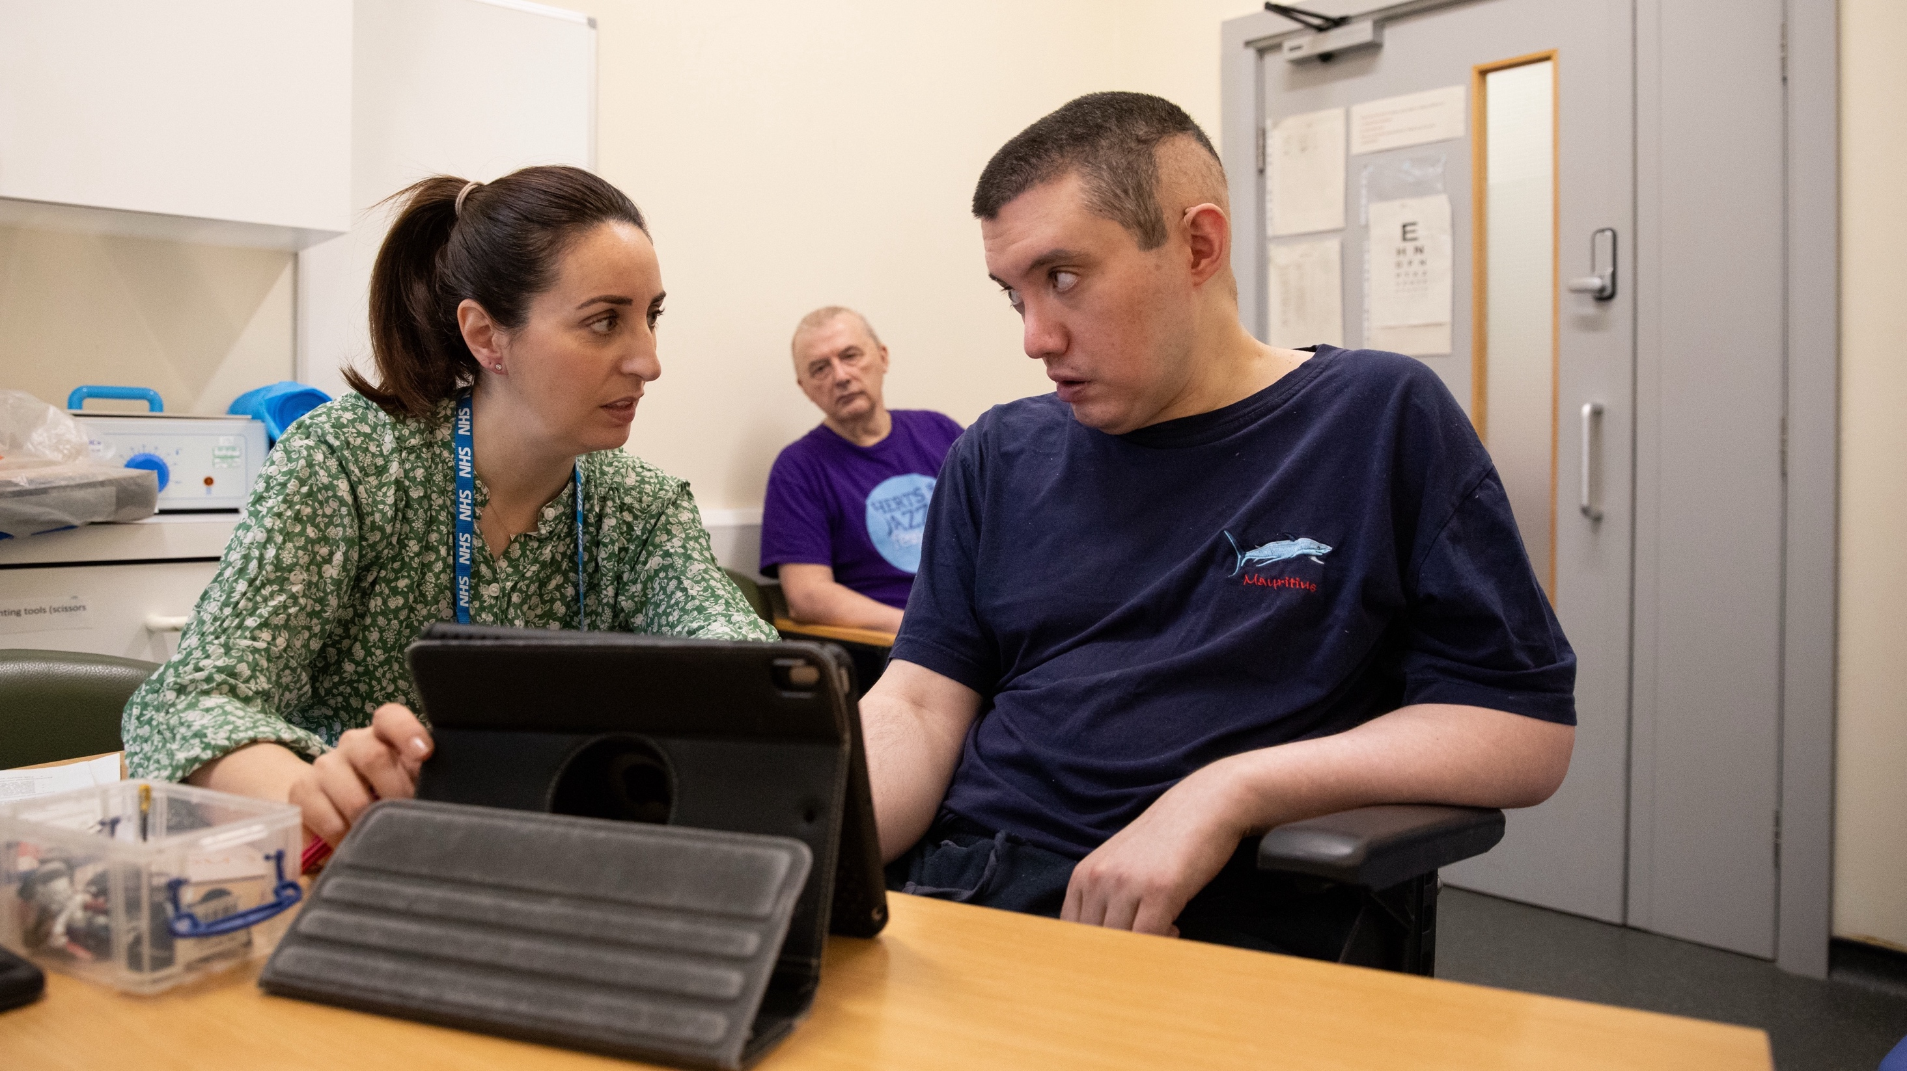

Slide 9
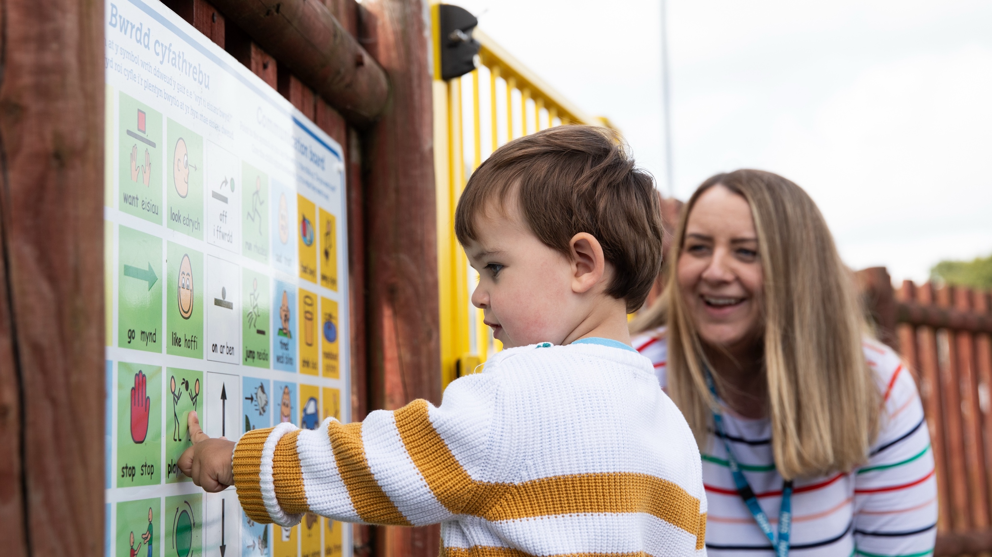

Slide 10
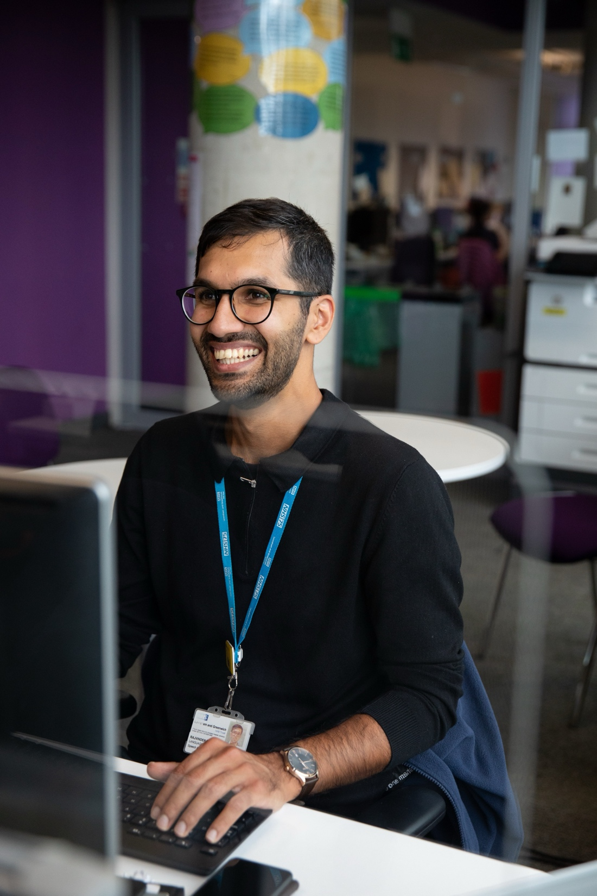

Slide 11
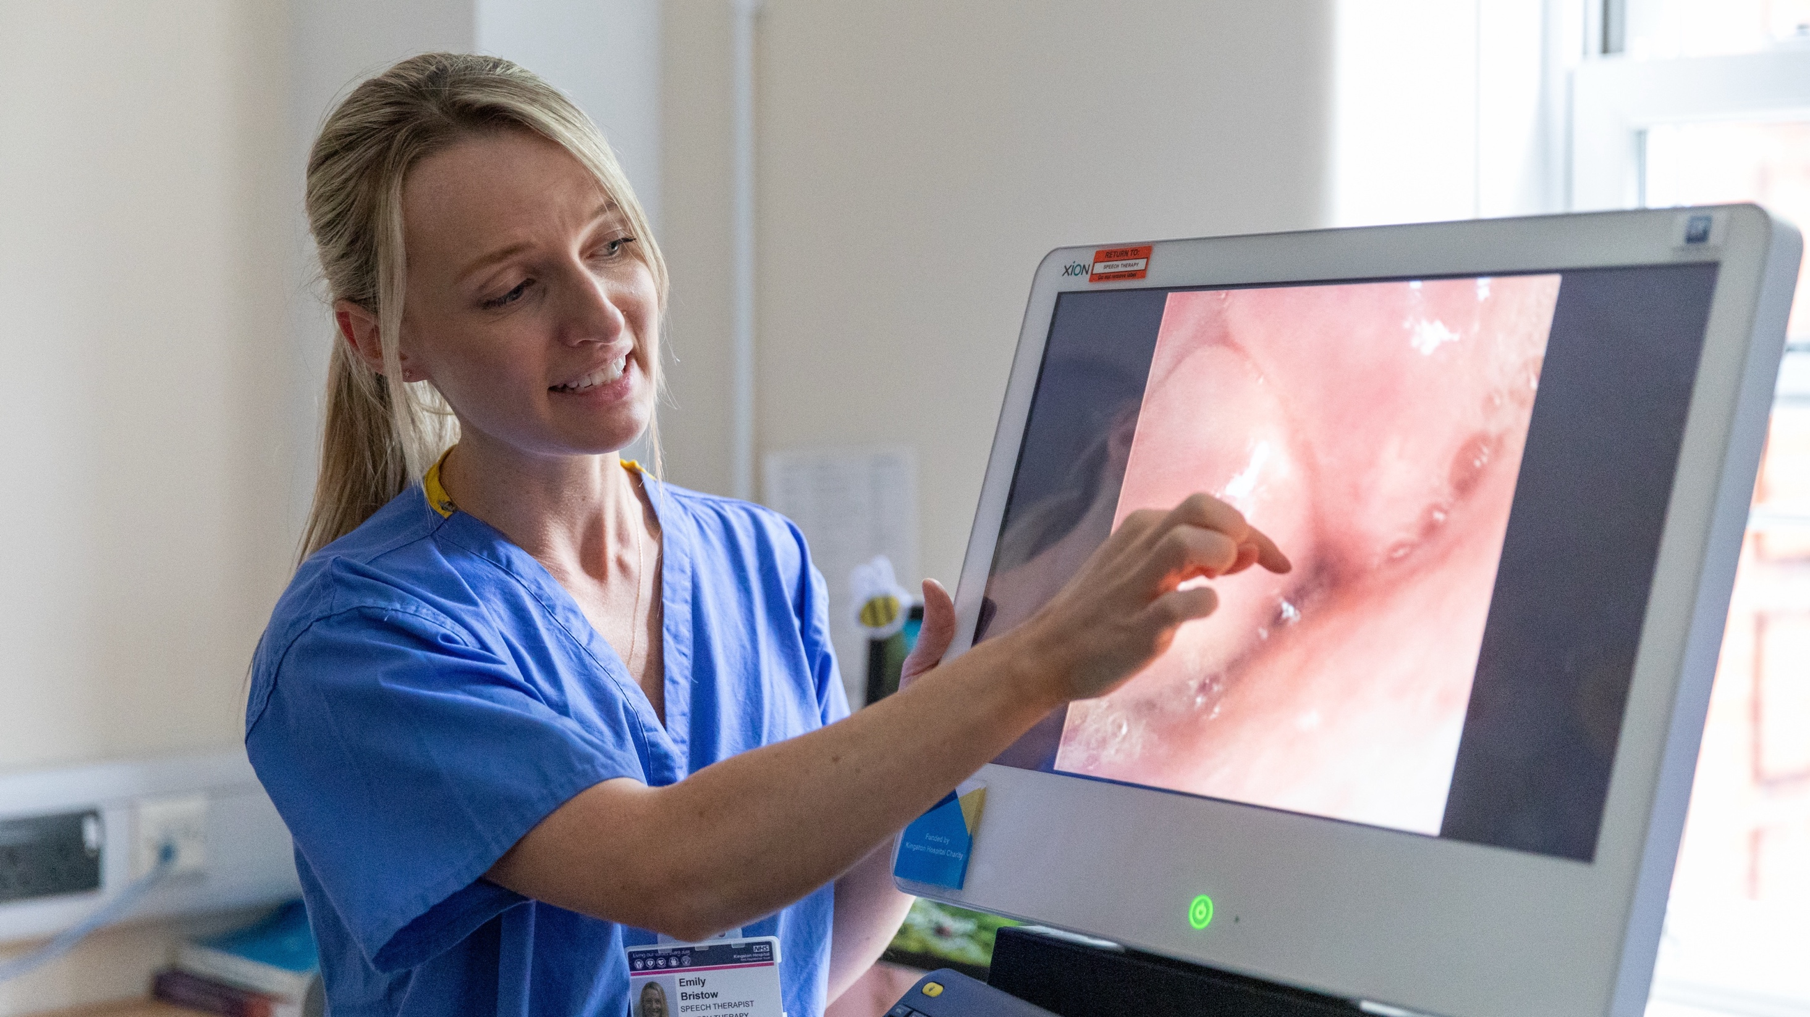

Slide 12
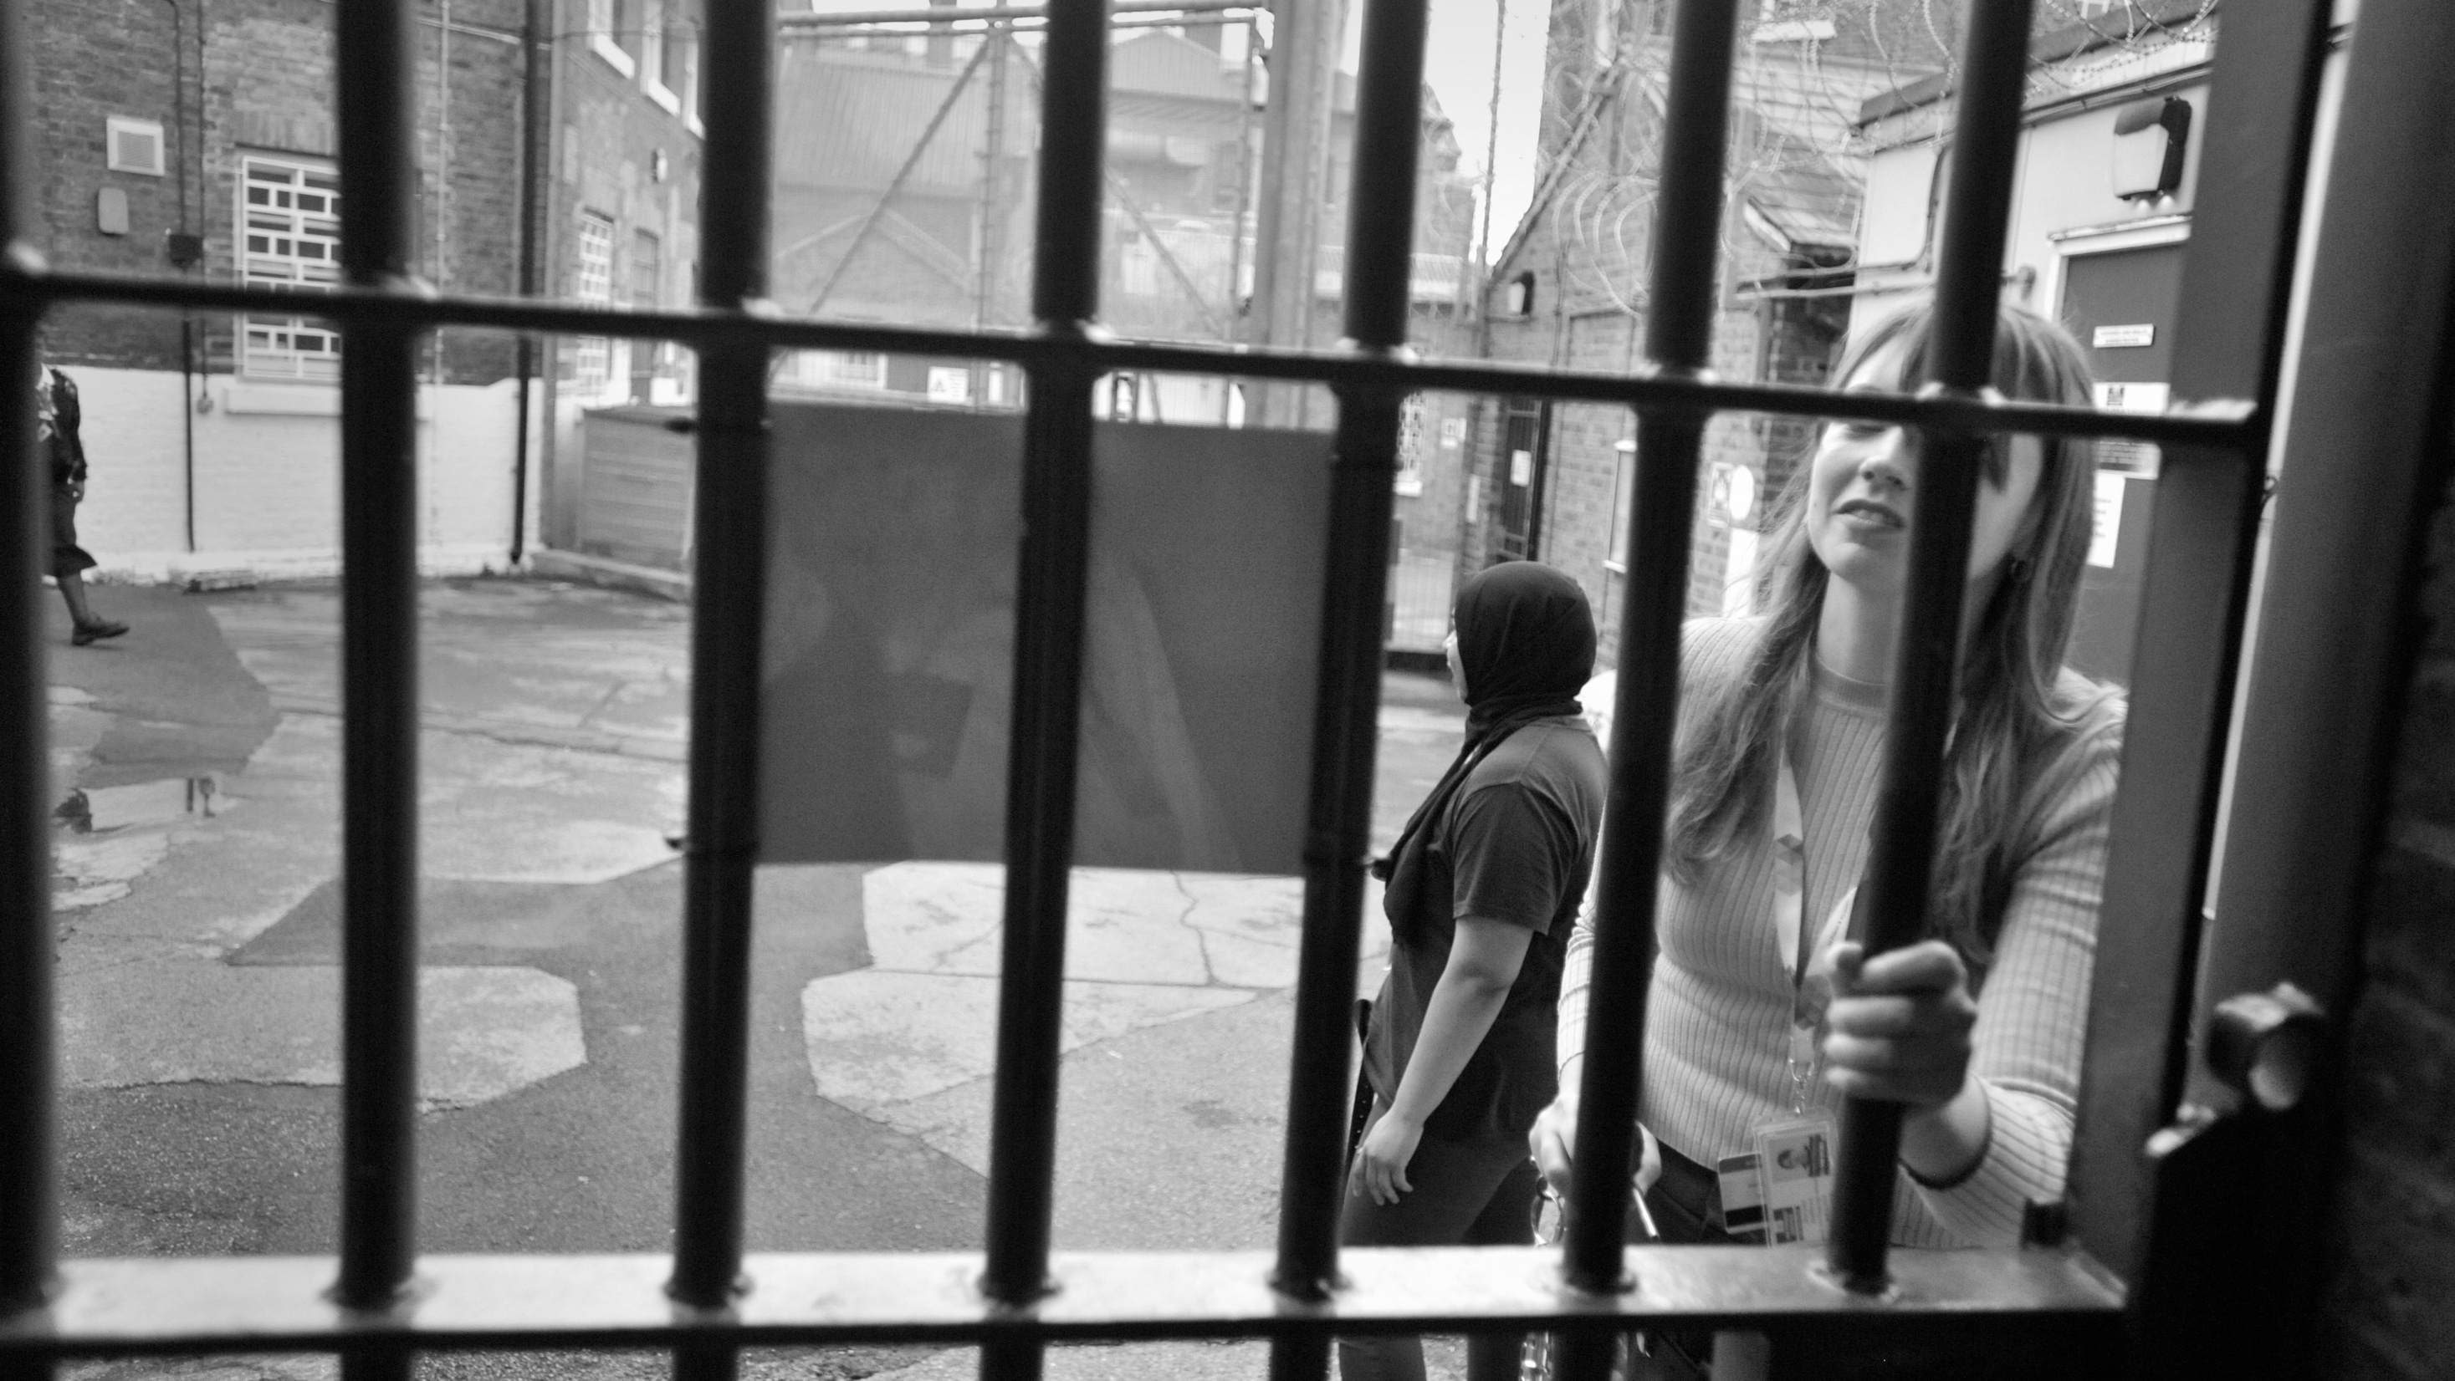

Slide 13
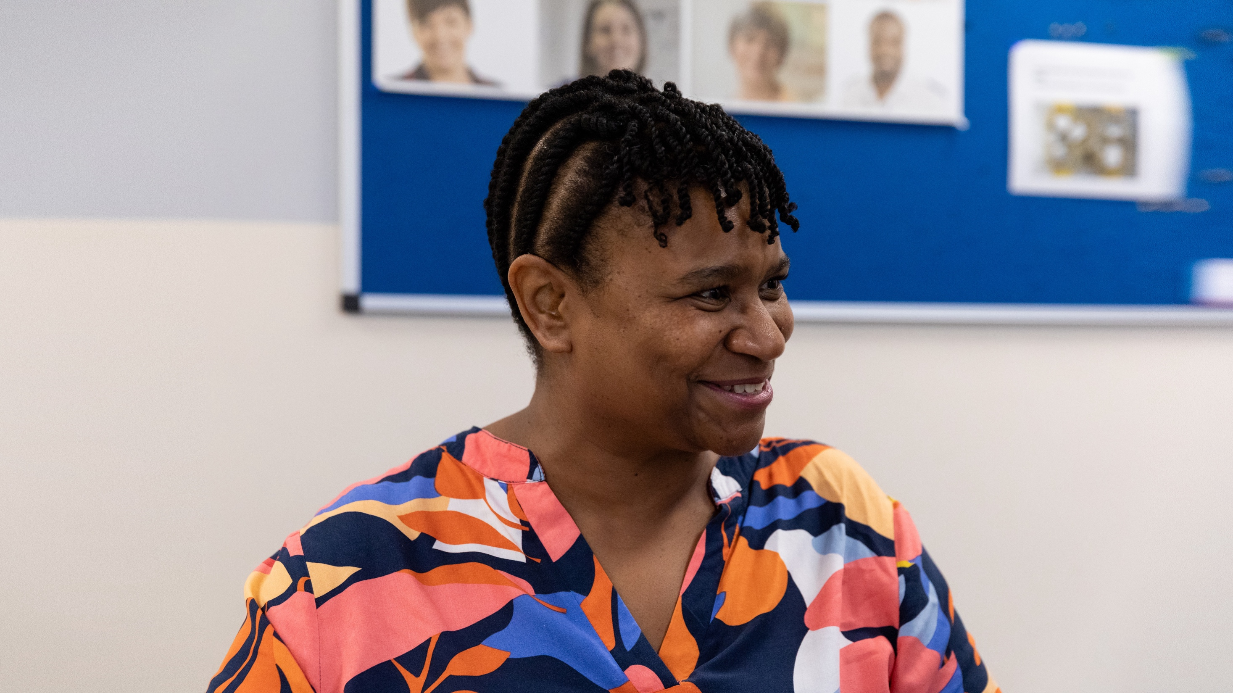

Slide 14
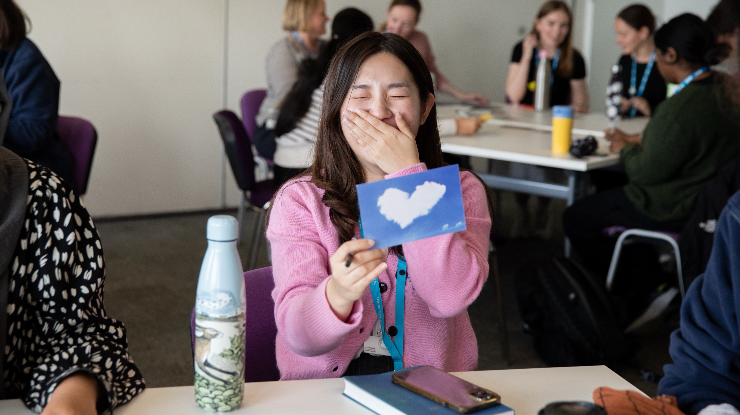

Slide 15
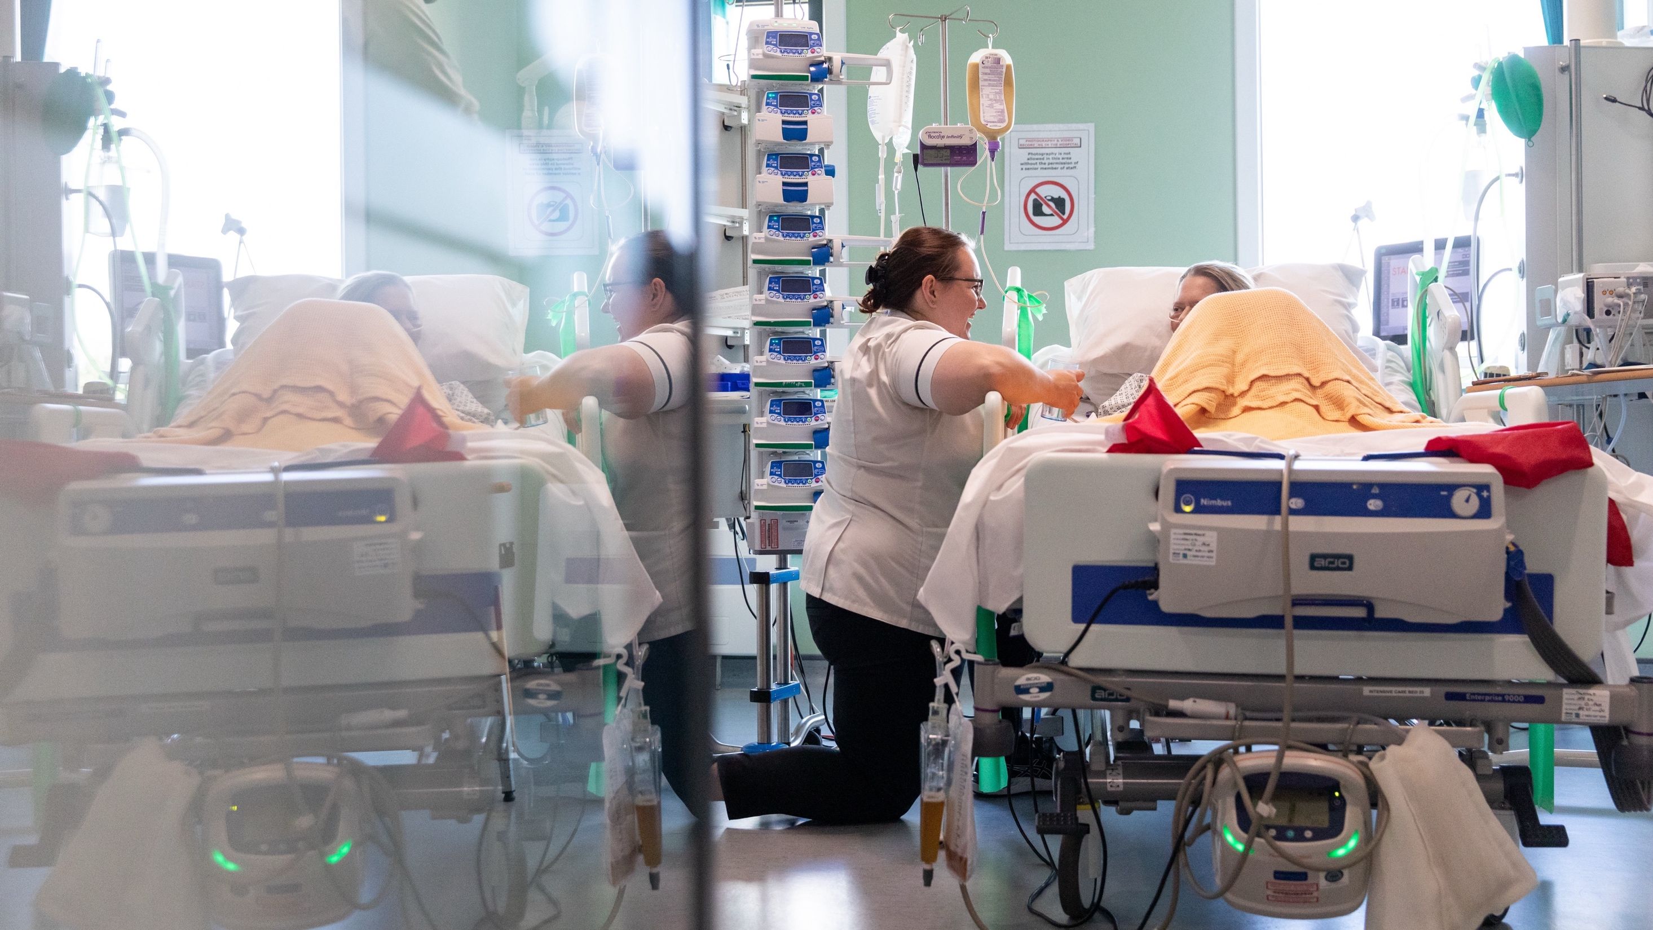

Slide 16
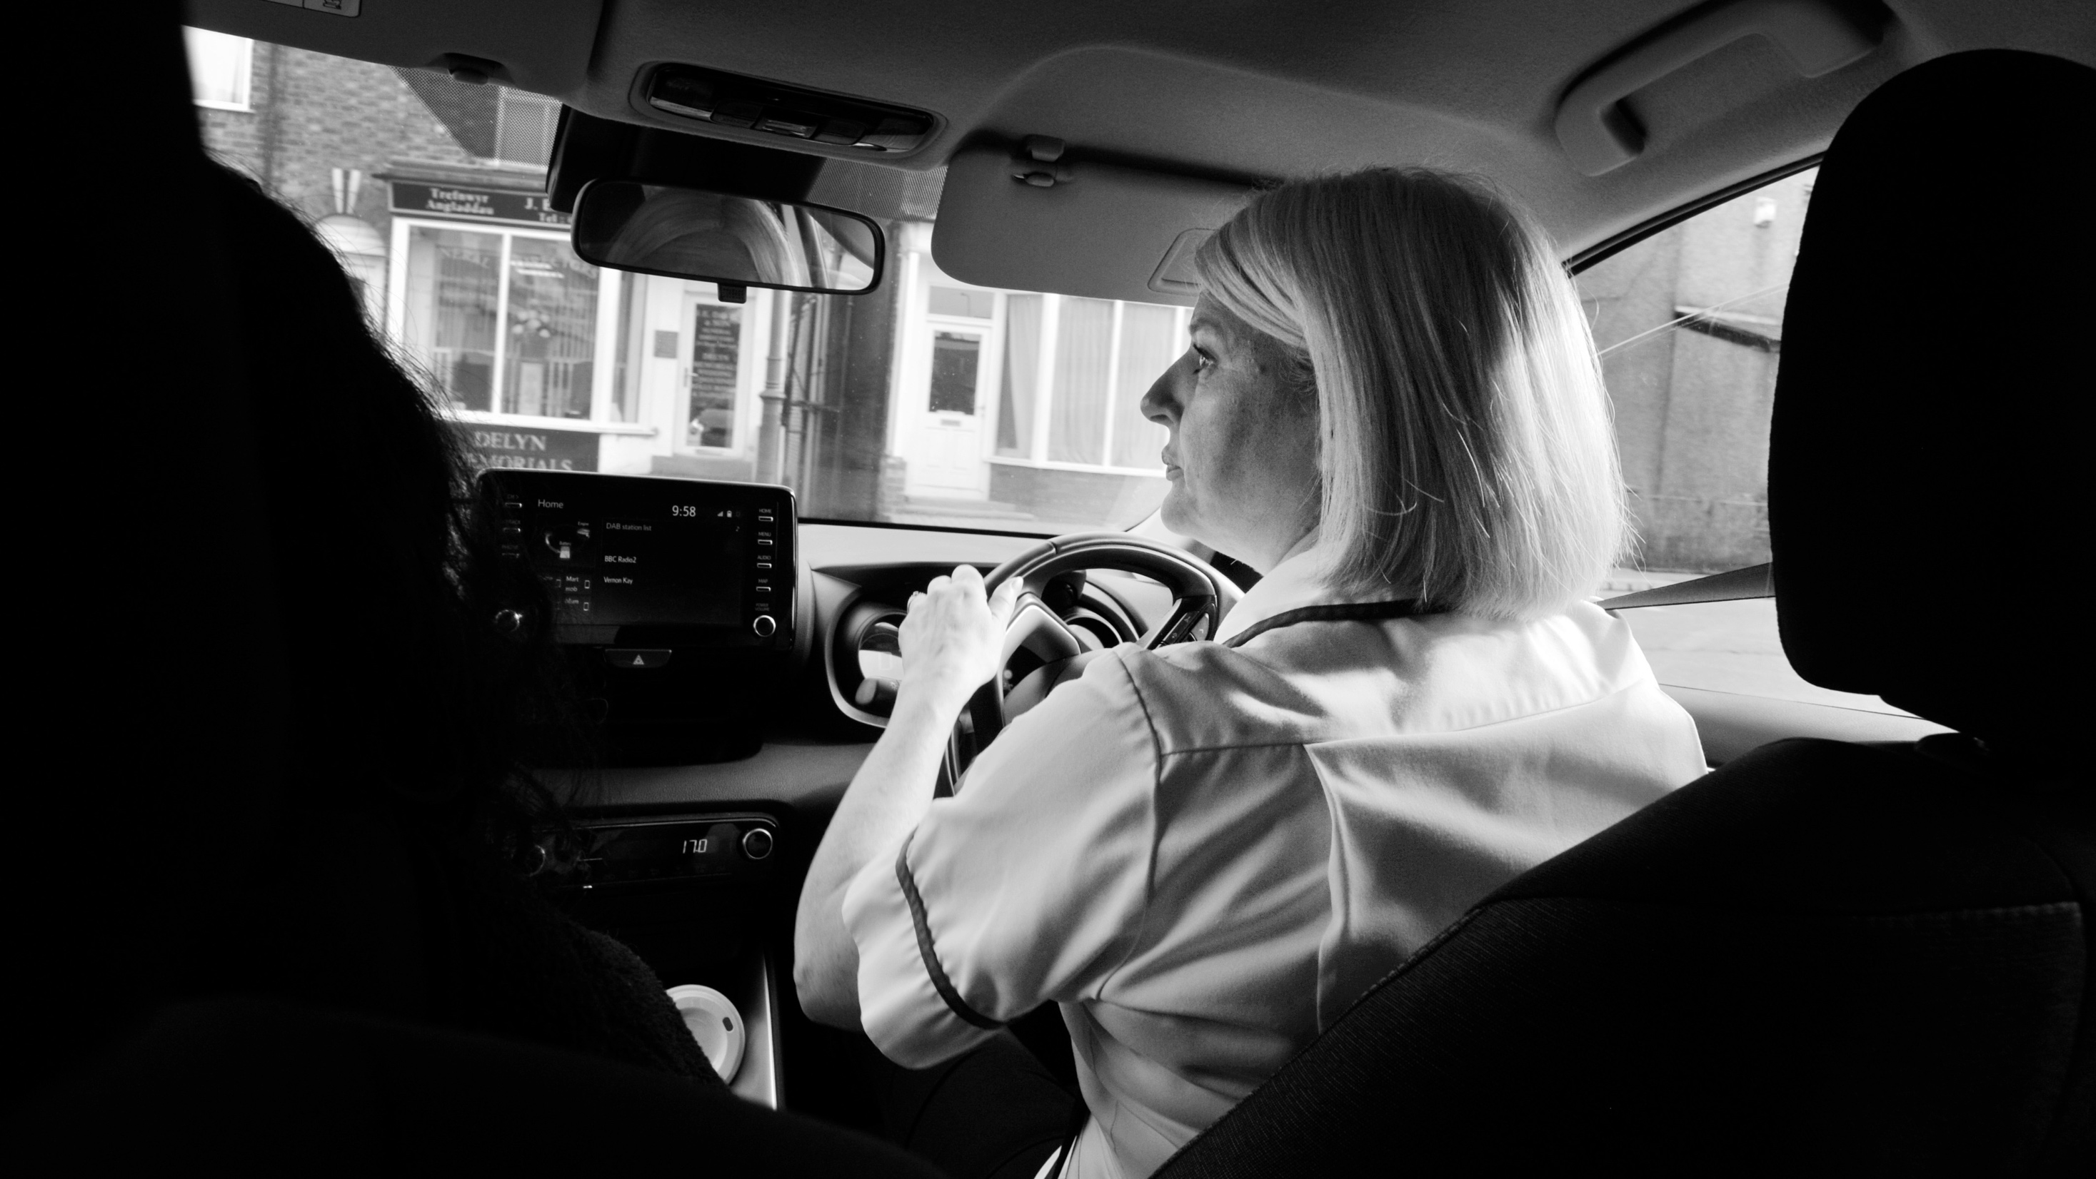

Slide 17
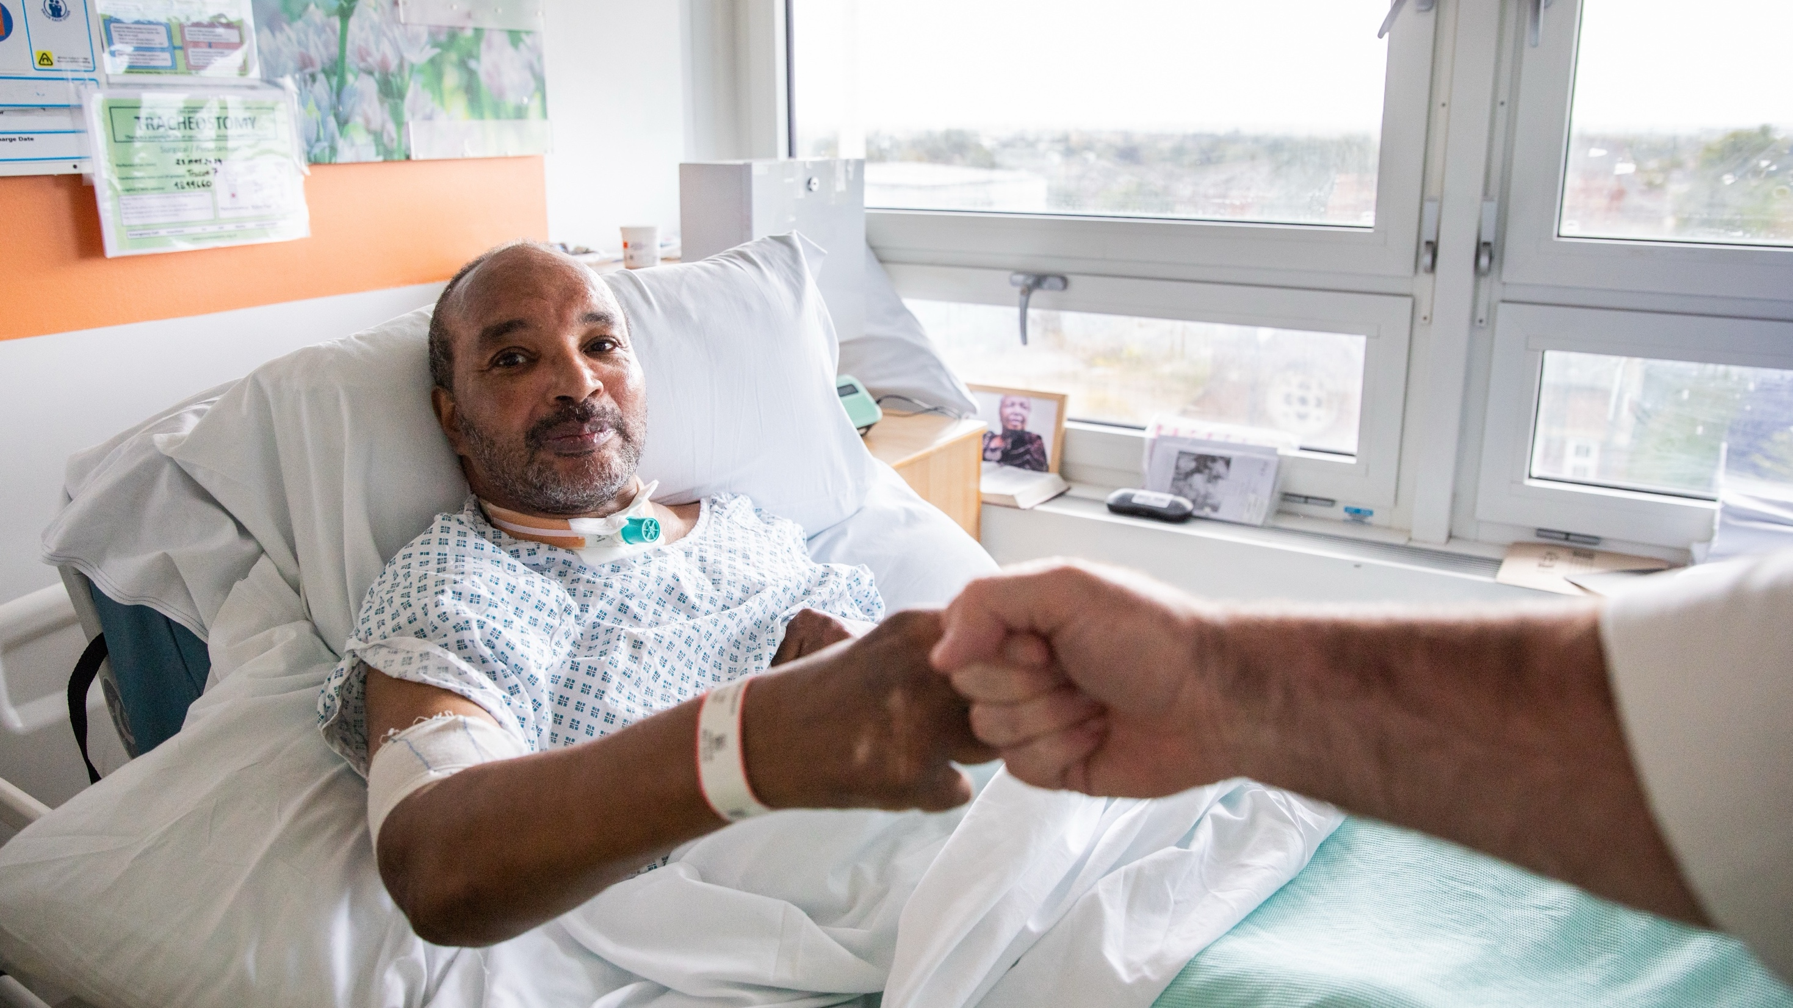

Slide 18
Find out more about how we’re celebrating RCSLT at 80 by visiting rcslt.info/RCSLTat80

