Slide 1













A collaborative approach to accessible examinations
Launch of the fourth edition of Language of Examinations:
Guidance for accessible language, teaching and assessment

Slide 2
Objectives
1
Explore the collaborative journey behind the publication and the partnerships that have supported its development
2
Understand the purpose and key updates within the fourth edition of the Language of Examinations
3
Understand the importance of accessible language across learning, teaching, assessment, examinations and its role in promoting accessibility, fairness and equity
4
Consider how the guidance can be applied within your role to identify and reduce unnecessary linguistic barriers in classroom materials, activities, assessments and examinations
5
Learn about the next steps in supporting accessible and inclusive practice through continued collaboration and shared learning

Slide 3


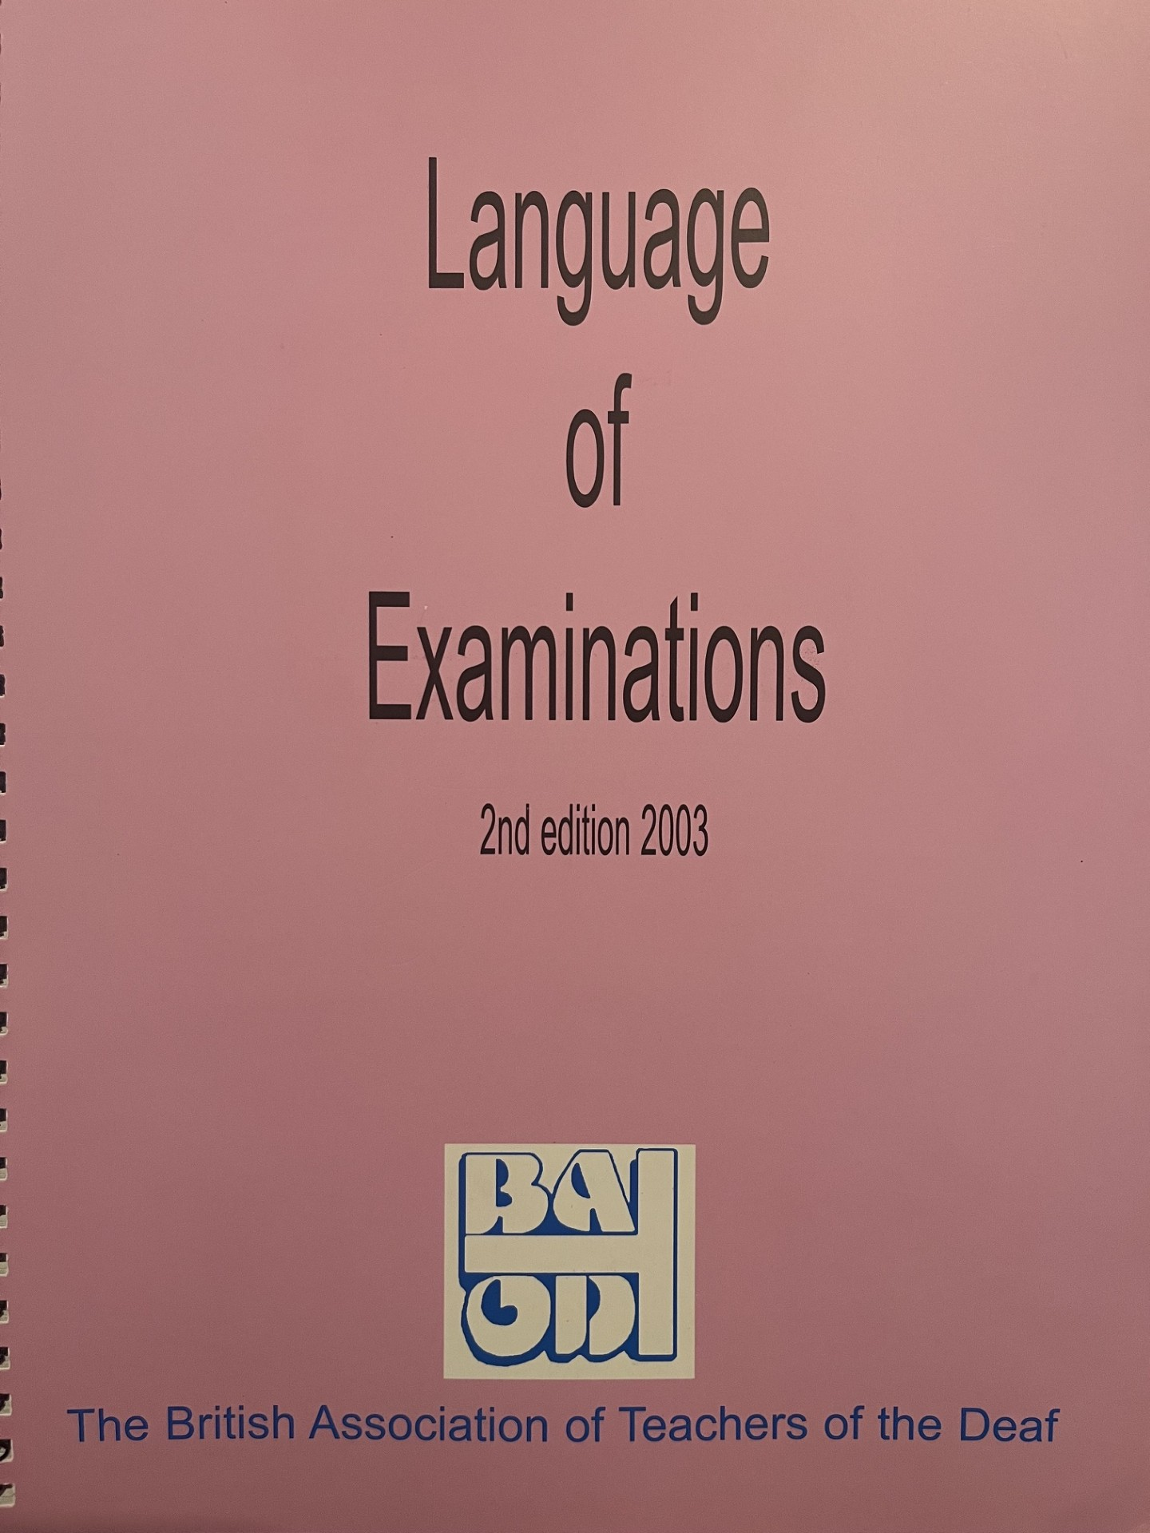

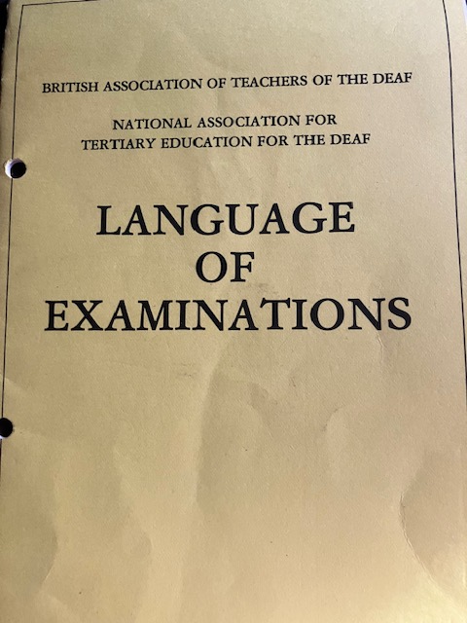
Publication history 1989 - 2026

Slide 4
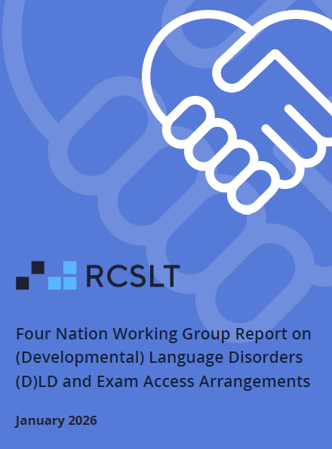
Four nation working group
Established in April 2025
Focus on Developmental Language Disorder and Exam Access from a MDT perspective
Report published in January 2026
List of recommendations

Slide 5
Expansion of the working group
SaLTs
Communicate-ed
After the report:
BATOD
PATOSS
Nasen
Afasic
Specialist Assessors / Teachers
British Dyslexia Association (BDA)
NAEO
CIEA

Slide 6
Language of Examinations fourth edition:
Part A. Understanding language accessibility
Chapter 1 – Introduction
Chapter 2 – Language modification in public examination
Chapter 4 – Professional expertise in language accessibility
Chapter 5 – Language accessibility, awarding bodies and regulation
Chapter 3 – The evidence underpinning language accessibility

Slide 7
PART B. Applying language accessibility in practice
Chapter 6 – Practical principles of language modification
Chapter 7 – Applying language modification principles in practice
Chapter 8 – Examples of questions with suggested modifications
Chapter 9 – Legibility and layout
Language of Examinations fourth edition:

Slide 8













The importance of language for testing knowledge
Сандип хочет выяснить, влияет ли температура на скорость поступления воды к листьям. Подумайте о том, какое исследование вы могли бы провести, чтобы выяснить, влияет ли температура на скорость поступления воды к листьям.
Sandeep souhaite savoir si la température influe sur la vitesse à laquelle l'eau atteint les feuilles. Réfléchissez à une expérience que vous pourriez mener pour déterminer si la température influe sur la vitesse à laquelle l'eau atteint les feuilles.
Notes:
UK Key Stage 2 (KS2) Science SATs national curriculum assessment.
Concepts vs understand the question when don’t know the language (vocabulary, grammar, script).
To help with script, could have a reader to turn into speech
CLICK maybe you heard word “temperature” in there.
CLICK A pictures helps a bit with vague topic, but still very little idea....
CLICK In French,
maybe understand more, maybe I am missing a few words, but can get the general context and idea.
For a child with language difficulties, their understanding of their primary language might be similar to my understanding of French.
Symbols really help with unknown vocabulary.

Slide 9
LANGUAGE
Structure
Vocabulary Grammar
Meaning
Sandeep wants to find out if the temperature affects how quickly the water gets to the leaves. Think about an investigation you could do to find out if the temperature affects how quickly the water gets to the leaves.
Notes:
However, language consists of structure and meaning.
To understand the meaning, you have to understand both the words and the structure of the sentences that they are placed in.
Both vocabulary and grammar are important.
If we look at the question in English…
CLICK A child with language difficulties might understand individual words (especially with symbols), but still not understand the total meaning, because they don't understand the grammar.

Slide 10
The importance of language for testing knowledge
Sandeep wants
  to find out
    if the temperature affects
      how quickly the water gets to the leaves.
Think about an investigation
  you could do
    to find out
      if the temperature affects
        how quickly the water gets to the leaves.
Multiple embedded clauses
Passive sentence
"The seeds can be blown by the children’s mouths or with a fan.
Explain why the fan helps to make the test fair"
Notes:
If we break this sentence down into its component parts, we can see that there are multiple embedded clauses.
hard for a child with a language disorder to understand.
CLICK here is another KS2 Science example. This one has a passive sentence that could easily have been active. This will also cause problems.

Slide 11
LANGUAGE
MODALITY
Structure
SPEECH
SIGN
Vocabulary Grammar
Meaning
WRITING
Context
purpose
audience
Notes:
Language not in vacuum,
CLICK used in a context, for a particular purpose and audience,
This affects words and sentence structure chosen,
and meaning, which may not be literal meaning of the sentences.
Language is abstract, to make it concrete and available to other people we have to express our language
CLICK using one of the three main modalities: speech, sign or writing

Slide 12
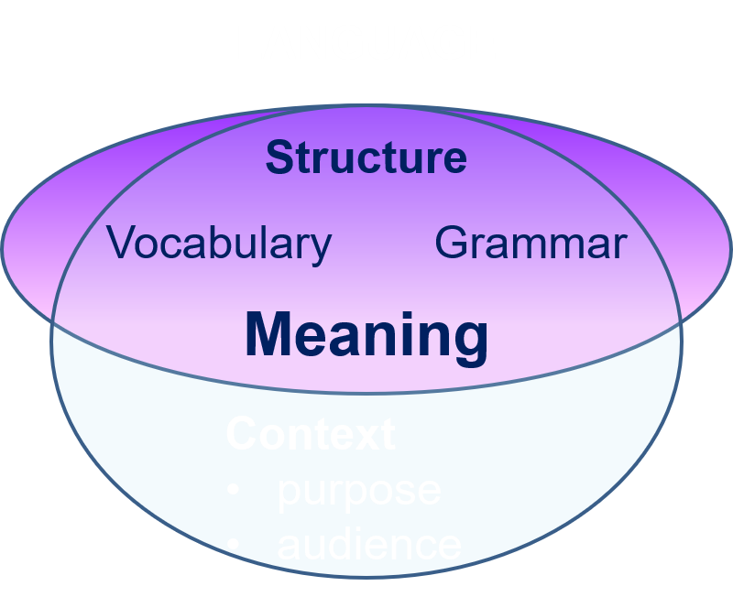
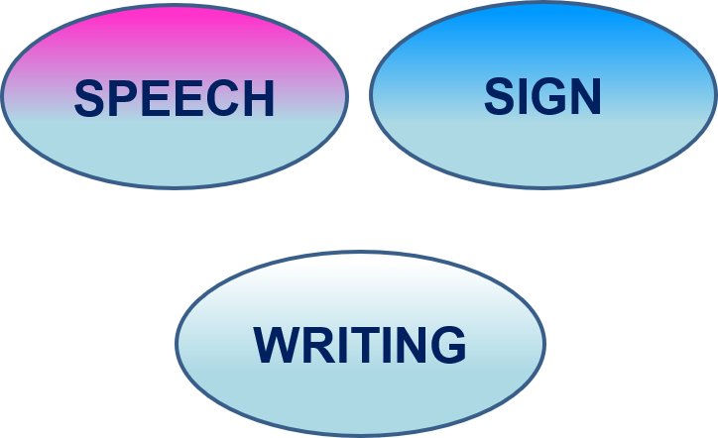
A
EXPRESSION
EXPRESSION
A
A
Message, thought, question, instruction etc
COMMUNICATION
Symbols
Pictures
B
B
COMPREHENSION
B
COMPREHENSION
Notes:
Communication: Person A has message etc
want Person B to receive.
CLICK person A turns the message into language: words, sentences, narratives.
Express this using speech, sign or writing
CLICK For Person B to understand the message,
first have to be able to hear speech, or see sign or writing.
For speech and sign which are transitory, they also need to hold the string of speech or signs in short-term memory while processing the language into meaning.
For writing, they need to be able to decode the script.
Then, use language knowledge to identify the structure and meaning of the words, sentences and narratives, using context to help them to draw inferences.
Even if B can see/hear the message, they won’t understand it if they don’t understand the meanings of the words or the sentence structures, or they draw incorrect inferences from the combination of the language and context.
Language used by A needs to match language knowledge of B.
In classroom, curriculum mainly taught and assessed through language,
either from spoken language used by their teacher or written language in textbooks.
So, teachers and textbook writers need to modify their language and also…
CLICK provide additional supports such as symbols and pictures to ensure that all children have the maximum chance of learning.

Slide 13
Norbury et al., 2016, Journal Child Psychology Psychiatry, 57: 1247-57
Difficulties talking and/or understanding primary language
Stammering
Language disorder
Speech Sound Disorder
9.9%
Language Disorder associated with…
Deafness
genetic conditions e.g. Down syndrome,
brain injury
autism
intellectual disability
Developmental Language Disorder (DLD)
2.3%
7.6%
Notes:
From the perspective of SLT, children can struggle to talk and understand for a variety of reasons.
CLICK They may have problems speaking: SSD or stammer.
Exams: only affect oral exams.
Learning: may not affect understanding and learning, only ability to express orally
However, having difficulties with language,
Exams: affect all exams in any modality,
Huge impact on learning, given that almost all of education is communicated via language
CLICK language disorder affects nearly 10% of children
can be split into
CLICK language disorder associated with another condition,
or can be the primary need, as in DLD.
CLICK 2.3% of children have language disorder associated with another condition.
Not all children with these conditions have a language disorder, but many do.
CLICK however, 7.6% of children have DLD.
All children who have DLD have a language disorder, as that is the defining feature.
Norbury found that by age 5 only about half had been identified

Slide 14

2 children in every classroom have DLD
DLD is a life-long disability
around 160,000 16-18 yr olds in the UK
Many are unidentified and undiagnosed
Notes:
7.6% of children = 2 in every class (with an additional child per class with a language disorder associated with another condition).
DLD is a life-long disability and so this translates to about 169k 16-18 year olds with DLD in the UK
Unidentified and undiagnosed because language is abstract,
so you can’t directly see a language disorder.
To spot that a child is struggling with language, you have to spot that they are struggling to understand, learn, understand or find words, put words together in sentences in the right order with all the grammatical bits in the right place.
Children often cover up language difficulties by copying others, reducing communication attempts, changing their behaviour to reduce communication demands,
May release frustration or direct others’ attention elsewhere.
So, ?external signs: inattentiveness, not listening, shy, naughty
Public and professional awareness of DLD is low.
Partly hidden nature of language and language difficulties,
Partly because of terminological confusion.
International consensus on what to call it was only reached in 2017,
before that there were 132 different terms, 33 used frequently.
Now have consensus on the name, awareness can grow.

Slide 15
Educational and longer-term impact
Barriers to literacy and/or numeracy
Difficulties accessing curriculum and assessment language
Greater risk of educational disengagement
Lower academic attainment
Fewer qualifications
Reduced progression to further education, training and employment
Increased risk of poorer emotional wellbeing and mental health
Impact varies between individuals and may be compounded by inaccessible learning and assessment environments and co-occurring needs.
Notes:
Read from slide

Slide 16
Difficulties talking and/or understanding primary language
Stammering
Language disorder
9.9%
Speech Sound Disorder
Language Disorder associated with…
deafness
genetic conditions e.g. Down syndrome,
brain injury
autism
intellectual disability
Developmental Language Disorder (DLD)
7.6%
2.3%
Dyslexia
ADHD
DCD,
dyspraxia
EBD
Notes:
The children with DLD who are the most difficult to spot are those where only language is affected.
SSD is more common in children with DLD, and therefore those children are more likely to be spotted and referred to an SLT, who hopefully would then also spot their DLD.
significant overlap with other conditions
CLICK like dyslexia – 50% overlap
CLICK with ADHD, DCD, EBD
Because there is greater awareness of these other conditions and their behavioural manifestations are more obvious, those spotted and diagnosed.
can sometimes mean that the co-occurring DLD may be missed.
Ideally any child with these other conditions also assessed for DLD due to the high levels of co-occurrence.
Just to note that there is much confusion around the term SLCN,
which covers a different number of these groups according to profession or nation.
SLTs, all children on this slide have SLCN.
For English education system, having a primary need of SLCN, cover DLD and SSD and maybe some of the children with overlapping conditions – depending which condition is "primary".
So, children who need language modification, may have any of these diagnoses.
However, if 10% of children are struggling to use and understand language, this is of huge importance to both our education and exam system.

Slide 17
EXPRESSION
EXPRESSION
Examiner
Examiner
Message, thought, question, instruction etc
COMMUNICATION
Symbols
Pictures
Student
Student
COMPREHENSION
COMPREHENSION
Notes:
So, thinking of the process of exams/assessment.
The examiner/assessor wants to communicate the question to the candidate. uses language, expressed usually in writing.
CLICK People with language difficulties will struggle primarily with the language.
Comprehension can break down if they don’t understand the meanings of the words or the sentence structures, or they draw incorrect inferences.
Difficulty if language knowledge not matching the language used.
Therefore. in exam/assessment context, yes, need to ensure content is presented in a modality they can access, but that is not sufficient.
The exam question writer needs to consider that the audience includes 10% of students with language difficulties.
With these large numbers, accessibility by design and modification at source will be crucial. Language needs to be accessible and not use complex vocabulary, or sentence structures, or require inferencing, unless that is what is being tested.
CLICK The normal way of working for children with severe language disorders (including DLD) may involve not only language modification, but also the addition of sign, symbols and pictures, so those can help in exams and assessments too.
Even if do understand language, may find harder and slower to process. Additional time, breaks and repetition therefore helpful,
Those with language difficulties need range of access arrangements, flexibility is key, even within an exam.
but the main accommodation needed is modified language to reduce the processing load and improve comprehension.

Slide 18
EXPRESSION
EXPRESSION
Student
Student
Message, thought, question, instruction etc
COMMUNICATION
Symbols
Pictures
Examiner
Examiner
COMPREHENSION
COMPREHENSION
Notes:
Once the student has understood the question, they then need to give a response, so the roles are reversed:
CLICK Now the student needs to communicate a message to the examiner using language.
While they may have a good grasp of the concept, they may struggle to convey that through language if they don’t have the words, sentence structures to do so. These things will need to be explicitly taught where it is required.

Slide 19
Key messages
Language is abstract, but made concrete through different modalities
10% of students have language difficulties in their primary language
Changes in modality don’t reduce language demands per se
Language difficulties are a major barrier to
  Learning, and
  Demonstrating your learning
Accessible language is an equality issue for 10% of students,
Including / especially the 7.6% with DLD (who may or may not be diagnosed)
Notes:
Read from slide

Slide 20
Co-occurrence is common rather than the exception
Co-occurrence is common rather than the exception
01
Multiple needs can contribute to examination disadvantage
02
A primary need alone may not capture the learner’s full profile
03
Combined needs can create more complex and significant barriers
04
Language demands can amplify cumulative impact in assessments
05
Notes:
One of the most important principles to recognise is that co-occurrence is common rather than exceptional. Learners rarely present with a single, isolated area of need.
Multiple needs can contribute to examination disadvantage, and a primary diagnostic label may not fully reflect the learner's functional profile. For example, a learner identified with dyslexia may also experience language difficulties, attentional challenges, or sensory needs that affect assessment access.
When needs occur together, barriers are often more complex than would be predicted by looking at each difficulty separately. In timed assessment conditions, these combined challenges can have a significant impact, particularly where language demands are high.
For this reason, decisions about assessment accessibility should begin with a holistic understanding of the learner rather than focusing solely on a single diagnosis.
‹#›

Slide 21











Learners with co-occurring needs
Language, literacy, sensory, attentional and other neurodevelopmental needs frequently co- occur
The interaction between them may influence how a learner accesses an assessment
Notes:
This highlights the broad range of needs that frequently co-occur.
Language, literacy, sensory, attentional, and other neurodevelopmental differences often overlap. While each area may create its own challenges, it is the interaction between them that often determines how a learner accesses an assessment.
This is particularly relevant when considering language accessibility. A learner's difficulties may not stem from one area alone but from the cumulative impact of several interacting needs.
Understanding these interactions is essential if we are to design or modify assessments in ways that remove unnecessary barriers while maintaining validity

Slide 22












Learners with co-occurring needs
Deaf learners may also have a language disorder, dyslexia, autism, ADHD and/ or another developmental or medical condition
DLD frequently occurs with other neurodevelopmental conditions including dyslexia, ADHD and DCD
Important overlap between DLD and dyslexia which may result in more extensive difficulties across oral language, decoding, reading fluency and comprehension
Autistic learners may have homogeneous language profiles and co- occurring language needs as well as literacy or attention difficulties
Notes:
Research consistently demonstrates that co-occurrence is the norm across many learner groups.
For example, deaf learners may also present with developmental language disorder, dyslexia, autism, ADHD, or other developmental and medical conditions. Similarly, developmental language disorder frequently occurs alongside dyslexia, ADHD, and developmental coordination disorder.
There is particularly significant overlap between DLD and dyslexia, which may affect oral language, decoding, reading fluency, and comprehension simultaneously.
Autistic learners may also have co-occurring language differences, literacy challenges, or attentional difficulties.
The key message is that learner profiles are often complex and multifaceted. This complexity must be recognised when considering accessibility and assessment arrangements.
‹#›

Slide 23











Learners with co- occurring needs
1
2
3
The effects of co-occurrence are not necessarily additive or predictable
A learner may have strengths in one area that compensate for difficulties in another but......
Co- occurring needs may interact to create a significant barrier when working in timed assessment conditions
Notes:
When we think about co-occurrence, it is important not to assume that the effects will simply add together in a predictable way.
The impact of co-occurring needs can vary considerably from one learner to another. A strength in one area may help compensate for a difficulty in another. For example, strong vocabulary knowledge may support reading comprehension despite decoding weaknesses.
However, timed assessment conditions can reduce the effectiveness of compensatory strategies. Under pressure, interacting needs may create barriers that are far more substantial than might be apparent in everyday learning situations.
This is why individual analysis remains so important.

Slide 24













Decisions should start with the individual learner profile
01
The learner’s individual functional profile
02
Evidence of need
03
Normal way of working applicable to the assessment arrangements
04
Careful analysis of the linguistic and cognitive demands of the assessment task
Notes:
Accessibility decisions should always begin with the learner, not the diagnosis.
We need to understand the learner's functional profile: how they process information, what creates barriers, and what supports effective access.
Alongside this, we need evidence of need and a clear understanding of the learner's normal way of working. Any arrangement should reflect established practice rather than introducing unfamiliar support solely for assessment purposes.
Finally, we must carefully analyse the linguistic and cognitive demands of the assessment itself. Only by bringing all of these elements together can we make valid and defensible decisions.

Slide 25









A diagnostic label alone cannot determine...
01
Whether language modification is required
02
Which linguistic features create a barrier
03
What form any modification should take
04
Whether a proposed modification would preserve the intended construct
Notes:
A diagnosis can provide useful information, but it cannot answer all the questions that matter for assessment accessibility.
A label alone cannot tell us whether language modification is needed. It cannot identify which aspects of language create barriers for a particular learner. It cannot determine what modifications would be most effective. Nor can it establish whether those modifications would preserve the construct being assessed.
Those decisions require detailed analysis of the learner, the assessment demands, and the purpose of the assessment itself.
In other words, diagnosis informs our thinking, but it should never replace professional judgement.

Slide 26













Why multidisciplinary expertise matters
Language accessibility sits at the intersection of several areas of professional knowledge
Multidisciplinary working supports the central distinction between
Language that is essential to the construct being assessed and must therefore be preserved
Language that is not essential to the construct being assessed could be adapted to improve accessibility
Notes:
Language accessibility sits at the intersection of multiple areas of specialist knowledge.
No single profession holds all of the expertise required to understand both learner needs and assessment validity. Effective decision-making therefore depends on multidisciplinary collaboration.
A central challenge is distinguishing between language that is essential to the construct being assessed and language that is not.
Where language is integral to what is being measured, it must be preserved. Where language is incidental to the construct, adaptation may improve accessibility without compromising validity.
Making that distinction often requires contributions from several professional perspectives

Slide 27





















Specialist expertise
Qualified teachers of deaf children and young people
Speech and language therapists
Specialist teachers and specialist assessors
Access arrangements assessors
SENCos, ALNCos, learning & support coordinators and support for learning teachers
Language modifier
Educational psychologists
Teachers and setting leaders
Notes:
This highlights the range of professionals who may contribute to accessibility discussions.
These include qualified teachers of deaf children and young people, speech and language therapists, specialist teachers, specialist assessors, access arrangement assessors, language modifiers, educational psychologists, and school-based inclusion leaders.
Classroom teachers and senior leaders also play a critical role because they understand the learner's day-to-day functioning and normal way of working.
The goal is not for every professional to make decisions independently, but for expertise to be combined in a way that leads to balanced, evidence-based judgement.

Slide 28










The aim....
What is the assessment intended to measure?
To bring together expertise necessary to answer three central questions
What is creating the barrier?
What, if anything, can be changed without changing what is being assessed?
Notes:
The overall aim is to bring together the expertise needed to answer three fundamental questions.
First, what is the assessment actually intended to measure?
Second, what is creating the barrier for this learner?
And third, what, if anything, can be changed without changing what is being assessed?
These questions should remain at the heart of discussions about accessibility, assessment arrangements, and language modification.
If we can answer them clearly and consistently, we are more likely to achieve the right balance between fairness, accessibility, and assessment validity.

Slide 29
Key principles
Maintain the assessment objective
Keep the same knowledge, skill and level of challenge.
Modify the carrier language, not what is being assessed.
Make instructions clear
Use direct, active language.
Keep instructions short and clearly separated.
Make it obvious what the candidate needs to do.
Reduce unnecessary language complexity
Prefer shorter sentences.
Avoid complex clauses, double negatives and unnecessary passive constructions.
Reduce language that requires learners to infer what is meant.

Slide 30
Vocabulary, structure and presentation
Use accessible wording
Prefer familiar words in carrier language.
Retain essential subject-specific terminology.
Avoid idioms, ambiguous phrasing and unnecessarily abstract language.
Use terminology and style consistently.
Make the paper easy to navigate
Use readable text, spacing and clear organisation.
Break up dense information with bullets, tables or headings where appropriate.
Ensure diagrams, labels and other visual material are clear and legible.

Slide 31
Questions and source material
Check the question as a whole
●Is the rubric as clear as the question itself?
●Can unnecessary carrier language be removed?
●Is it immediately clear what response is required?
Check source and stimulus material
●Consider the accessibility of extracts, case studies, diagrams and supporting text.
●Modify examiner-written material where appropriate.
●Consider a glossary where source wording must be retained.
●Avoid unintentionally turning a subject assessment into a reading-comprehension test, unless reading comprehension is what is being assessed.
Key check: Does every word, sentence and piece of information need to be there?

Slide 32
Rubric example
Instead of:
“Attempt any two of the following, ensuring no repetition of topics.”
Use:
“Answer any two questions. Do not choose both on the same topic.”

Slide 33
Example
A garden fence is made from 4 panels, each 80 cm long, and 2 panels, each 1.5 m long.
What is the total length of the fence in metres?
Possible modification:
A garden fence has 6 panels
4 of the panels are each 80cm long.
2 of the panels are each 1.5m long.
What is the total length of the fence in metres?

Slide 34
Example
Identify any two factors which you should avoid when you design a building where physically disabled people must be able to access the building.
Possible modification:
You are designing a building.
Physically disabled people must have access to the building.
Identify two factors to design a more accessible building.​

Slide 35
Example
Original
The yellow alloy brass does not corrode easily.
Brass is a mixture of the metals copper and zinc. The more zinc in the brass, the lighter the colour becomes. More zinc in brass makes it hard-wearing. The bigger the percentage of copper in brass, the easier the brass is to shape. More copper in brass makes the yellow colour darker.

Slide 36
Possible modification
Here is some information about brass
Brass is a yellow alloy. It does not corrode easily.
Brass is a mixture of the metals copper and zinc.
More zinc in the brass makes the brass a lighter yellow colour.
If there is a bigger percentage of copper in the brass, it will be easier to shape.
More copper in the brass makes the brass a darker yellow colour.

Slide 37
Individual language modification:
Language modifiers work live in the exam to further modify language at the candidate’s request
have a low standard score for reading comprehension and/or vocabulary (<70)
need extensive modification to language in class and
have support with comprehension as their normal way of working

Slide 38
Language Modifier
Can reword the carrier language of a question only where a candidate indicates a specific need for help
Cannot change:
  technical language
  subject specific language
  source material
Take care when rewording the command word (e.g. describe, explain, suggest)
Notes:
The possibility of advantaging, or disadvantaging the candidate is high – high risk arrangement

Slide 39
Language Modifier for Candidates
High risk arrangement
Language Modifier is an adjustment of last resort
Only when all other arrangements have been considered and found unsuitable or unworkable
The Language Modifier must have successfully completed accredited training in language modification and note on coversheet
The JCQ inspector will ask to see proof of accreditation
Notes:
JCQ inspectors visit centres to check paperwork is in order

Slide 40
SENDCo perspective
Many SENDCOs are not Specialist Assessors but are experienced in AA and NWOW
Language modifier (sector voice – awareness of the arrangement but rarely used)
Secondary provision (Three provisions, Cognition+Learning, VI and Deaf CYP
135 Education, Health and Care Plans)
CYP who qualify were accessing alternative curriculum pathways (ELC) or using exam boards modifying at source
Training need – Language modifier
"When I led across Resource bases...we didn't use language modifiers as when investigated, papers were modified at source"

Slide 41
Panel Questions

Slide 42
Resources
Fourth edition
Language of examinations
● Collins Online Dictionary
● Cambridge English Vocabulary Profile
● Lextutor

Slide 43

Any questions?
Contact: Teresa Quail (exec@batod.org.uk) and Sue McBride (sue.mcbride@rcslt.org)

