Slide 1

North Yorkshire County Council
Rethinking care for adolescents
Janice Nicholson - 12th July 2017

Slide 2
No Wrong Door
The challenge
High-needs adolescents with poor long-term outcomes i.e ETE
‘We didn’t know what we didn’t know’ – unmet needs
The system does not cope well with these young people
The vision
Ensuring young people access the right services at the right time and in the right place to meet their needs
Permanence in a family setting
‘Fast in, slow out’ = no move until it’s the right move

Slide 3
What was needed
Change/embed practice, culture & build relationships v partners/agencies
Ensure partners understand balance v innovation & ‘risk avoidance’
Collect consistent data/evidence to make the moral, business & evaluation case for the model
‘Reset’ tricky relationships v young people & services, e.g. police perceptions of adolescents /families
‘Push the boundaries’ such as:
- new uses of ‘bespoke’ placements/ Ofsted exemption - now accepted practice
- RAISE process (risk manage not risk averse!)

Slide 4
What is it?
1st wave Innovation Programme ‘rethinking care for adolescents’ confidence from DfE - funding to support hypothesis!
Integrated service for complex adolescents
Needs addressed in single team of specialists - working together ‘shared language & practice’
One consistent key worker - follows young person through placements
Range of accommodation options, services and outreach support
Edge of care work with families (prevent entry to and out of care)
Residential care used to stabilise situations, with continuous assessment and risk management

Slide 5

What’s innovative
Pulling expertise into the team instead of passing cases on
Engaging wider group of professionals
Training in evidence-based practice: e.g. RP, SOS, TCI
Consistency & clear purpose (TOC)
A genuine commitment from leadership to co-producing provision at every level
Co-designing with young people
Working in partnership
Practitioner-led development
Changing system conditions by thinking differently about assets, resources and value for money
Focusing on long-term value for money
Using existing placement options in new ways
Integrated management

Slide 6

Resilient &
flexible
NWD
Hub Team
NWD ‘Carers’ & Supported Lodgings
Embedded Speech & Language Therapist
‘CSW’
Embedded
Police intelligence roles
Embedded
Clinical Psychologist
‘Life Coach’
Young person & key worker
Family
relationship
support
Homelessness support & bespoke placements

Slide 7
More than ‘sum of their parts’ - joint training to reluctant school
‘Impact of abuse & neglect on communication & attachment’
Insecure attachments - severely affect ability to communicate & interact with others
May have reduced ability to form healthy relationships throughout life
Language and behaviour learnt during interactions and life experiences
Experiences impacting on mental wellbeing
SLCN more likely in LAC population
IMPACT – YP accepted into school !

Slide 8
Emerging outcomes
It is evident that working together is the key!
“Normally we would never be working together… it is the wrap around support that makes such a difference”
NWD Life Coach (embedded Clinical Psychologist)

Slide 9
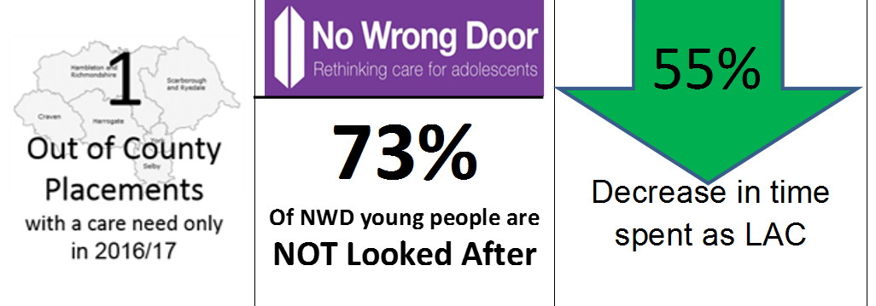
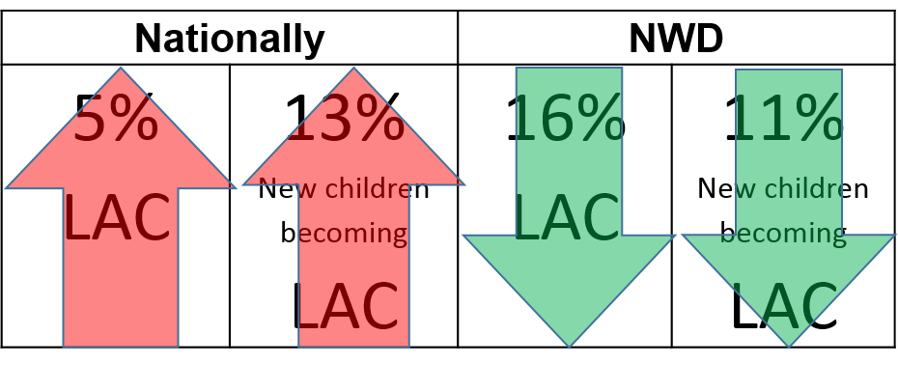
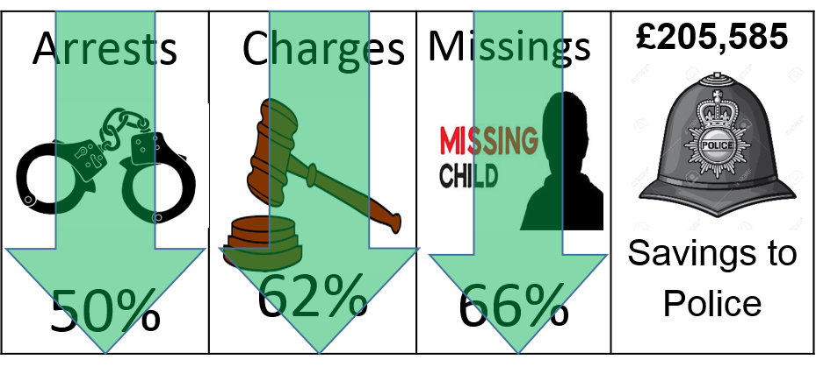
Emerging outcomes

Slide 10
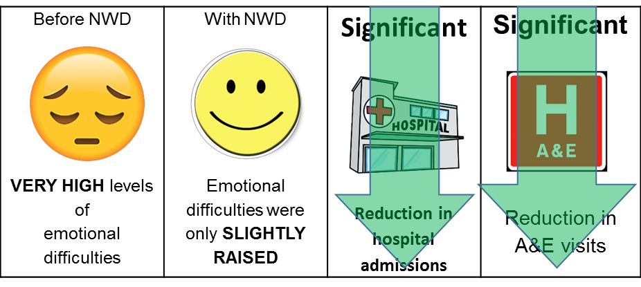
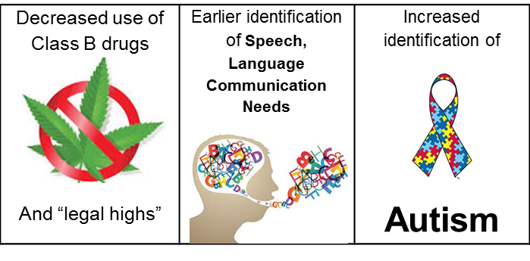
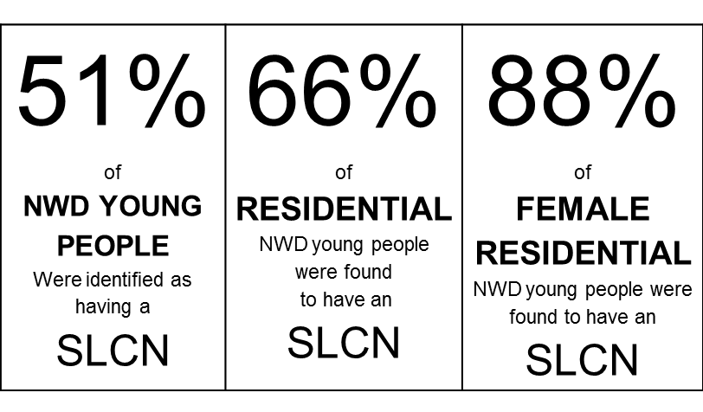
More emerging outcomes

Slide 11






ANALYSIS – MISSINGS FROM HOMES
When Interventions
are HIGH
Missing incidents
are LOW
When Interventions
are LOW
Missing incidents
are HIGH
Linear correlation work – impact of roles ‘not by chance’

Slide 12
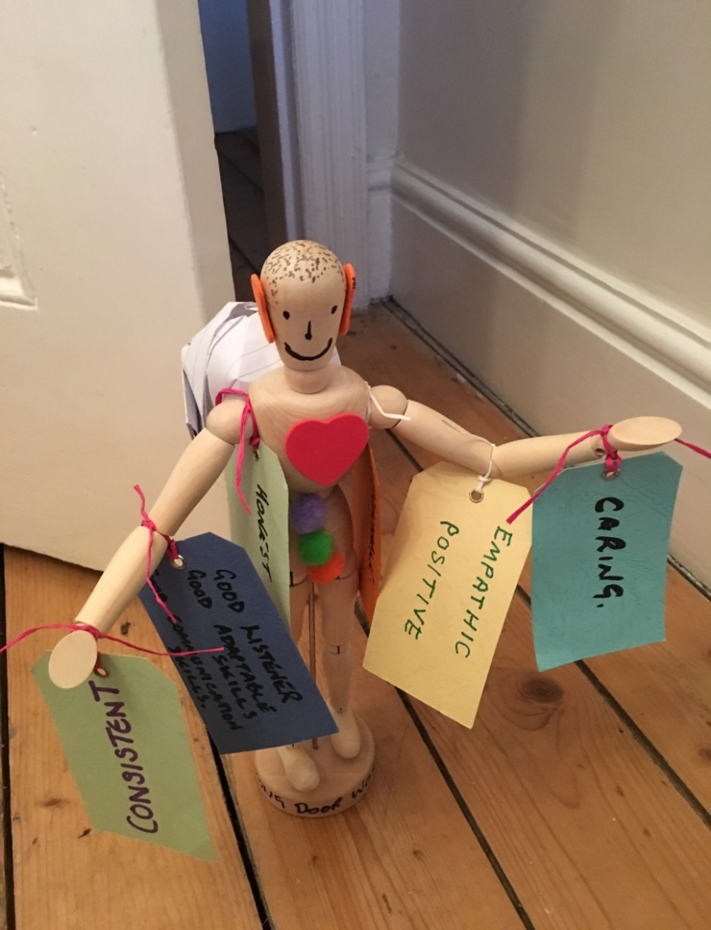
We think this is a good residential worker.
They have a big heart, big ears for listening.
They carry a big bag on their backs so that they can carry loads for me when it gets too heavy.
Their arms are stretched out so that they can rush in and save me if I need them to.
Workers should stick with you …… they need to look beyond the bad things and keep giving you second, third and fourth chances!
“Everything based on human relationships & communication!”
The experience of young people

Slide 13
The experience of young people
“Knowing that the staff will be there after I have turned 18 makes a big difference and I know they will be because I have seen it happen with others.”
“ I am seen as an individual rather than a problem.”
“My keyworker stuck by me and helped so much, they couldn’t have done anymore for me !”
“It’s ok mum, it’s different to normal fostering because it’s [John] and I know him already - so I am happy.”

Slide 14
“This was never a pilot !
Fundamentally redesigning delivery yet attracting investment ….
  momentum is delivering results”
  Pete Dwyer, Corporate Director Children & Young Peoples Service
CHILDREN’S SOCIAL CARE REFORM - A VISION FOR CHANGE
“There have always been bold local leaders willing to do things differently – for example in North Yorkshire, where a radical new approach to supporting adolescents in care has been developed.”
Nicky Morgan, Secretary of State for Education
“I found NWD staff to be passionate about residential care, with a critical role to play in providing the time and opportunity to nurture relationships …as a platform for longer term work directed at eventually placing a child in a family setting” Sir Martin Narey, Residential Review England
“Best data in 15 years”
Lisa Holmes - Director, Centre for Child &Family Research, Loughborough University
…“for these young people the diversity of level & complexity of need needs a planned intervention not a crisis response. NWD provides stability, skills and support when needed, to more successfully manage difficult transitions; adolescence to adulthood” Matthew Horne, Innovation Programme Lead Coach
…“Or North Yorkshire, and the fundamental rethink in its approach to residential care and care leavers. They’ve demonstrated to Ofsted that the imaginative approaches they’re taking can make children safer”
Edward Timpson, Minister of State for Children and Families

Slide 15

Youth Communication Team
Anne Elliott
Professional Lead
Harrogate and District NHS Foundation Trust
12th July 2017

Slide 16
What is the Youth Communication Team?
Three year NYCC funded project from Nov 2013-2016, now extended to 2020
NYCC commissioned the provision of speech and language therapy from Harrogate and District Foundation Trust NHS
Working with Young People with multiple vulnerabilities 11-25 years old
No Wrong Door Service, Youth Justice Service and specialist educational provision

Slide 17
Aims of the Youth Communication Team
To identify young people within the No Wrong Door service who may have Speech Language & Communication Needs
If a need is identified, the Communication Support Worker will provide:
  Advice
  Direct therapy
  On-going referral to other services
  Communication strategies
  Communication supportive environment
  Training

Slide 18
How Many Young People Were Found to Have Speech, Language and Communication Needs?
(Year 2 of No Wrong Door)

Slide 19
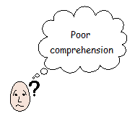
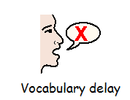
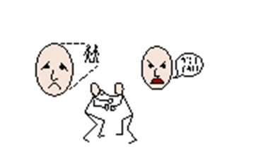
What have we found?
Social Communication Difficulties

Slide 20
Case Study M
Diagnosis of Attention Deficit Hyperactivity Disorder and Foetal Alcohol Syndrome. He was referred to the NWD service due to reported issues including:
taking part in risky and impulsive behaviour
regularly going missing
not conforming at school and spending most of his time in the hub
early signs of engaging in criminal activity
potential drug use
fighting and trying to harm younger siblings.

Slide 21
Speech, Language and Communication Needs
On SLT assessment, M presented with significant difficulties aside his weakness in maintaining attention including:
reduced ability to plan and organise times and activities based on verbal and written information provided
reduced ability to demonstrate empathy
inability to predict potential outcomes based on information given
limited generation of ideas and words when given specific topic.
slow reading of connected prose

Slide 22
I struggle to understand everything
I can’t concentrate
I feel aggressive when I am asked to do work that I don’t understand
Words move and jump around when I am reading
I get anxious when I see lots of writing
I don’t remember what lessons I have
I feel better in the morning because I’m more chilled
If my teachers try to explain it to me they make me feel like a right dummy
I hate asking for help – it makes me lose my temper.

Slide 23
No Wrong Door Input
Communication Support Worker supported mother to request a Education, Health and Care Plan
Keyworker provided respite for family
Education provided by CSW for M, family and NWD team re diagnosis and implications
Work with M regarding insight and self management.
Covered some particular topics including how to try and be empathetic towards his younger sibling work has who has a learning disability (this is an ongoing difficulty for M).
Life coach work with M regarding attachment difficulties
Positive activity with M with keyworker at times convenient to family
Bespoke placement provided for summer holiday

Slide 24
Outcomes
After M being on a bespoke placement during the summer holidays, he also engaged well with his family during their own holiday.
M transferred to a smaller school with a managed move -education supported by NWD re needs and support required
Assessment of reading started
M engaging in meaningful activities-support for family and positive effect on M’s outlook
M has remained in family home and parents want him there

Slide 25
Safety
No longer running away from home Not using cannabis. Attending school and is therefore not out in the community during school time.
Stability
Now in much smaller school which offers more vocation based learning in addition to academic. M is planning to complete his education.
Emotional & Physical Wellbeing
No use of drugs. Reduced risk taking behaviour More positive towards siblings
Reduced Criminal Activity
M has only had a warning. He is not with the YJS and the police have not been involved in the past three months.
Engagement
Trusted relationship with keyworker and ongoing engagement in all proposed activities. Attending school full time. Improved education outlook – feels his difficulties are now being noticed but he isn’t ‘different’ because several students in the new school receive additional support.
Reduced Costs to Society
Reduction in criminal activity. Safe reduction in LAC status. Reduced crisis presentations. Potential employment aspirations.

Slide 26
Measurable Impacts and Outcomes
Outstanding OFSTED report acknowledged the importance of embedded specialist roles within the children’s homes.
Young people’s access to Speech & Language Therapy is exemplary as the therapist is based within the home and openly available. This brings substantial advantages to young people, staff and other professionals. Addressing young people’s communication needs brings with it life-long benefits. By significantly improving young people’s ability to understand the world around them and by making themselves understood reduces the risk of being marginalised in adulthood.

Slide 27

Any Questions?

