Slide 1


Slide 2
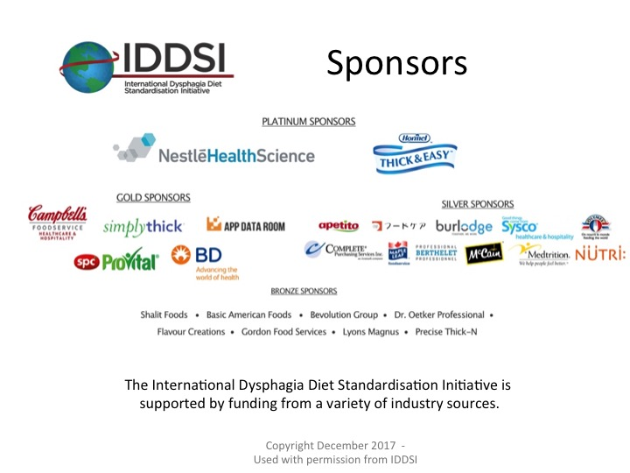
Notes:
The International Dysphagia Diet Standardisation Initiative would like to acknowledge these wonderful sponsors for their continued support. Sponsors provide their funding unconditionally. IDDSI uses funding to support the website, develop resources and make publications available open access

Slide 3
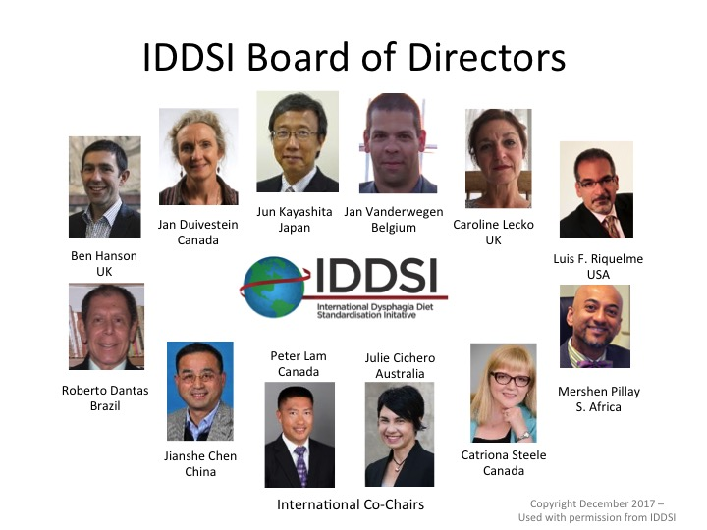
Notes:
In 2012 a group of professionals from around the globe came together to discuss the idea of developing international dysphagia diet standards that would meet the needs of all individuals with dysphagia. They are speech-language pathologists, dietitians, nurses, occupational therapists, physiotherapists, doctors, mechanical engineers, food technologists, and scientists. IDDSI was officially formed in 2013. Above is the current IDDSI board of directors. All board members are volunteers and all are committed to improving the safety of people with dysphagia.

Slide 4
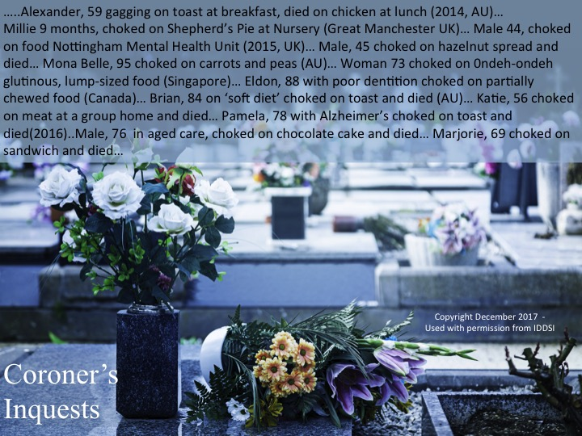
Notes:
The over-riding goal of IDDSI is around patient safety. As this slide sadly shows there are choking incidents around the world from people across the age span – on this slide alone people have choked and died on food from as young as 9 months to 95 years of age.

Slide 5
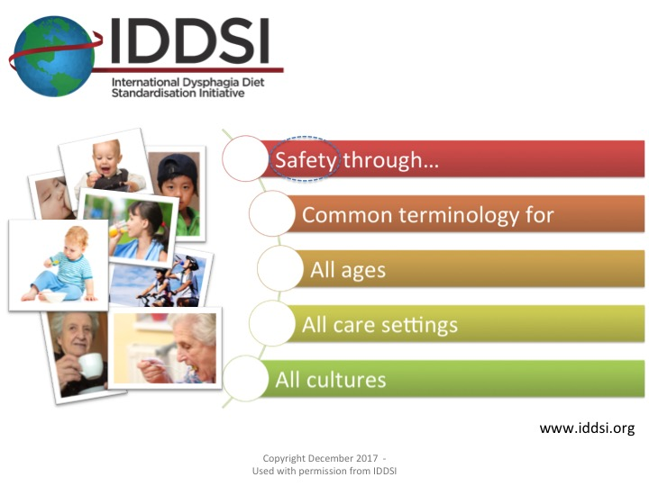
Notes:
IDDSI goal and purpose is: (read each line of the slide)

Slide 6
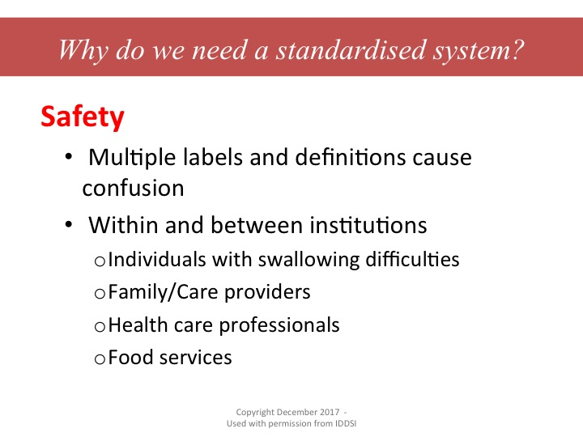
Notes:
Multiple labels and definitions cause confusion. Think about locations that you have visited and even the labels and definitions that you have used yourself to describe food textures and thickened liquids.

Slide 7
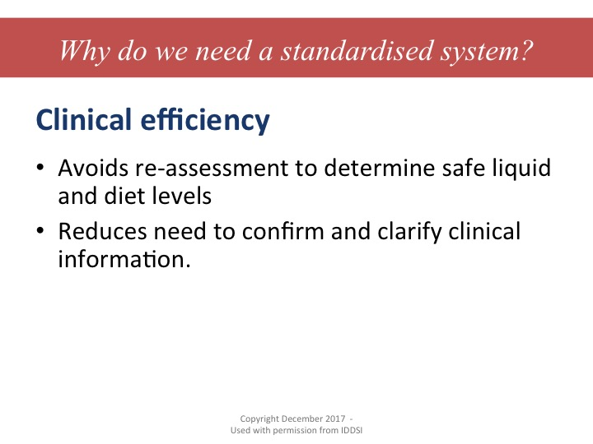
Notes:
Often because labels for dysphagia diets have varied so greatly, an individual who is transferred from an acute care hospital to a long term care home (which may be across the street or a block or two away) needs to be re-assessed because the dysphagia diet terms are different in the 2 facilities.

Slide 8
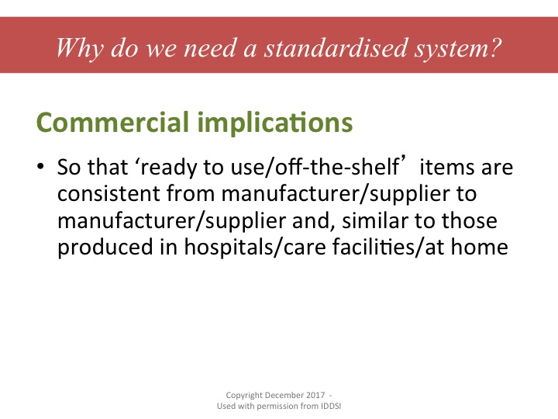
Notes:
One commercial product is not the same as another commercial product. IDDSI has examined many samples and recipes from manufacturers and the products vary significantly. This causes great confusion for carers and individuals with dysphagia.
There is great research going on but unfortunately, because different terms and definitions are used, we are unable to accurately compare and draw valid conclusions from the results of the research findings.

Slide 9
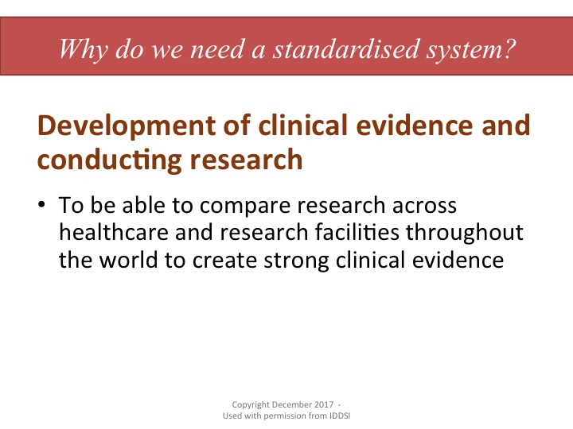
Notes:
There is great research going on but unfortunately, because different terms and definitions are used, we are unable to accurately compare and draw valid conclusions from the results of the research findings. Using the same terminology and measuring systems for research can help develop a larger body of evidence.

Slide 10
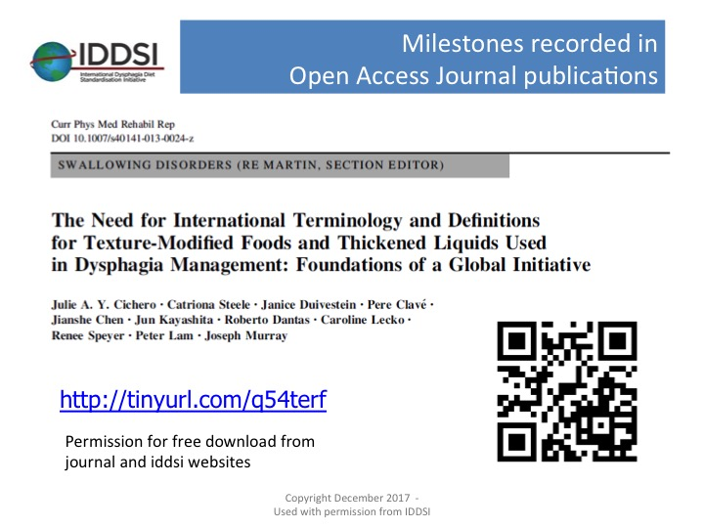
Notes:
The rationale behind the development of an International Terminology can be found in this Open Access journal publication. It is free to download from the journal and also from the iddsi website.

Slide 11
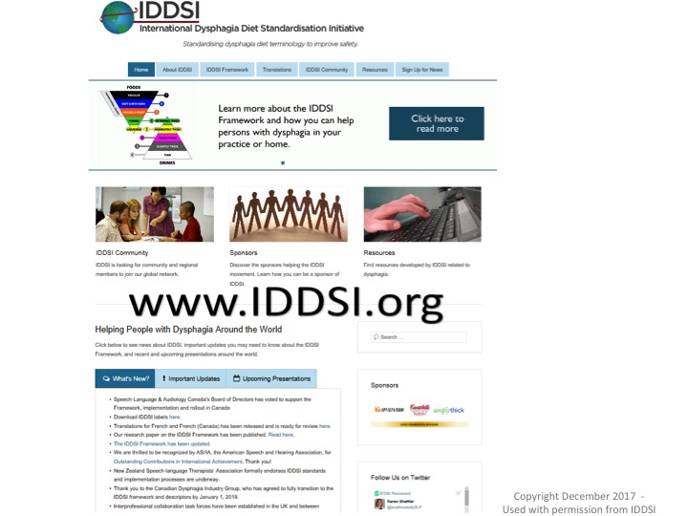
Notes:
So, you are encouraged to go to the website at IDDSI.org and explore all of the resources. Please take a moment to sign up to be kept informed of future developments in IDDSI.

Slide 12
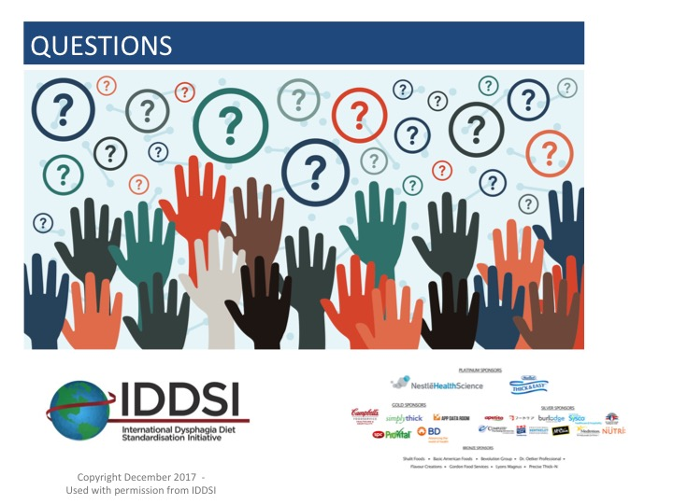
Notes:
Questions and once again, thank you to our wonderful sponsors!

