Slide 1



International Dysphagia Diet Standardisation Initiative (IDDSI)
UK Training slides

Slide 2
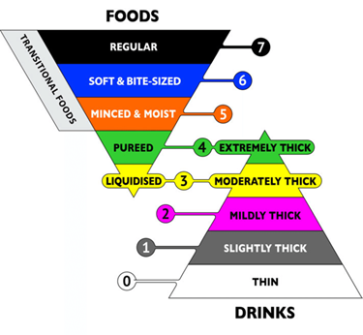
What is IDDSI?
Published in November 2015.
It consists of a continuum of 8 levels (0-7)
Global standardised framework which provides terminology and definitions for texture modified foods and thickened liquids
Colour-coded model
Uses culturally
neutral terminology
Includes descriptors,
testing methods and
evidence for both drink
thickness and food texture levels

Slide 3


UK Professional Adoption
IDDSI framework has been formally adopted by

Slide 4

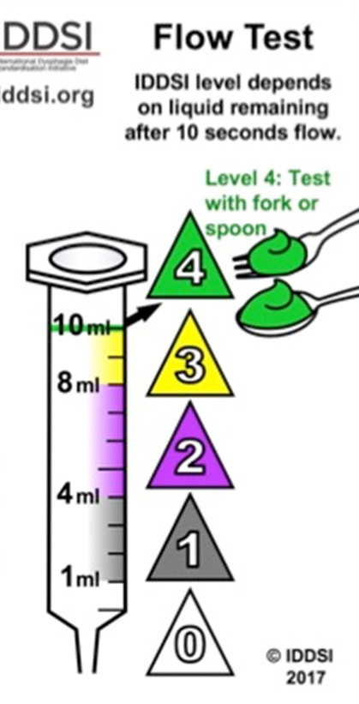
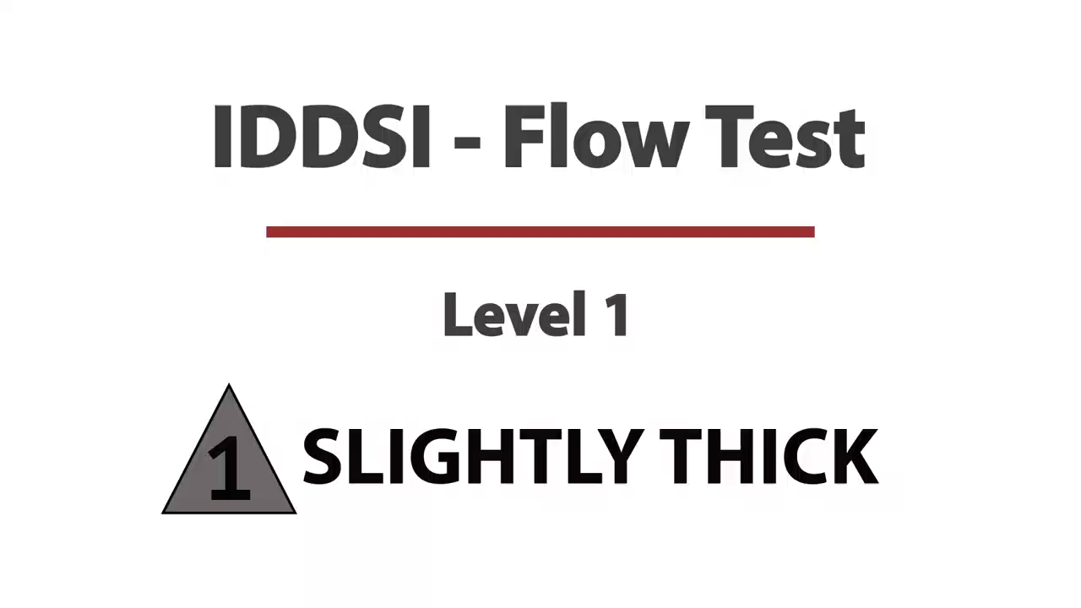
The thickness level of the liquid is defined by the amount of fluid remaining in the 10 ml syringe after 10 seconds. Note that the dimensions of the syringe are important – please ensure that the length from the zero line to the 10 mL line on the syringe measures 61.5mm

Slide 5

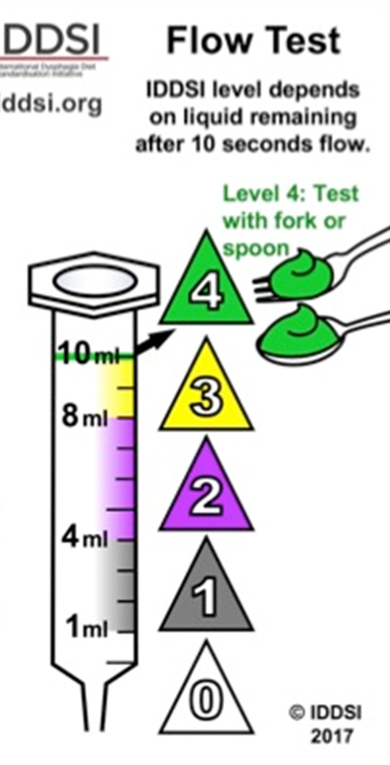
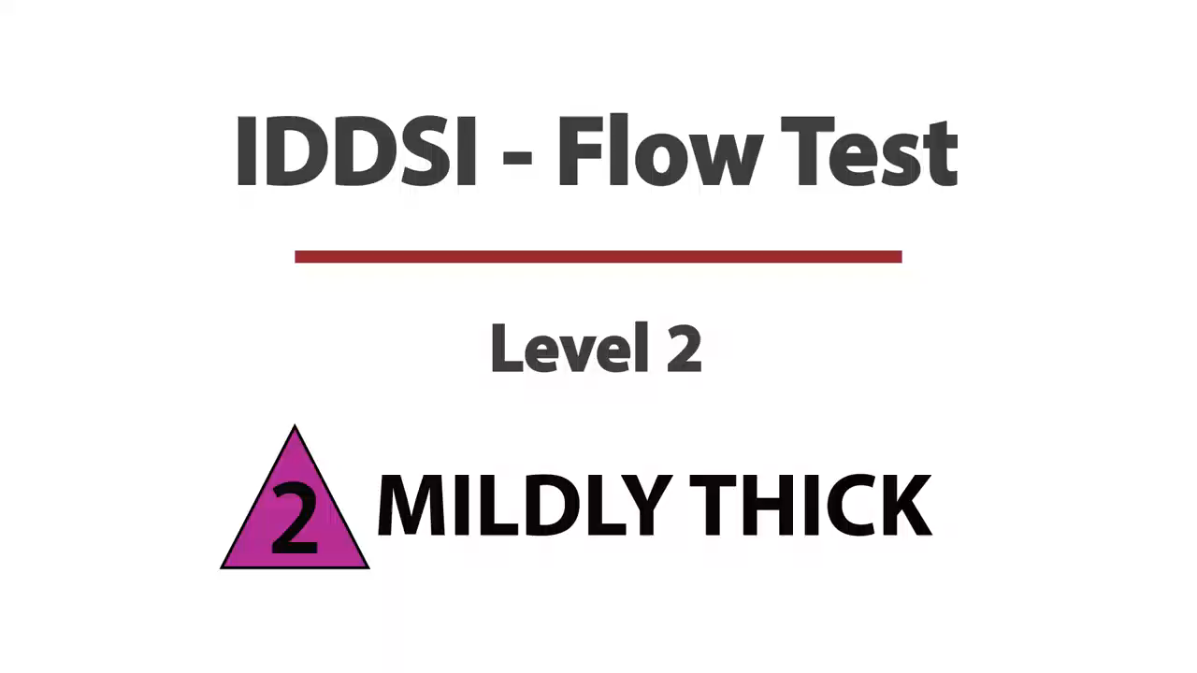
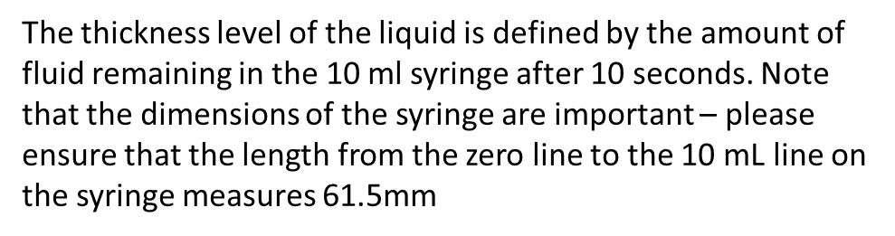

Slide 6


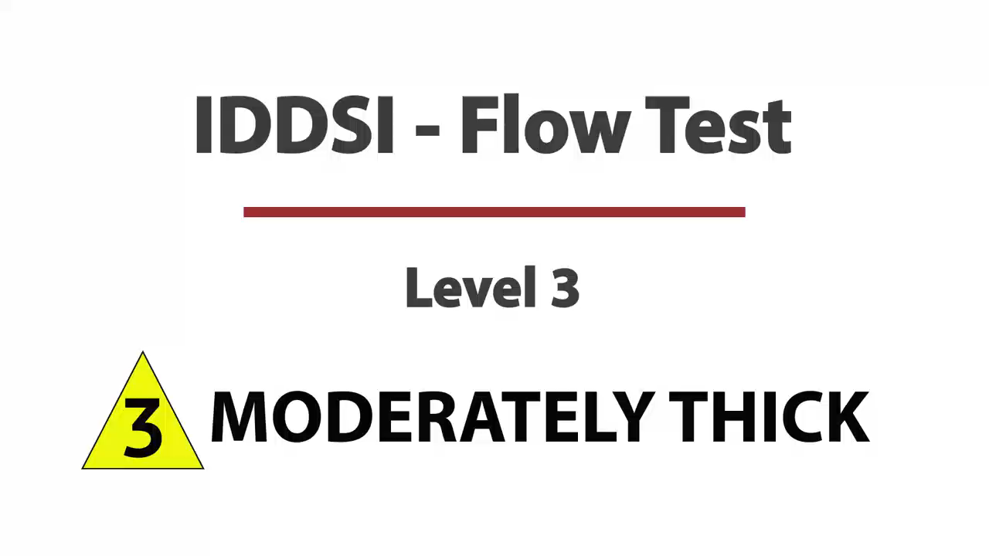
The thickness level of the liquid is defined by the amount of fluid remaining in the 10 ml syringe after 10 seconds. Note that the dimensions of the syringe are important – please ensure that the length from the zero line to the 10 mL line on the syringe measures 61.5mm.

Slide 7


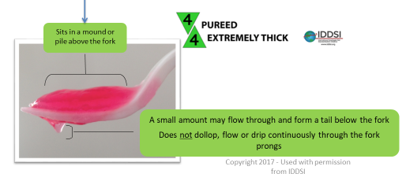

Slide 8

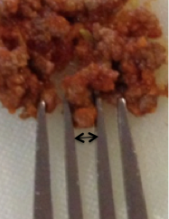
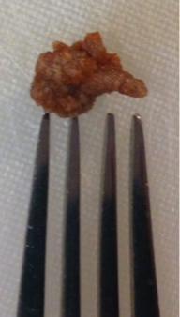
Soft and moist with no separate liquid. Small particle size of 4mm for adults, which is the measurement between the prongs of a typical fork. Minimal chewing is required. Lumps can be mashed with tongue. You can check this by pressing a fork into it. The food can be easily mashed with just a little pressure from the fork.
You should be able to scoop it
up with a fork with no liquid
dripping through and no crumbles
falling off the fork.
The particles of food presented
at Level 5 – Minced & Moist,
should measure 4mm for adults
and 2mm for children.
☑
☒

Slide 9

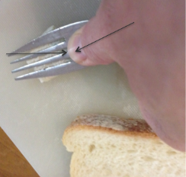
Bite-sized pieces of 1.5 x 1.5cm for adults (the size of an adult thumbnail), to avoid choking risk. Chewing is necessary. Tongue strength and control are needed to move food around and to swallow. You should be able to easily cut into this texture with just the side of a fork. Press into a piece of food with your thumb in the bowl of a fork – so that your thumbnail turns white. The food should squash easily and NOT return to its original shape.

Slide 10
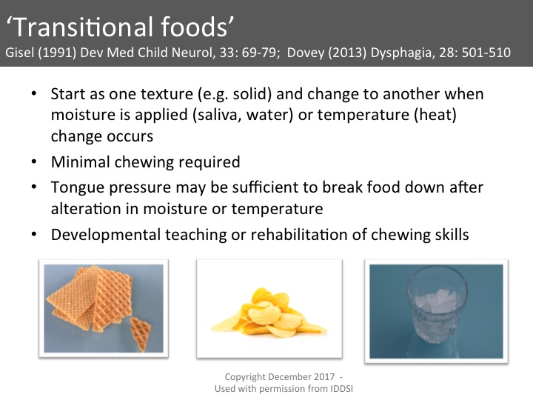


Slide 11
For more information
Go to www.rcslt.org for:
training materials
implementation strategy
frequently asked questions
Go to www.iddsi.org for:
IDDSI framework, resources, open access
articles, frequently asked questions

Slide 12
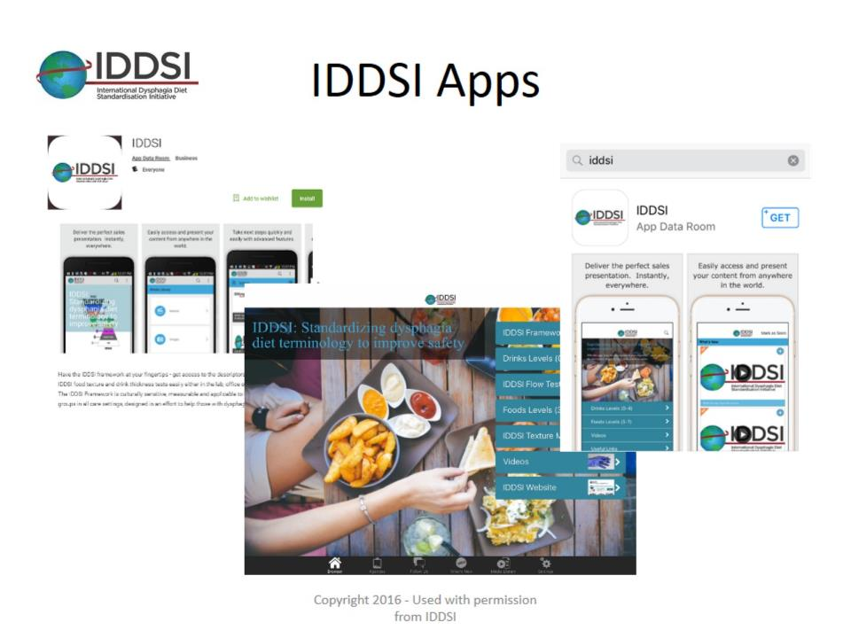
IDDSI Apps

