Slide 1


Salford Royal
Speech and Language Therapists
are
Nikki Clark, Naomi Sirkett and Laura O’Shea
Notes:
Thank everyone for coming
Introduce self, Naomi and Laura
Structure of the next few hours

Slide 2
Aims
What is ‘Giving Voice’?
What is Speech and Language Therapy?
  What types of patients do we see
  What input we deliver
Case studies
Guest stories
Why campaign?
Notes:
We have asked you hear today to give voice- we will start by explaining what this this is.
Go through what SLT is- brief overview of the types of patients that we see, our role and how we aim to help our patients
Why we are campaining

Slide 3

National campaign by Royal College of Speech and Language Therapists
Increase understanding of the role of speech and language therapy
Show how it transforms lives
Show how investment in speech and language therapy can save money for the government, society and the economy
Notes:
The Royal College of Speech and Language Therapists Giving Voice campaign
People have rarely heard of an SLT, or if they have, they are not fully aware of our role.
Obviouslt the way we have decided to give voice is to invite Rebecca here to get to know more about our service and our service users.
Others have done bakes sales, had thickened fluids and pureed diet for several days which may be a management option as part of our role, flash mobs etc

Slide 4
Our service
Adult service
Communication and swallowing difficulties
Work in the hospital, community, outpatient clinics
Notes:
Speech Therapists work with adults and children. Our service works predominantly with adults
Community, outpatient service, specialist early discharge rehab service in community
People rareley know that we work with swallowing disorders, and yet this makes up the majority of our referrals

Slide 5
  Who do we work with?
  People with:
  Neurological conditions e.g., stroke, head injury
  Degenerative conditions - MND, Parkinson’s Disease
  Dementia
  Head and Neck Cancer
  Stammering
  Voice
Notes:
We work with people with a range of conditions, all of which can impact on their communication or swallowing
In one study indicated 33% of individuals with MS impairment of chewing and swallowing abilities (Hartelius & Svensson, 1994).
People may not think of e.g.
people with Psychological swallow difficulties,
acutely unwell elderly patients (10% of who have swallowing diffiuculties- Lugger 1994)
COPD 27% (McKinstry et al 2009) of those suffer from swallowing difficulties

Slide 6
Facts and Figures
20% of the population may experience communication difficulties at some point in their lives
700,000 people in the UK living with Dementia have communication needs. In Salford 1322 people are living with dementia.
1/3 of stroke patients have communication difficulties
10% of stroke-related deaths are caused by neurological deficits, while 30% of post-stroke deaths are due to pneumonia
58% of people who had a stammer at 16 are bullied during childhood
Notes:
So a few figures
2011 census reported that at this time 233,900 salford residents
So if 20% of people epx communication diff in their lives- that’s 46,780 of salford residents who will potentially need access and support from an SLT for communication difficulties at some point in their lives
AGE uk Salford Website
Facts and figures put into context how many ppl will need SLT input at some point in their lives
Scottish Executive Social Research (2007) Communication support needs, a review of the literature. http://www.qmu.ac.uk/casl/pubs/communication_ support_needs_lit_review_2007.pdf
vi Stroke Association (2012). Speech and Language Therapy after Stroke. Stroke Association: London
(Martino 2005).
4. Age UK Salford

Slide 7
Communication
Assessment
Therapy
Alternative Augmentative Communication
Advice e.g. patient, family, professionals
Notes:
Our role with communication difficulties
Involved with all of the above
Management can be dependent on somebody's diagnosis and prognosis
Example somebody with a progressive disease e.g. MND, try and maximize communication and reduce risk. AAC
Disease where recovery expected i.e. stroke, consider therapy to maximize recovery
May also carry out training to help ppl understand changes with communication and to try and maximize communicaiton whilst recovery is irmpoving
Varied

Slide 8
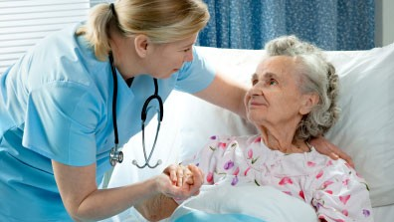




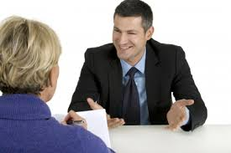

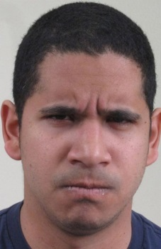


eye contact
gesture
talking
How do we communicate?
social media
body language
reading & writing
facial expression
campaigning
Notes:
How do we communicate
Use many different methods
Diffs can occur at with any one of these methods
IF YOU COULDN’T DO THESE THINGS HOW WOULD IT IMPACT ON YOUR LIFE?
Communication is required for so much in our day to day lives.
Not only do we need communication for work, we need it to maintain relationships and socialise.
For instance, imagine attempting to text or call a friend to meet up for lunch, if you are unable to spell and have difficulties constructing sentences and articulating? What for you and I is something that can take 5 mins with no thought, can e a very traumatic and daunting experience for somebody with communication difficulties.
Being here, listening to us and reading these slides, require excellent communication skills
Campaigning- gesture to emphasis points, eye contact, body language, facial expression for canvasing, access social media using reading and writing to promote self
Less effective at job
Communication difficulties can lead to increased crime, unemployment, mental health issues e.g. depression, increased vulnerability
E.g. More than 60% of young offenders can have difficulties with speech, language or communication.
Bryan K, Freer J, Furlong C. Language and communication difficulties in juvenile offenders. International Journal of Language and Communication Disorders 2007; 42, 505-520.

Slide 9
VIDEO SLIDE
Sarah Scott, 19
Notes:
Imagine how difficult and frustrating that must be. It took her about 8 seconds to say her name and 15c secs to try and say her age. Even then her mam has done it for her. Imaging how frustrating that would be. Imagine how you would feel right now, in this environment, if somebody asked for your name and you knew that it may or may not come out. Anxious.
19- life just beginning. At college- next step in life, seeking jobs uni- how do you think she would manage? Forge relationships?

Slide 10
Case study 1 – Mr Jones
  45 years old
  Recently married
  Qualified solicitor
  Large stroke
  Significant communication difficulties
  Loss of independence and identity
  Depression
  Marriage breaking down
Notes:
I want to go on and talk to you now about gentleman I know and how acquired communication difficulties impacted on his life.
Background
Stroke
Significant communication diffs
The resulting communication difficulties led to enormous problems in both work and personal life
Unable to return to job- loss of wages and financial constraints
Loss of independence and identity- previous bread winner and took care of his wife. Complete role reversal
Pt no longer went out due to communication difficulties
Lead to depression for both husband and wife
Marriage began to break-down
SLT delivered therapy for communication difficulties. However focused on teaching pt and his wife about his communicaiton diff and how to compensate for these to communicate once
Also helped increase pts confidence to begin socialising again by teaching him these techniques and supported him with doing day to day tasks i.e. going to the shops and asking for a food item, going out for ‘date nights’.
Signposted for emotional suport for he and wife
One year on- happy outcome
I hope this case study demonstrated the potentially devestating impact of communication difficulties
How it can happen to anyone
As SLT’s it is part of our job to provide the tools for ppl like Mr Jones to restroe independence and QOL at a very scary and challenging time
I think it demonstrates the important role of SLT and it’s role in recovery

Slide 11
Swallowing
> 80% referrals for people with swallowing difficulties
Complex process - 31 pairs of muscles and 5 pairs of cranial nerves
We swallow ~ 850 times a day and 2 litres of saliva daily
Weakness or incoordination at any stage of the swallow can cause swallowing difficulties
Notes:
Lesser known area of speech and language therapy
Swallow lots of times in one day, so large impact if any stage of swallow affected
Weakness of the muscles or nerves not sending messages to the brain causes difficulties.

Slide 12
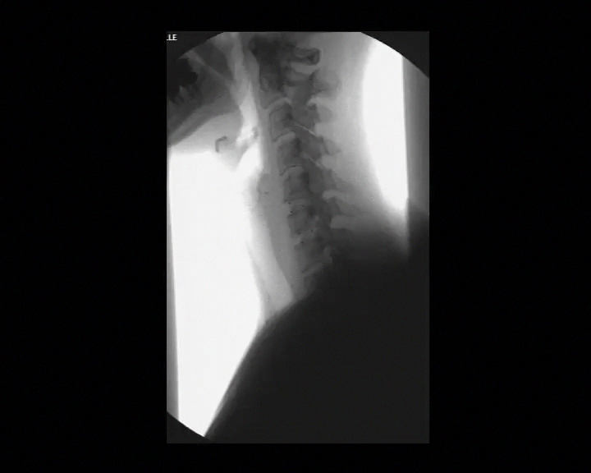
Normal Swallowing
Notes:
Want to tell you a bit about normal swallowing so that we can see the potential impact it can have when it goes wrong.
When we swallow normally all the food and drink goes the right way down into stomach.
Let’s have a look at this video.

Slide 13
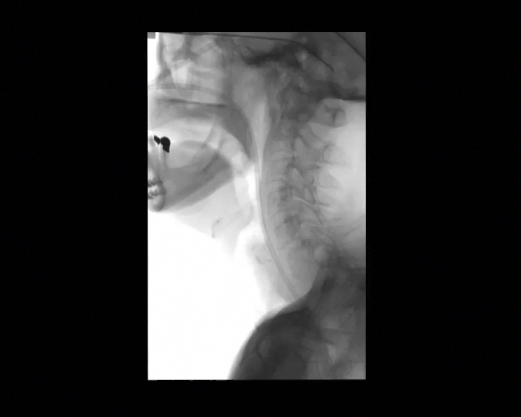
Swallowing Difficulty
Notes:
When swallowing muscles and nerves don’t work properly, risk of food and drink going down the wrong way, into the airway and lungs, likely to cough when swallowing to try and clear it, but if it goes into lungs can lead to chest infections.

Slide 14
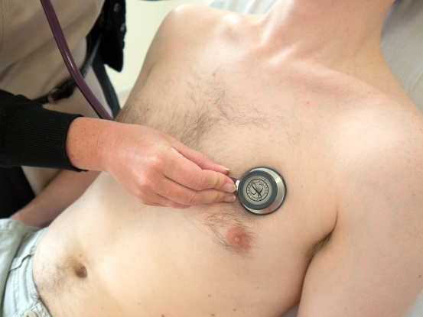

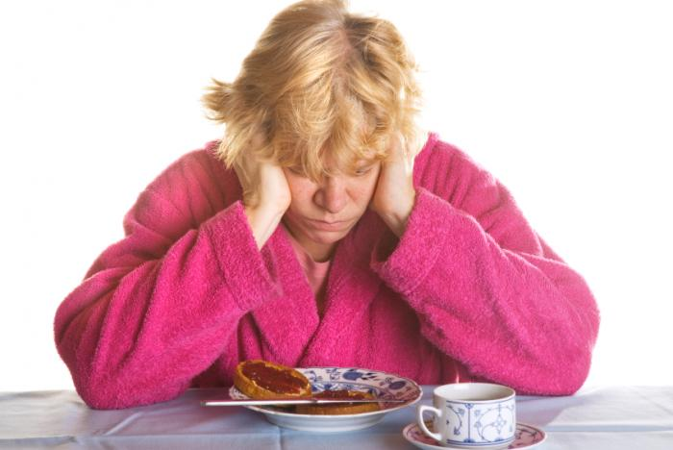
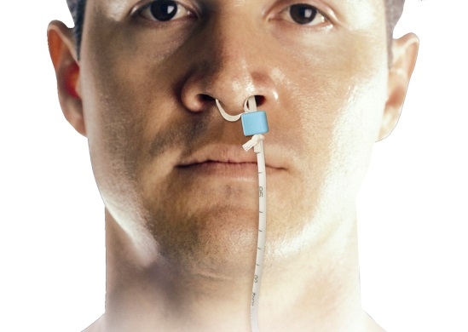
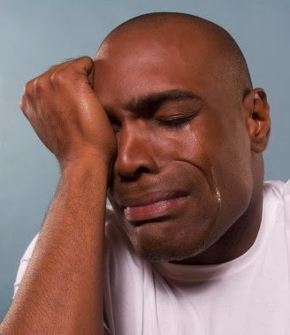
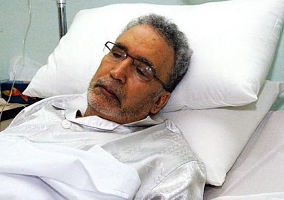
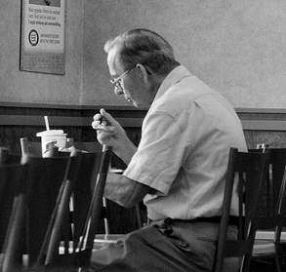

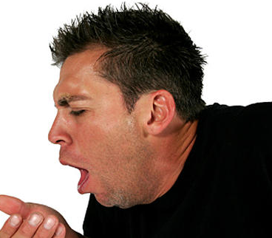
food stuck in
throat
hospital admissions
coughing
chest infection
Swallowing Difficulty
Side Effects
depression
malnutrition
embarrassment eating in front of others
tube feeding
upset
Notes:
So when swallowing goes wrong it can have a large impact in many different areas:
Socially – going out with others
Emotionally – embarrassment / upset / low mood
Physically – coughing / chest infections
Financially – hospital admissions / repeat x-rays

Slide 15
Swallowing
Management of difficulties:
Assessment – bedside / xray / endoscopy
Advice - modifying food and drink consistencies
Monitor chest status
Swallowing rehabilitation exercises
Liaison with other professionals

Slide 16
Case Study 2 - Mr Smith
  Patient living with Dementia
  Admitted with pneumonia
  Repeat chest infections
  Coughing when eating and drinking
  Not responding to treatment
Notes:
Our role in supporting someone with swallowing difficulty.
Case study about Mr Smith:
Poor response to antibiotics and remained chesty, gradual deterioration during admission
Medical team felt approaching end of life. We offered advice to help swallow more safely by modifying the consistency of his food and drink.
Chest infection resolved.
Discharged from hospital medically well.

Slide 17
Our patients can tell you about their communication and swallowing difficulties
Notes:
Joan
Mark
Ian

Slide 18
Speech Therapy at Salford Royal
16 Speech and Language Therapists (14.5 WTE)
2 Assistants (1.5 WTE)
Work across hospital and community
Community service covers patients resident or registered with a Salford GP
Notes:
Let’s go back to having a look at speech therapy at Salford Royal
Acute – respiratory, dementia neuro
Community - See people in their own homes or clinics
We actually cover quite a large area – Cadishead to Little Hulton

Slide 19
Increased demand for service
Due to:
Expansion of specialist services
- hyperacute stroke unit, trauma
Improved staff education and awareness
- eLearning module
Increased complexity of patients
- ageing population, specialist neuro
Notes:
- New hyperacute stroke ward opening
Salford Royal Comprehensive stroke centre for Greater Manchester – provide hyperacute stroke care for people presenting with stroke in Greater Manchester. 1/3 stroke communication difficulties, lots swallowing difficulties – large role.
Lead provider for trauma services in Greater Manchester
Improved staff awareness of us and training – e-learning module and training for wards / community support workers new to Trust
Staff aware of our role and impact of communication and swallowing difficulties unmanaged.
Complex patients, elderly patients living longer better medicine

Slide 20
Community Referrals
Notes:
Information to show increased referrals since 2011
What has been done to manage increase referrals?
Clinics so able to see more patients in a day
Re-prioritisation for patients
Quality Improvement team micro systems of service
Groups for outpatient voice patients to manage long list of referrals
Assistants supporting with therapy

Slide 21
Hospital Referrals
Notes:
Increase number of referrals in hospital – 30% increase
Mainly due to opening of hyperacute stroke unit.
Re-prioritisation – expense of therapy
Coaching

Slide 22
Why campaign?
Tackling communication and swallowing problems reduces avoidable costs and waste:
  in the NHS
  local authorities
  criminal justice system
  wider economy

Slide 23
Invest in speech therapy,
SAVE money - How?
Speech Therapy Intervention | Net Savings | Return on Investment
Dysphagia in stroke patients | £13.3 million annual saving | £2.30 for every £1 invested
Communication difficulties in stroke patients | £15.4 million annual saving | £1.30 for every £1 invested
Notes:
RCSLT Evidence Matrix Report
Stroke patients with swallowing difficulties
Avoid chest infections, reduced respiratory problems, health cost savings exceeds cost of SLT, improved quality of life, reduce malnutrition and death
Stroke patients with language Improve language skills and ability to perform activities of daily living
Health related quality of life gains
Prevents hospital re-admission
Accessing other services and attending appointments
Understanding how / why to take medication
Maintaining relationships
Improve social skills and educational outcomes
Reduce anti-social behaviour and worklessness
Supports earlier discharge and care closer to home for stroke survivors, individuals with head injury and people living with dementia

Slide 24
Why campaign?
But...
    80% of speech and language therapy services are being asked to cut costs and services resulting in:
    - increased waiting times
    - reduced access to services
    Media campaigns fight to increase numbers of nurses and doctors …what about support services?

Slide 25
Key Messages
Greater awareness of speech and language therapy
The impact speech and language therapy can have on service users.
    - Rehabilitation and management of symptoms
    Re-enablement back into society
Remember wider support services not just doctors and nurses in the NHS!

