Slide 1
Royal College of Speech and Language Therapists

Slide 2
Welcome to the RCSLT!
DC
We are the professional body for speech and language therapists in the UK.
Notes:
Kathryn

Slide 3
Who are we?
Established in 1945
22,000 members – 2k of whom are students!
Accrediting body for 27 SLT higher education courses
Membership is FREE for students!
We are NOT a trade union (but do work closely with them)
Notes:
Kathryn

Slide 4
What does the RCSLT do?
Facilitate and promote research
Produce best-practice guidance
Host events and conferences
Influence government and institutions
Promote better education and training for speech and language therapists
Provide information to our members and the public about speech and language therapy
Notes:
Kathryn

Slide 5
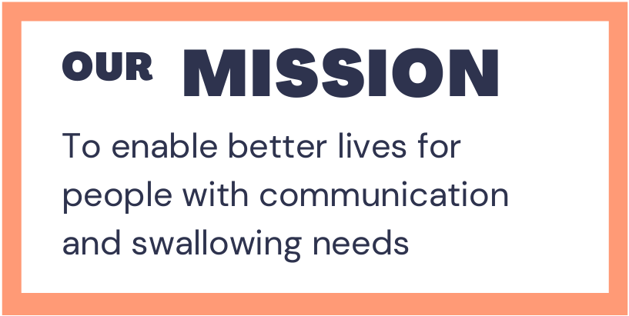
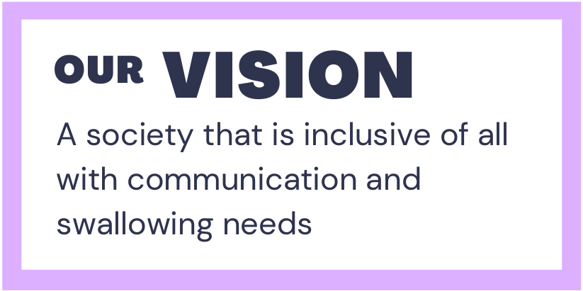
Why?
The SLT community
The Royal College
Notes:
Kathryn

Slide 6
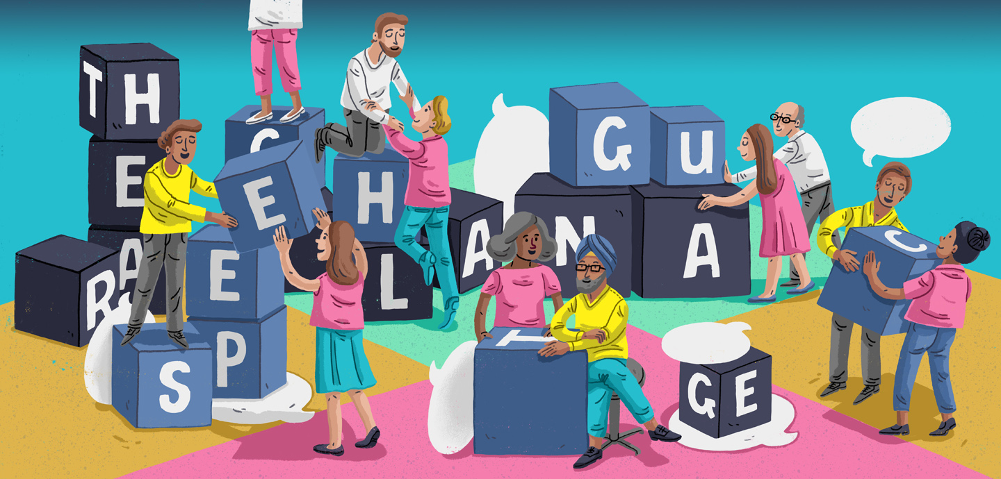
DC
An introduction to Speech and Language Therapy
Notes:
Handover to Alison

Slide 7
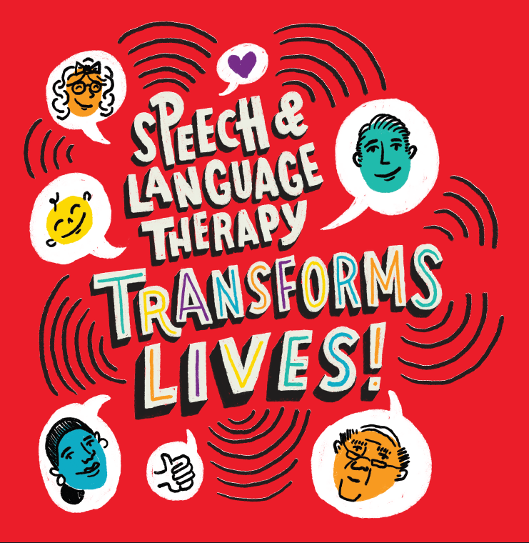
What is Speech and Language Therapy?
Speech and language therapy provides treatment, support and care for children and adults who have difficulties with communication, or with eating, drinking and swallowing.
Notes:
Alison

Slide 8
What we don’t do
Speech and Language Therapists are NOT:
Elocution teachers
Voice coaches
Teachers
Nurses
Notes:
Alison

Slide 9
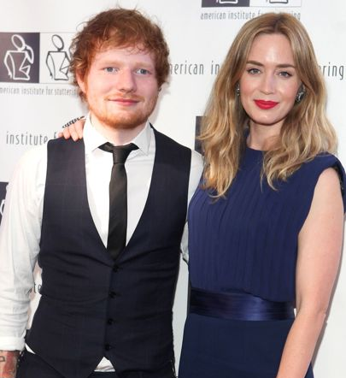
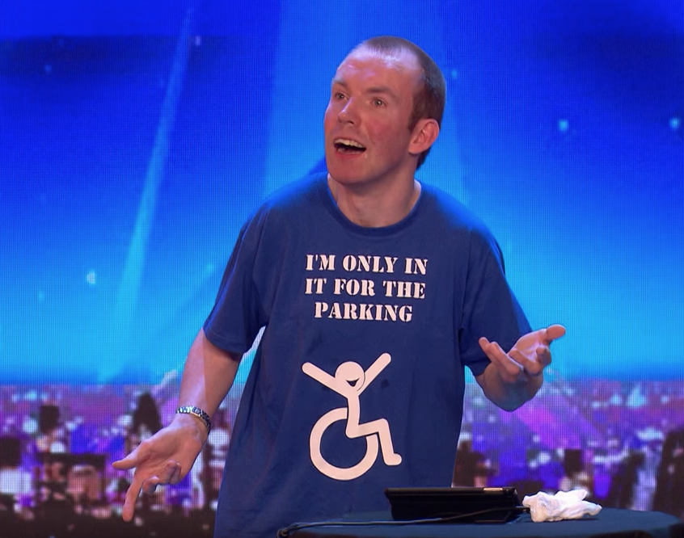
Did you know…
Adele
damaged her vocal folds
Ed Sheeran and Emily Blunt
learned to manage their stammers
Lee Ridley - aka Lost Voice Guy -
used Augmentative and Alternative Communication (AAC) on Britain's Got Talent
Notes:
Kathryn

Slide 10
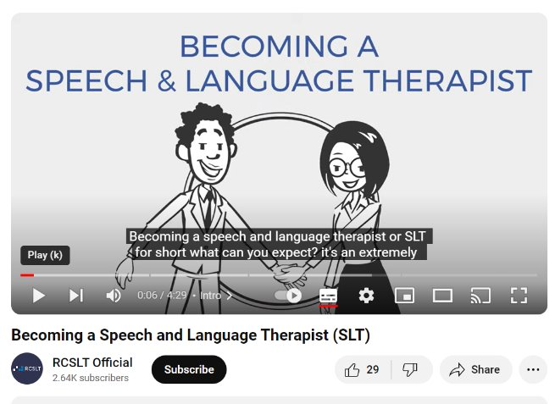
Becoming a speech and language therapist
Take a look at our video on YouTube from current students
More information on our website
Notes:
Kathryn

Slide 11
Notes:
ADD video

Slide 12
Who are our clients?
Speech and language therapists work with people of all ages with a range of communication, eating or swallowing difficulties.
SLTs support babies with feeding and swallowing difficulties.
They support children with:
Autism/social interaction difficulties
Cleft palate
Dyslexia
Deafness
Dysfluency
Language delay
Language disorders
Learning difficulties – mild, moderate or severe
Physical disabilities
Selective mutism
Specific difficulties in producing sounds
Stammering
Voice disorders
Notes:
Kathryn

Slide 13
Who are our clients?
Adults
SLTs can help adults who have communication or eating and swallowing problems, including those that are a result of neurological impairments and degenerative conditions, for example:
Stroke
Brain injury
Parkinson’s disease
Dementia
Head and neck cancer
Deafness
Learning disabilities
Mental health (adults)
Physical disabilities
Stammering
Voice
Notes:
Kathryn

Slide 14
What do speech and language therapists do?
Short video examples of:
speech
swallowing
aphasia
Notes:
Alison

Slide 15
How do I qualify as an SLT?
You will need to pass a degree accredited by the Health and Care Professionals Council (HCPC) to register to become a speech and language therapist. You can do this in three different ways:
a speech and language therapy undergraduate (BSc) at university (3 - 4 years);
A masters (MSc) degree at university, if you already have a relevant undergraduate degree (2 years);
a degree apprenticeship, where you are employed by an organisation (eg a hospital) as an SLT apprentice, and also study for the degree at the same time (4 years).
Notes:
Kathryn

Slide 16
The university route: key facts
You can apply, through UCAS, to study a speech and language therapy BSc degree at universities across the UK. See the current list here.​
You can apply for a student loan to cover tuition fees and living costs through the Student Loans Company. ​
For studying in Wales there is an NHS Wales Bursary Scheme. (Commitment to work in Wales for a required period).
In addition, you can also apply for a £5,000 grant, for each year of your study – you don't need to pay this back! ​
In Northern Ireland, the Department of Health pay tuition fees if you live in NI and study at Ulster University.
In Scotland, undergraduate students will have your tuition fees paid if you live in Scotland and study at one of their Universities.
Notes:
Kathryn

Slide 17
The university route: key facts
Entry qualifications – for BSc degrees you will usually require 3 A-Level passes, 5 Highers, or the equivalent at BTEC or T-Levels. Universities all have different entry requirements, so check their websites carefully.
Applying for a degree – take a look at our tips for applying and a reading list to find out more.
Notes:
Kathryn

Slide 18
Diversity and inclusion
A diverse profession makes for a stronger profession, and a diverse workforce helps us to reflect the communities we serve.
The RCSLT wants to encourage more students from Black, Asian and minority ethnic backgrounds, from people with a disability, from men, from people who speak languages other than English, from people from economically under-represented communities and from the LGBTQIA+ community, to become SLTs.
Read our statement with universities here.
Notes:
Kathryn

Slide 19
The apprenticeship route: key facts
An apprentice is an employee not a student.
You do not apply to a university, instead you apply for SLT degree apprentice jobs advertised by employers, for example in a hospital. These are normally posted on NHS Jobs.
You would spend at least 20% of your working week at university doing the degree learning.
No tuition fees (paid by the Government).
Notes:
Alison

Slide 20
The apprenticeship route: key facts
Entry qualifications broadly similar to traditional degrees.
There are currently 3 universities working with employers to provide the degree apprenticeship (Birmingham City, Essex and Sheffield) and we are expecting several more to start in 2025, including some in the London area.
Lots more information on the website about the SLT degree apprenticeship route.
Notes:
Alison

Slide 21
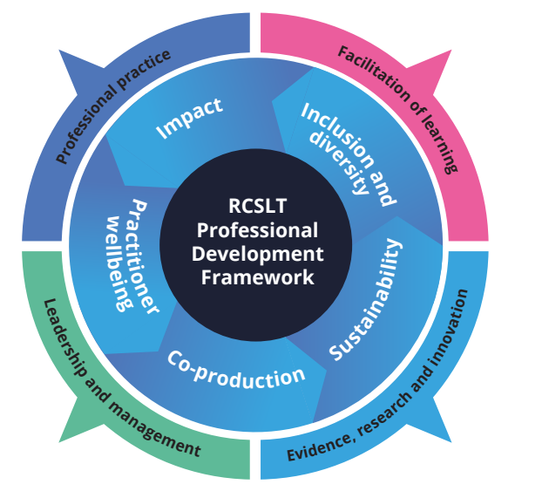
But, the learning never stops
Continuing professional development
Meeting the standards of the regulator (HCPC)
Diverse career options
Other opportunities, such as working abroad!
Notes:
Alison

Slide 22
My Journey
Why I chose speech and language therapy
University
First job
Future goals
Notes:
Kathryn then Alison

Slide 23
Not decided yet if SLT is the career for you?
If you are not yet decided about your career choice, you could ask at local hospitals, charities for any work experience or shadowing opportunities. Many also have open days.
Take a look at our reading and other resources to find out more about the profession.
Alternatively, you might wish to consider first applying for an SLT support worker role in a hospital or education setting.
Notes:
Kathryn

Slide 24
Not decided yet if SLT is the career for you?
This would allow you to see whether SLT is the career for you before committing to the degree or degree apprenticeship, to help prepare you for it and to be able to show valuable experience in the profession, in any later application for the degree.
The majority of current SLT apprentices were SLT support workers before starting their degree apprenticeship.
Notes:
Kathryn

Slide 25
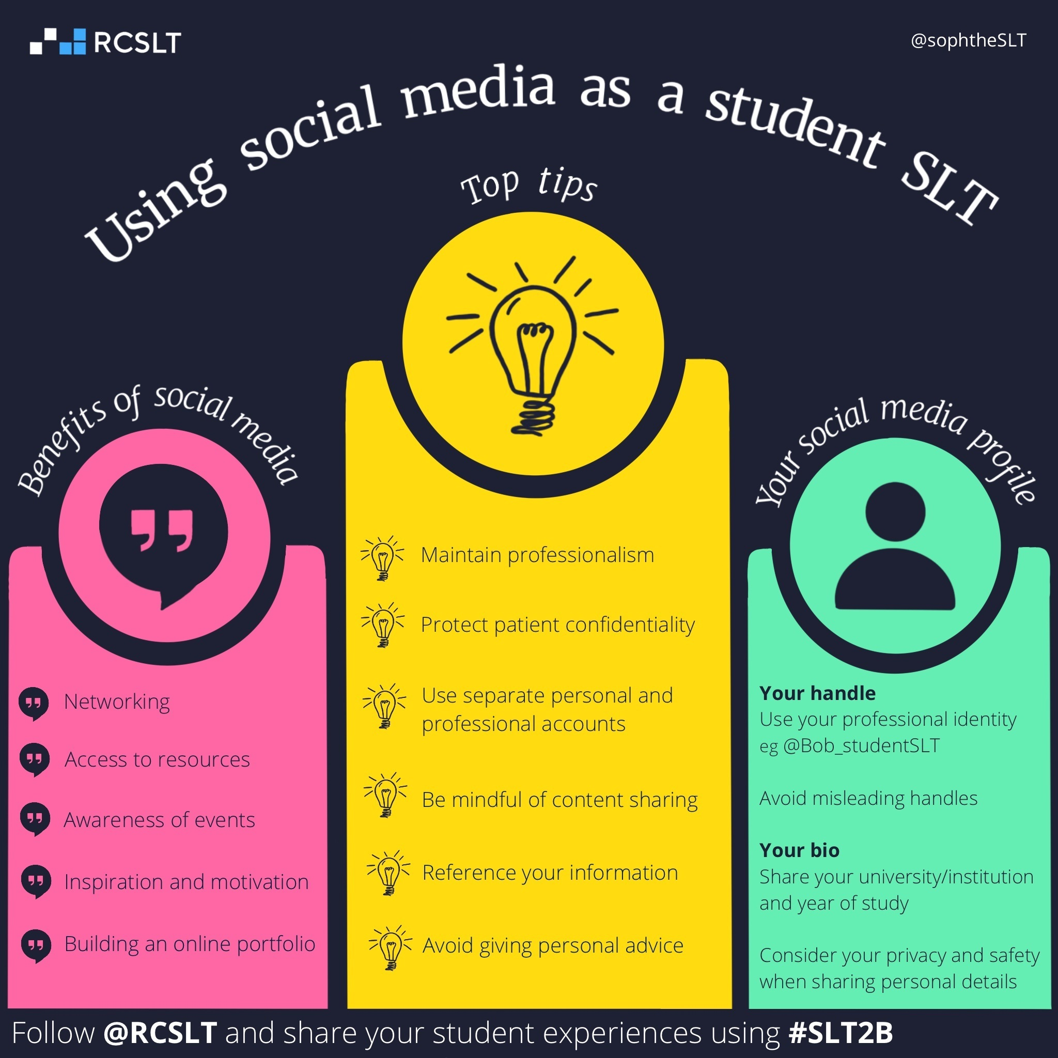
Using social media
HCPC standards and social media guidance
"You should note that historic social media activity may be considered against our standards, even if you were not a registered professional at the time of that social media activity."
Notes:
Kathryn

Slide 26
Notes:
Both!

