Slide 1
An Introduction to Speech and Language Therapy

Slide 2
Who am I?

Slide 3
What is Speech and Language Therapy?
Speech and language therapy provides treatment, support and care for children and adults who have difficulties with communication, or with eating, drinking and swallowing.
You will need a degree or masters accredited by the Royal College of Speech and Language Therapists to work as a speech and language therapist.
But you’ll need great people skills too!

Slide 4
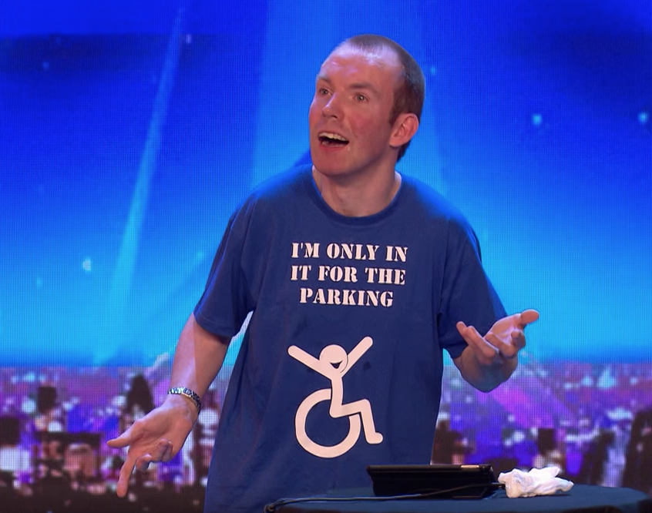
Did you know…
Adele
damaged vocal folds
Ed Sheeran and Emily Blunt
learned to manage their stammers
Lee Ridley aka Lost Voice Guy
using AAC on Britain's Got Talent

Slide 5
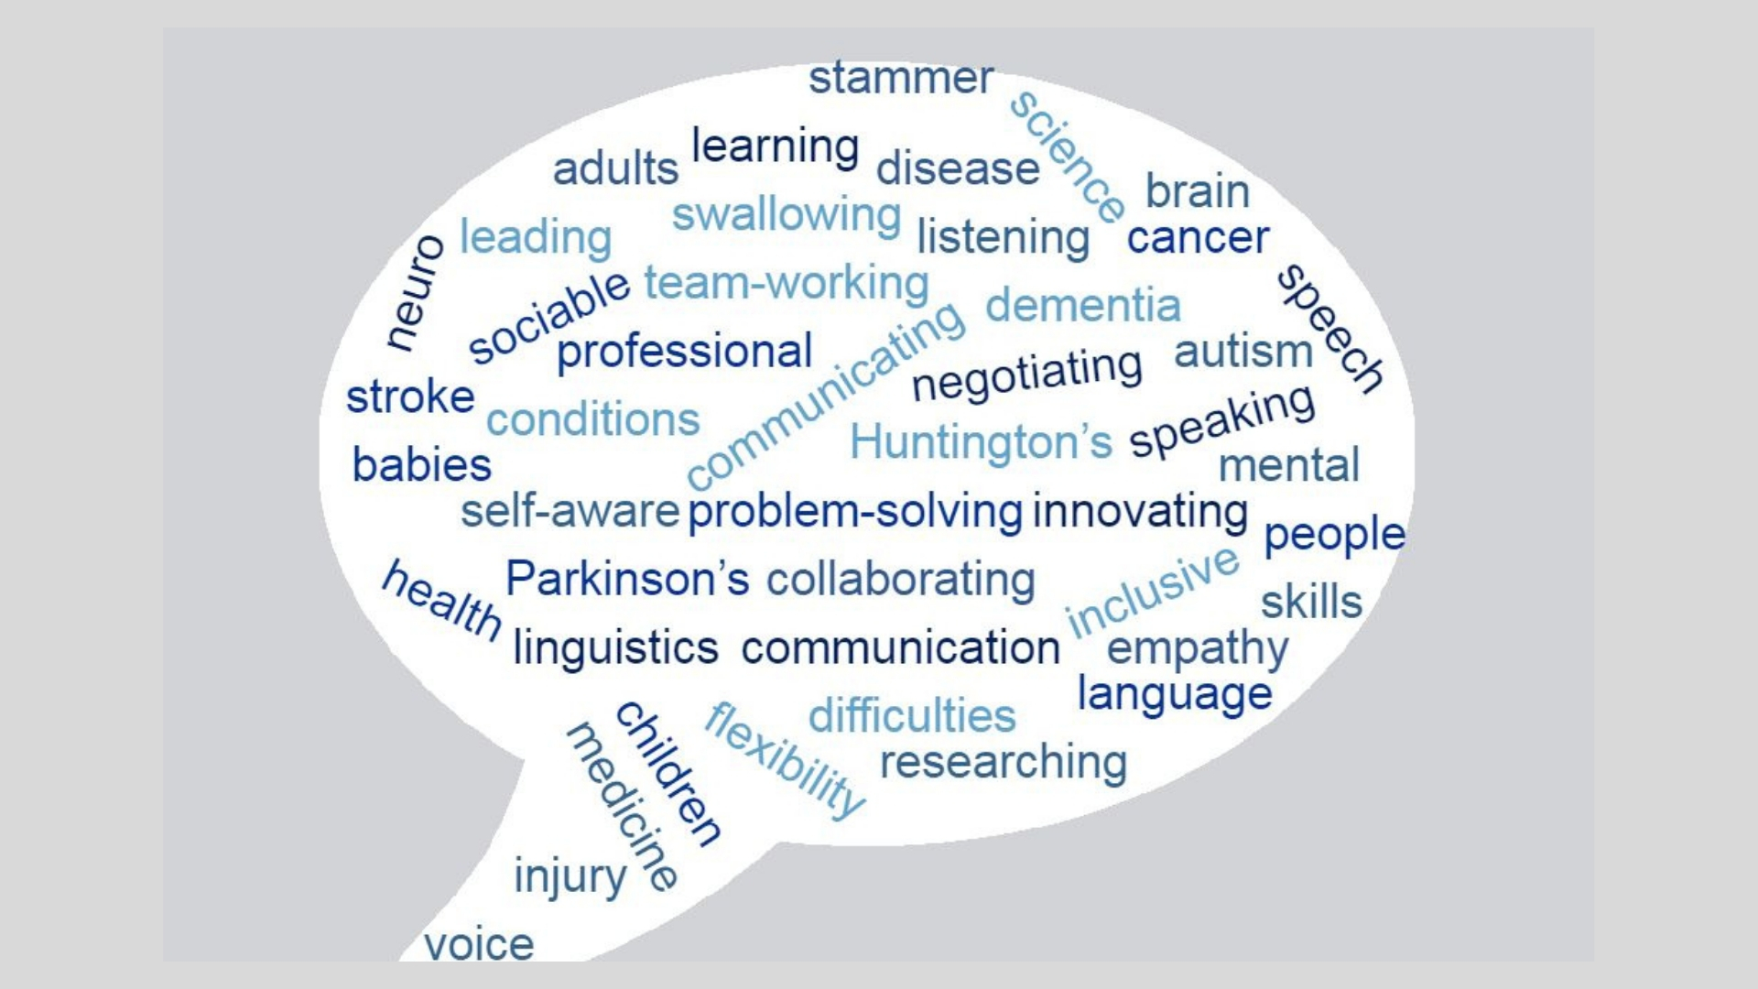
What do speech and language therapists do?

Slide 6
What we don’t do
Speech and Language Therapists are NOT:
Elocution teachers
Voice coaches
Teachers
Nurses

Slide 7
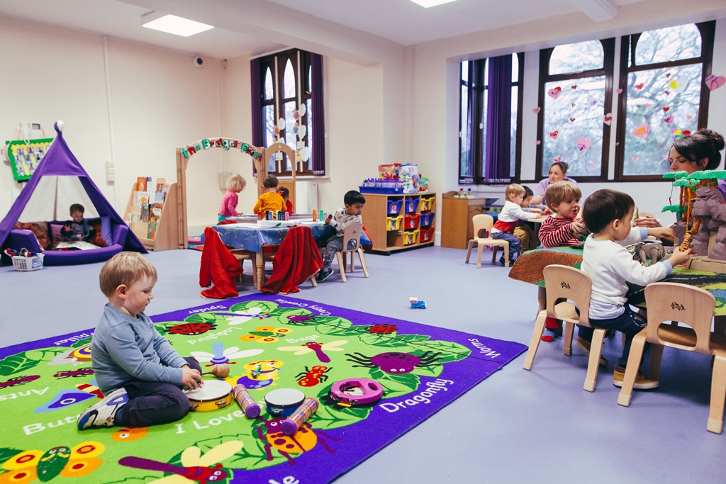
Where we can work
Nurseries
Schools
Client’s home
Hospitals in both acute care and outpatients
Prisons
Secure units
Community clinics
Child development centres
Day centres for people with learning disabilities
Care homes
Own our own businesses providing speech and language therapy

Slide 8
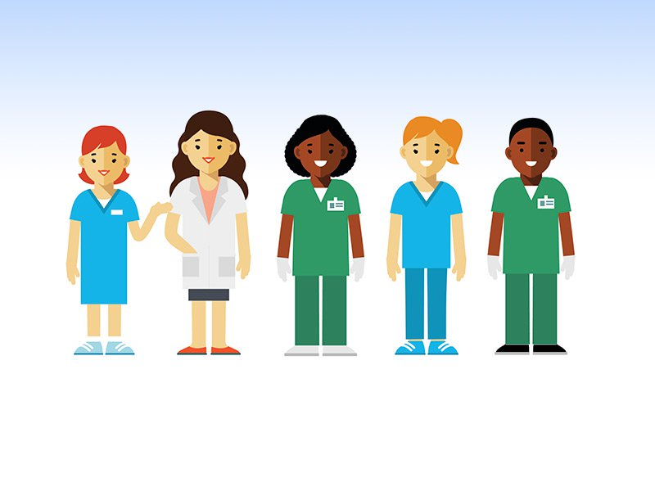
Other professionals we work with
Speech and Language Therapists work alongside other professionals, often as part of a team, assessing the clients difficulties and deciding how to manage them.
Teachers
Teaching Assistants
SENCOs
Social workers
Nursery staff
Educational Psychologists
Psychologists
Support workers
Businesses - providing training to staff
Teachers of the Deaf
Health care professionals
Nurses
Doctors
Occupational therapists
Physiotherapists
Paediatricians

Slide 9
My Journey
Why I chose to do SLT
University
First job
Future goals

Slide 10
How do I get qualified to become a speech and language therapist?
You need to do an accredited degree to become a speech and language therapist.
There are 18 universities across the UK that offer speech and language therapy degrees.
You will need to take 3 A-levels or their equivalent. Some universities require specific GCSE and A-levels, such as English and biology, so check the entry requirements with each university.
Find a careers guide, more information and list of universities offering speech and language therapy degrees https://www.rcslt.org/speech-and-language-therapy/become-a-speech-and-language-therapist-overview#section-1

